Slide 1
Xian and Xing Ping CHINA 2013 Silk Road Summer English Camp
by Nolan R. Tomboulian
NOLAN@TEEI.org

Slide 3
Camp Shirts

Slide 4
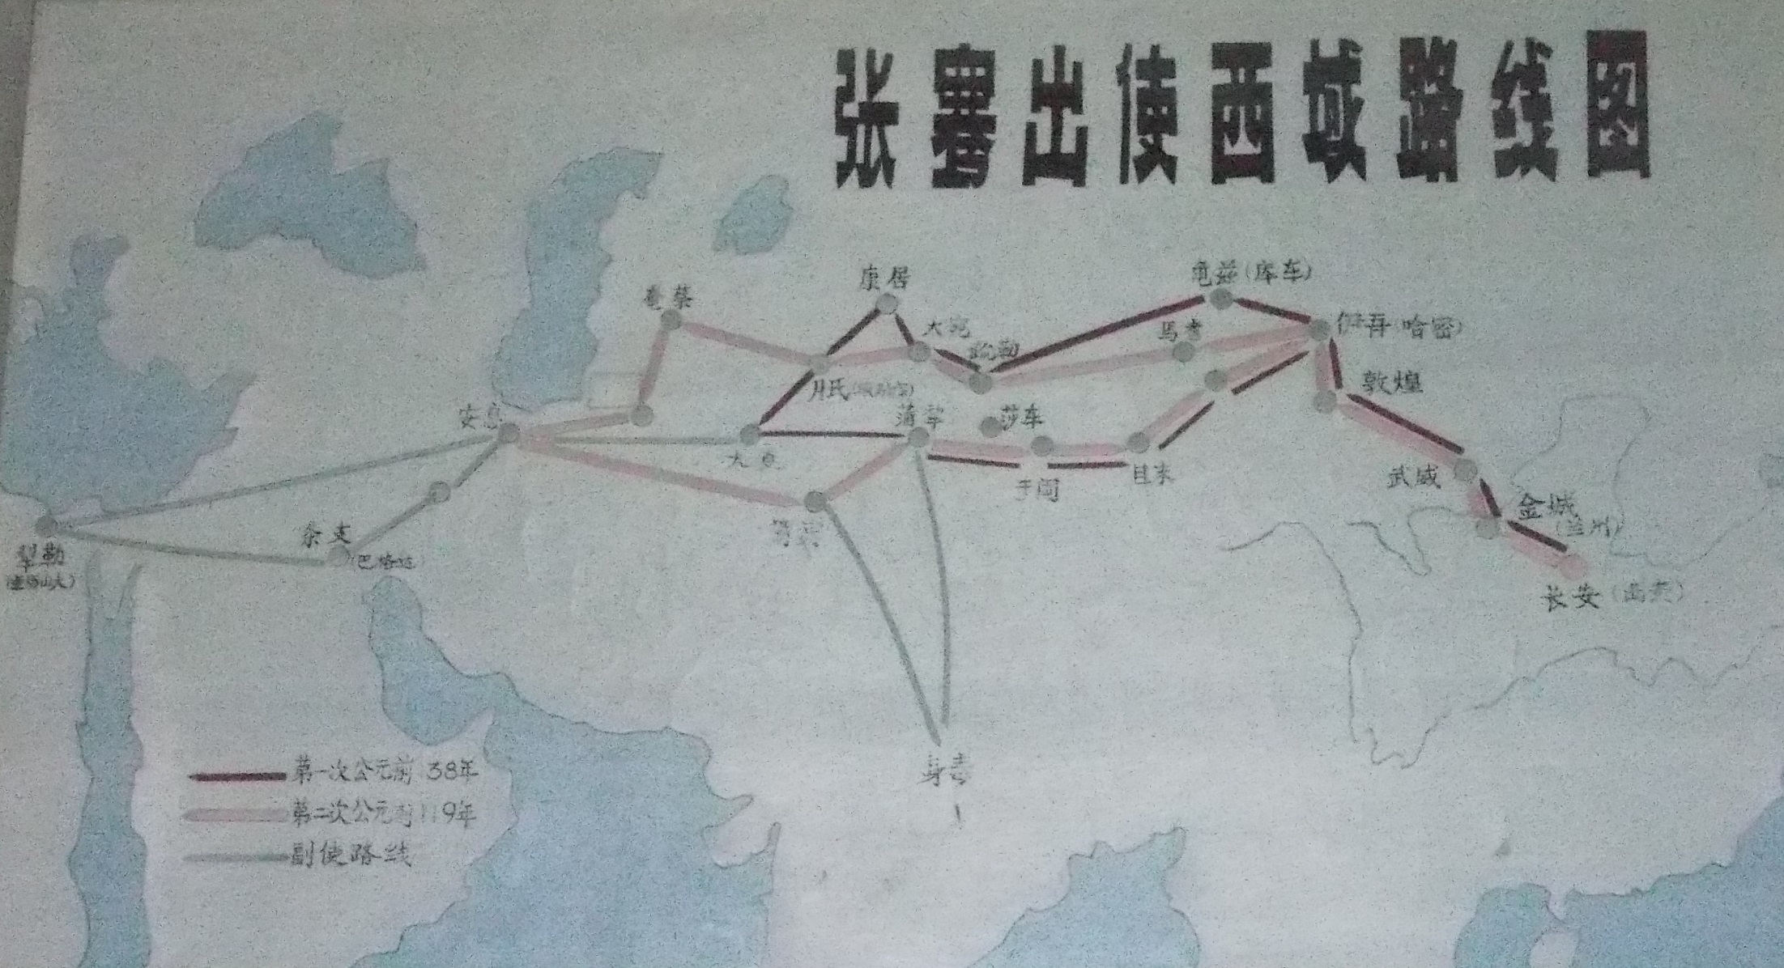
Ancient Silk Road Map
Even the longest journey begins with the 1st step!

Slide 5
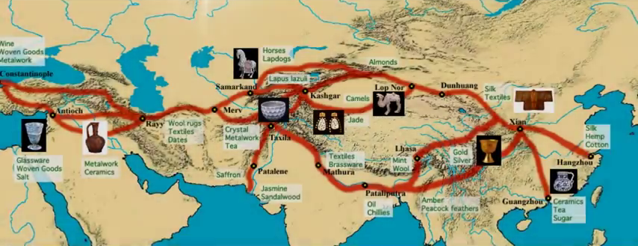

Slide 6
SILK ROAD CAMP
PURPOSE: To provide an educational learning community network in cities along the SILK ROAD through short and long-term projects. Team Leaders will develop relationships with schools, businesses, government officials and other like-minded individuals interested in fostering a better understanding and partnership between China and the United States.

Slide 7
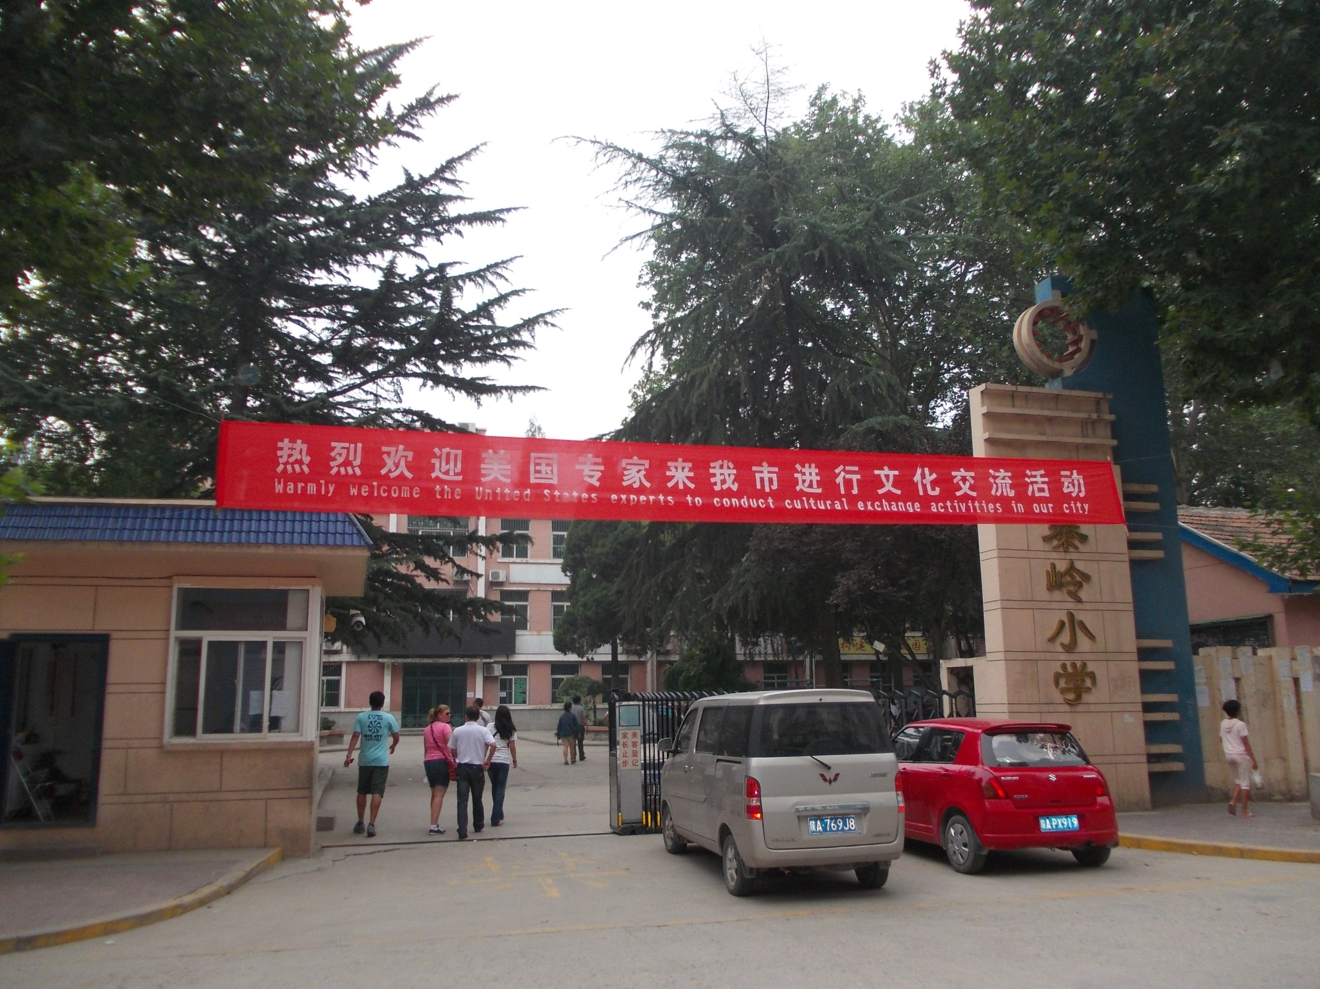
Welcome to the Host School
Qin Ling Primary School, Xing Ping City, Shannxi Province, China

Slide 8
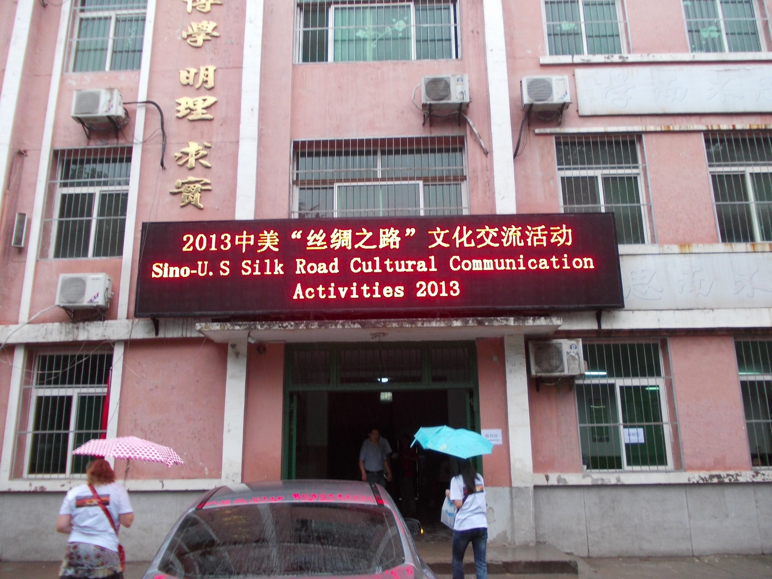

Slide 9
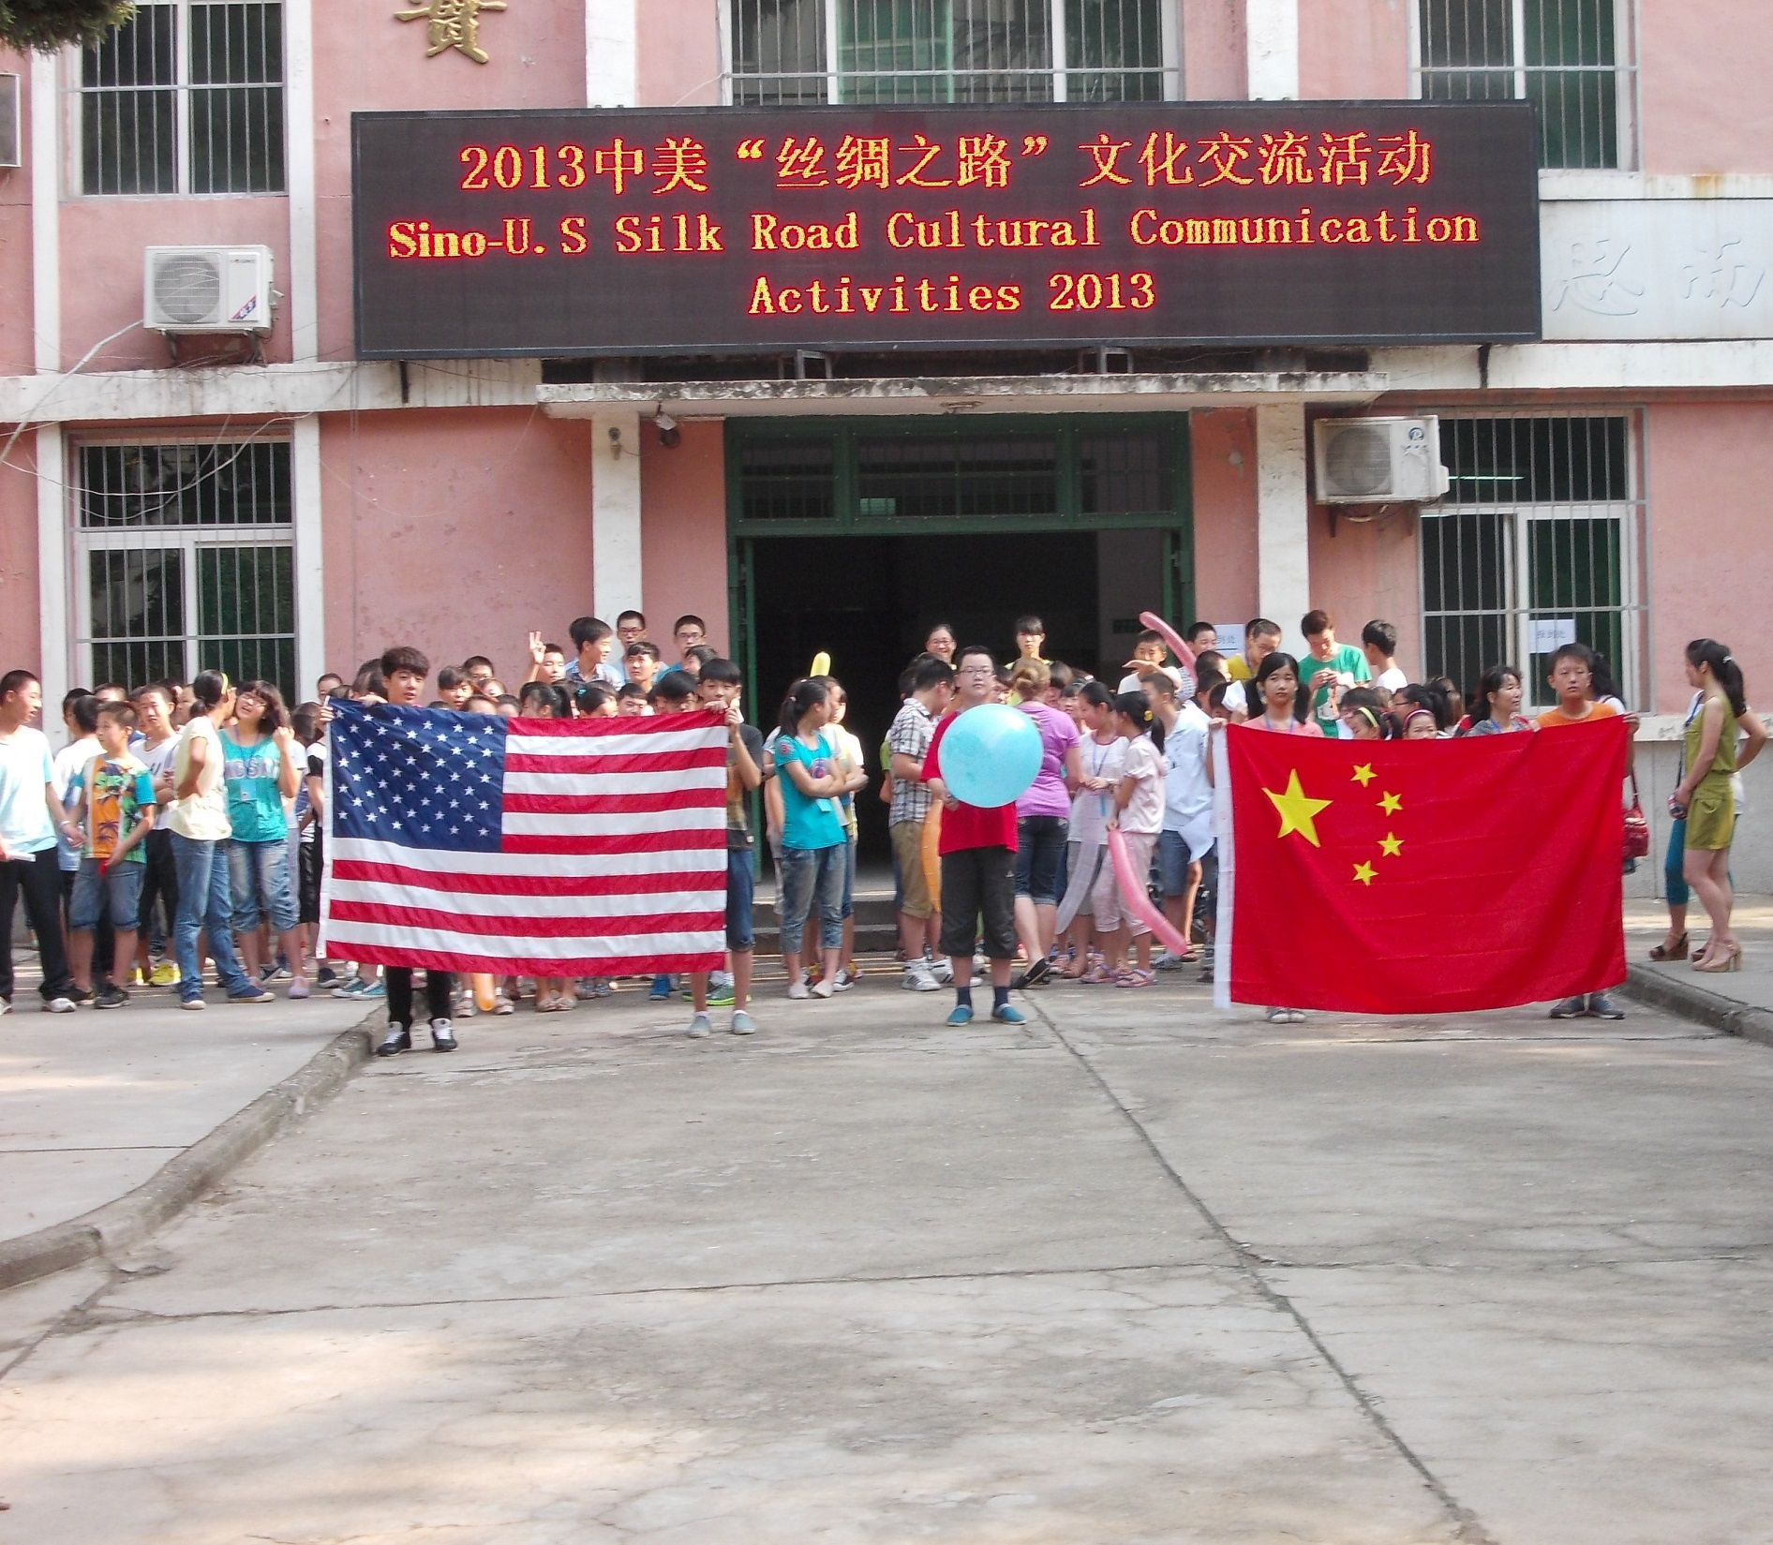
REACHING THROUGH TEACHING
BUILDING CULTURAL BRIDGES
CHANGING LIVES

Slide 10
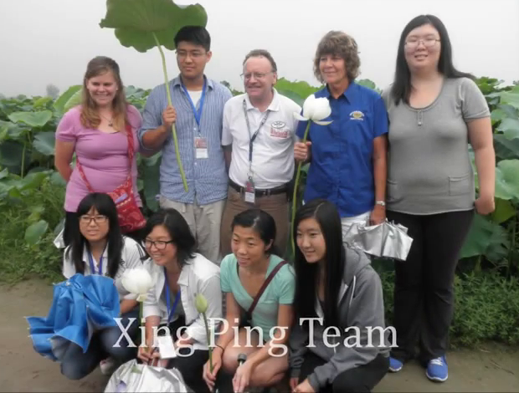
Back:
Samantha, Bryan, Nolan, Kate, Susan
Front:
Janelle, JoJo, Arianne, Nancy

Slide 11
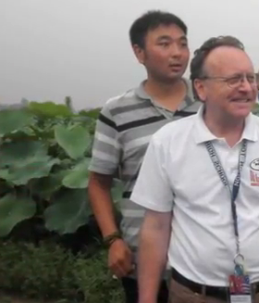
Rio (Wang Lei)
& Nolan

Slide 12
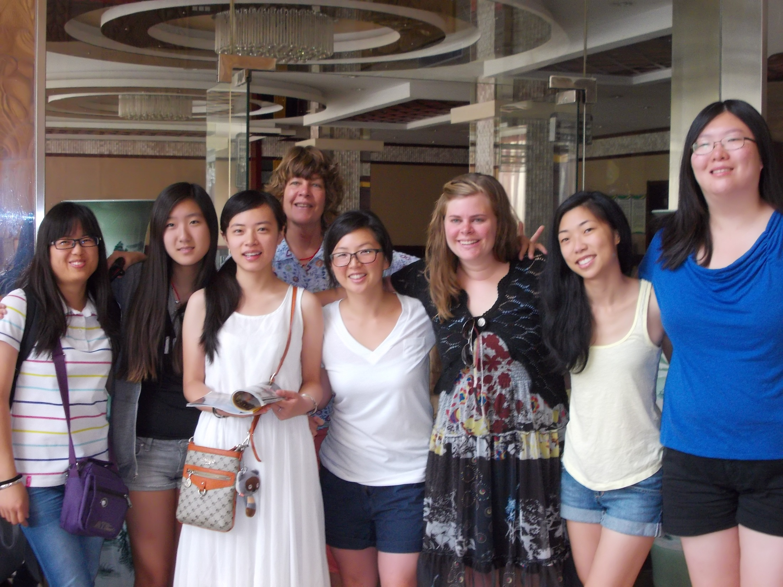

Slide 13
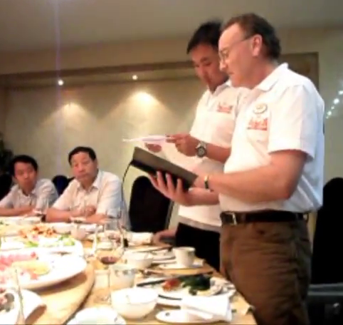
Opening Banquet

Slide 14
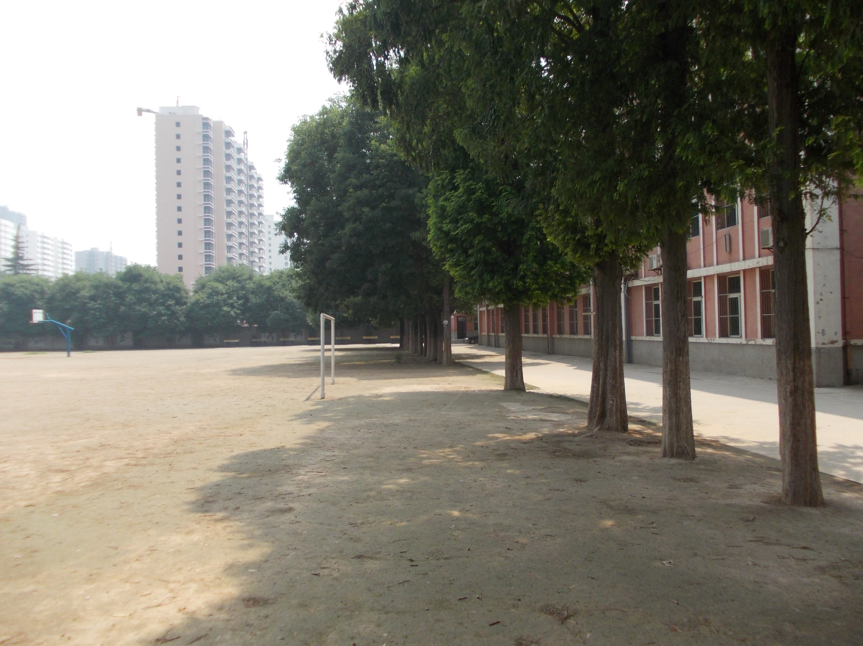
Back playground area of school
(Apartments in background)

Slide 15
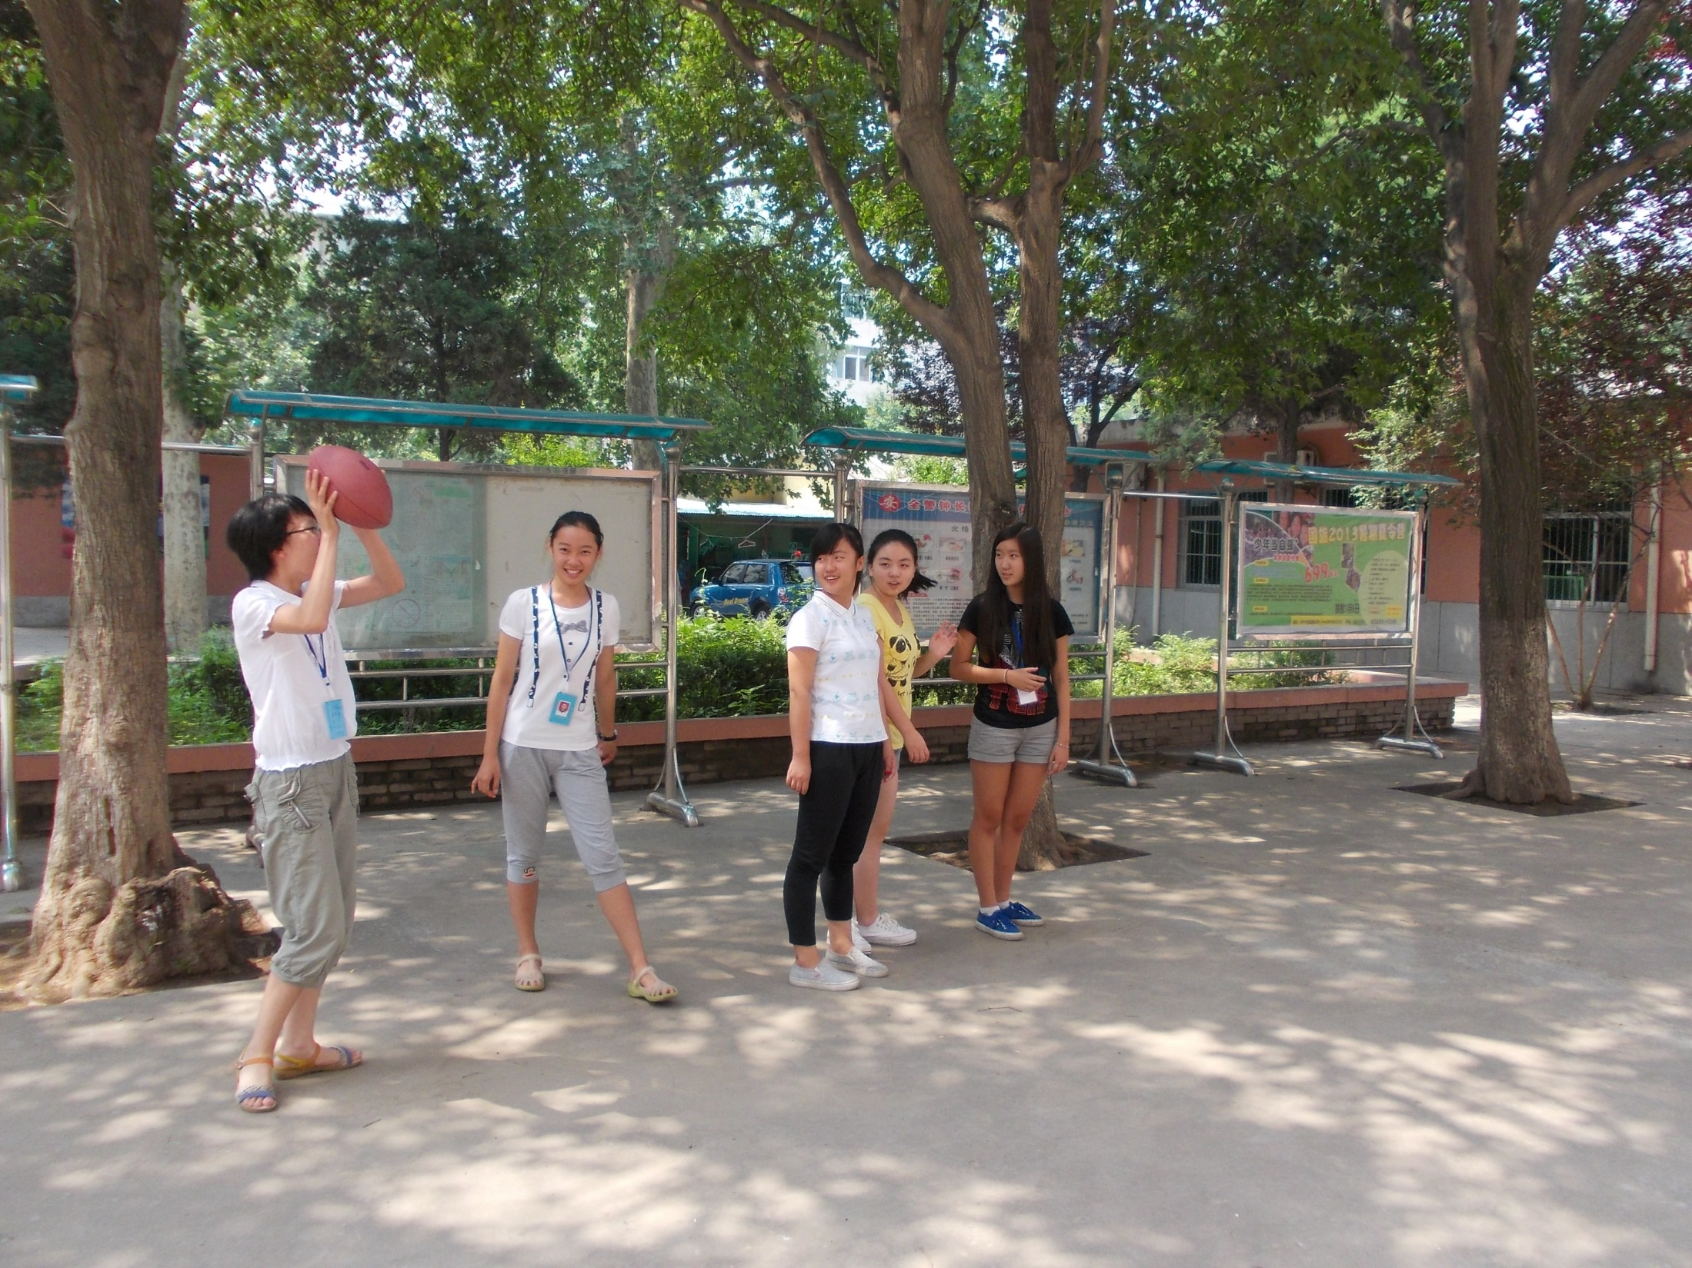
Front yard of school

Slide 16
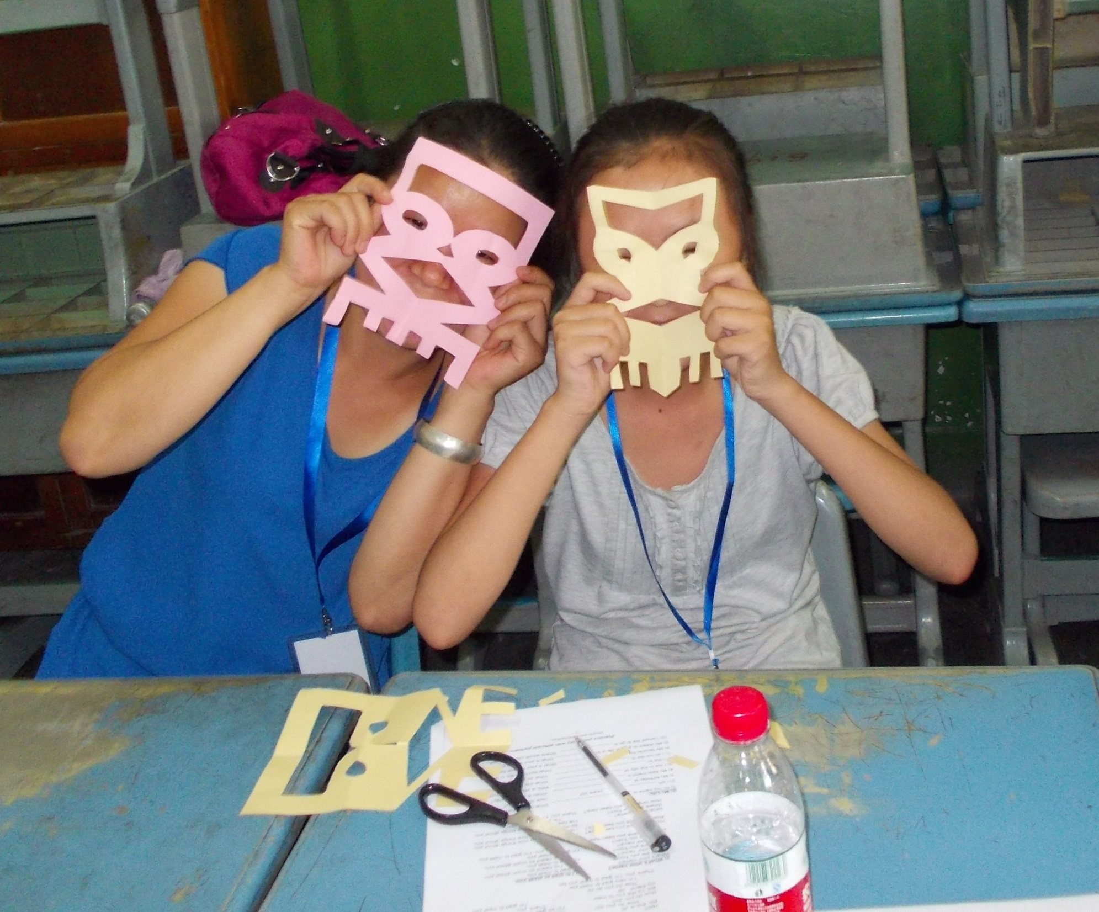
LOVE
SYMMETRY
PROJECT
The many faces of LOVE!

Slide 17
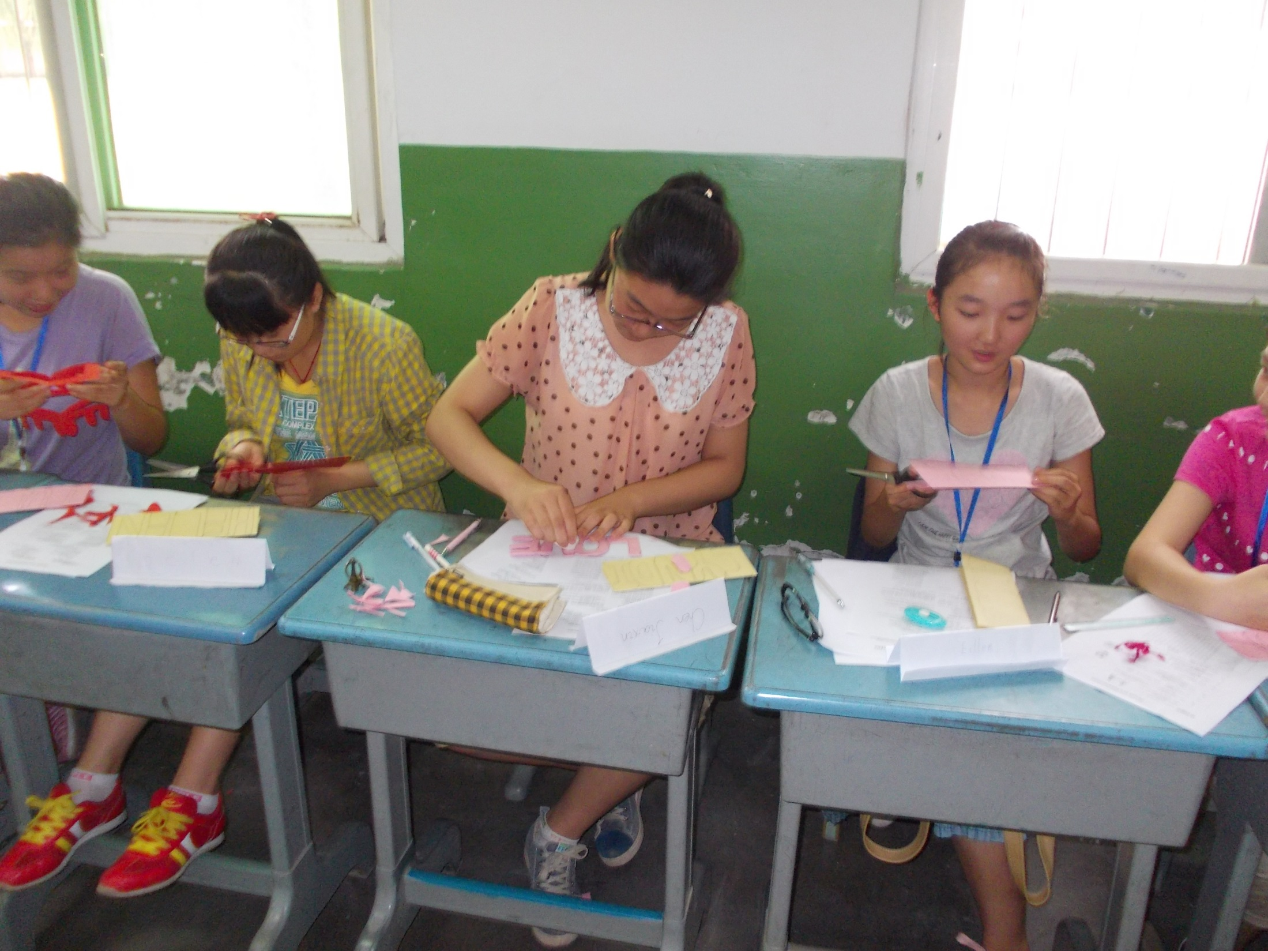

Slide 18
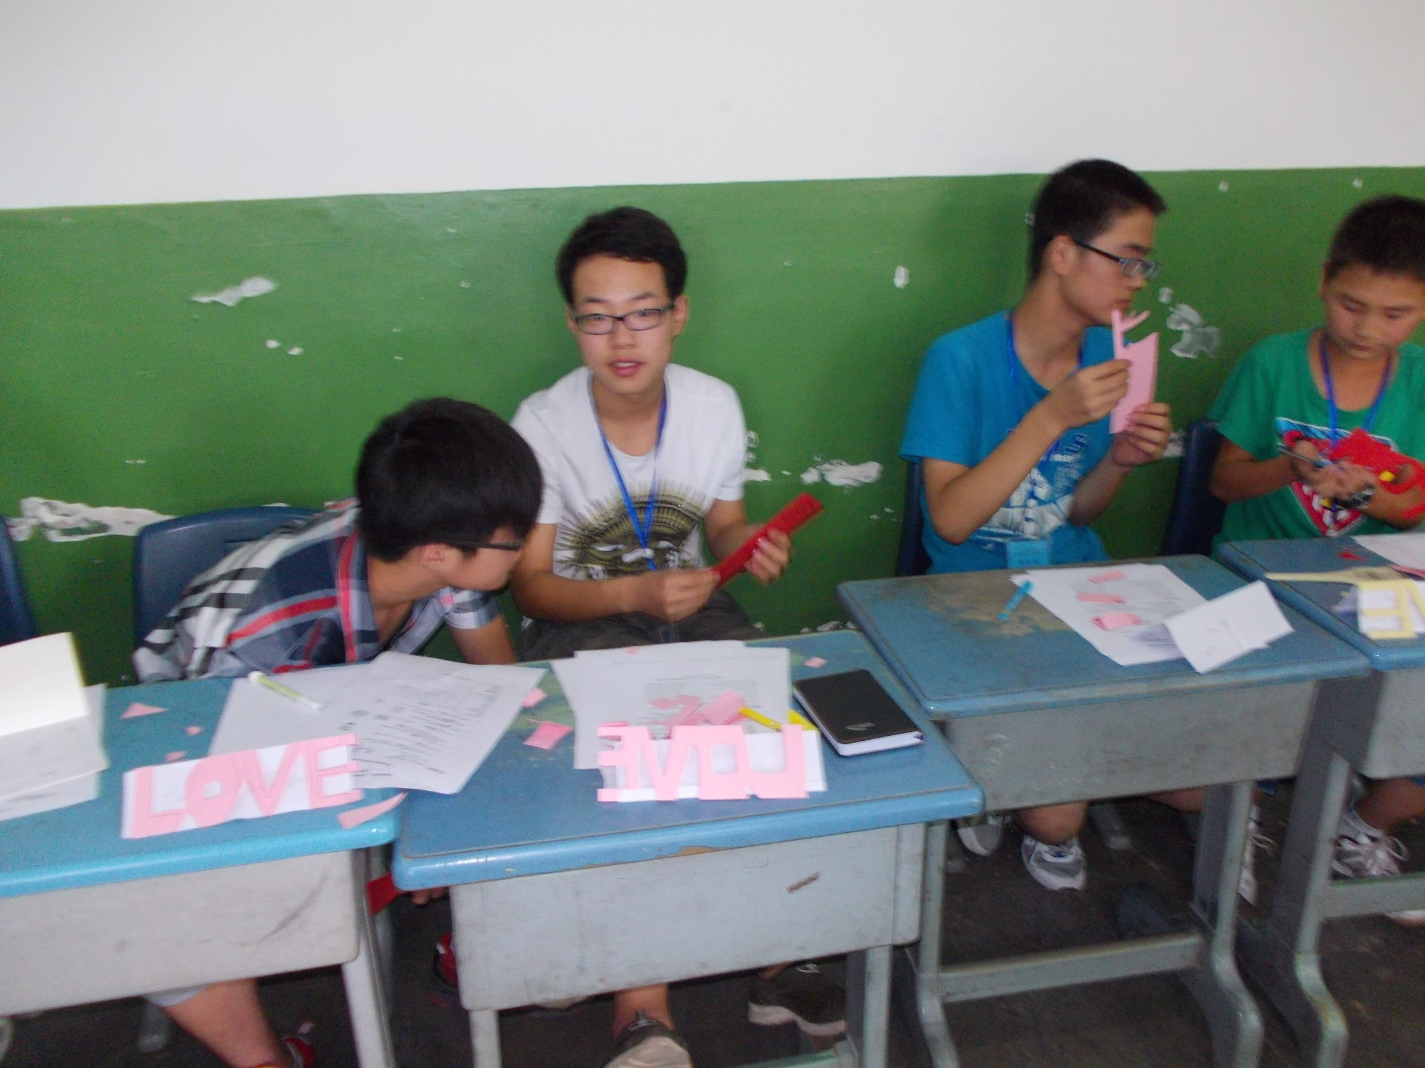

Slide 19
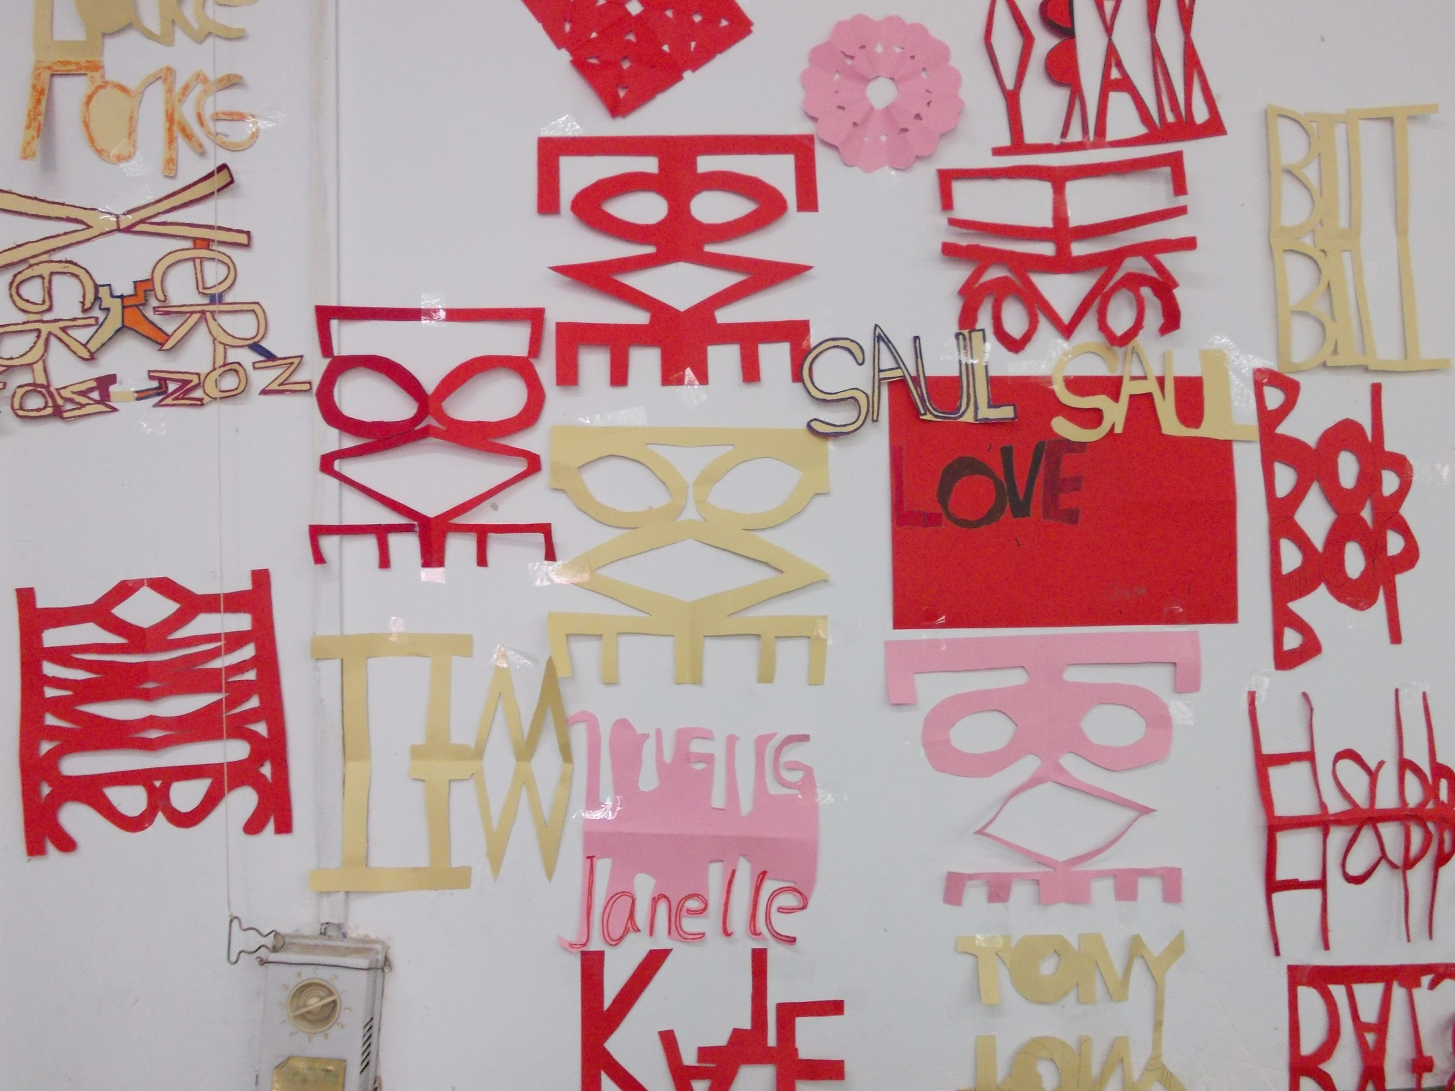

Slide 20
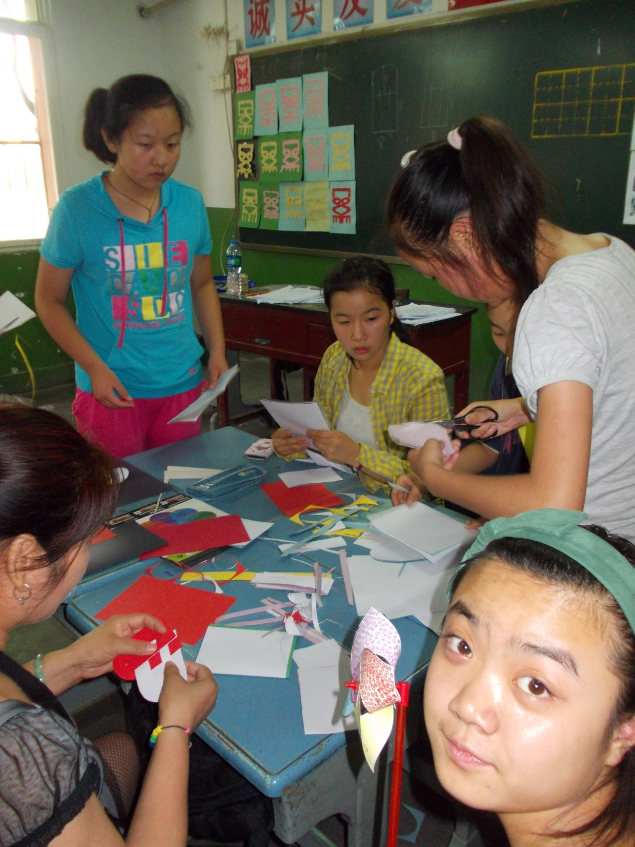
WOVEN HEARTS

Slide 21
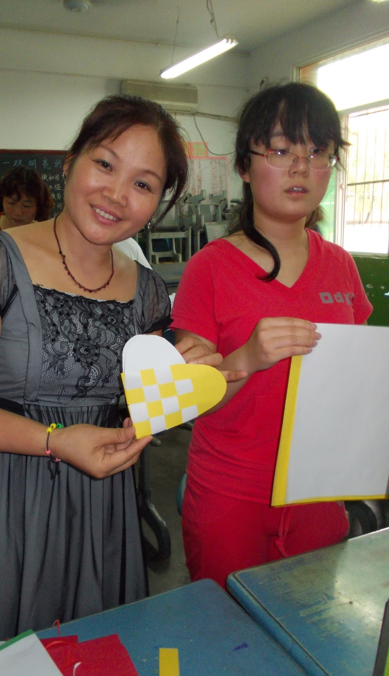

Slide 22
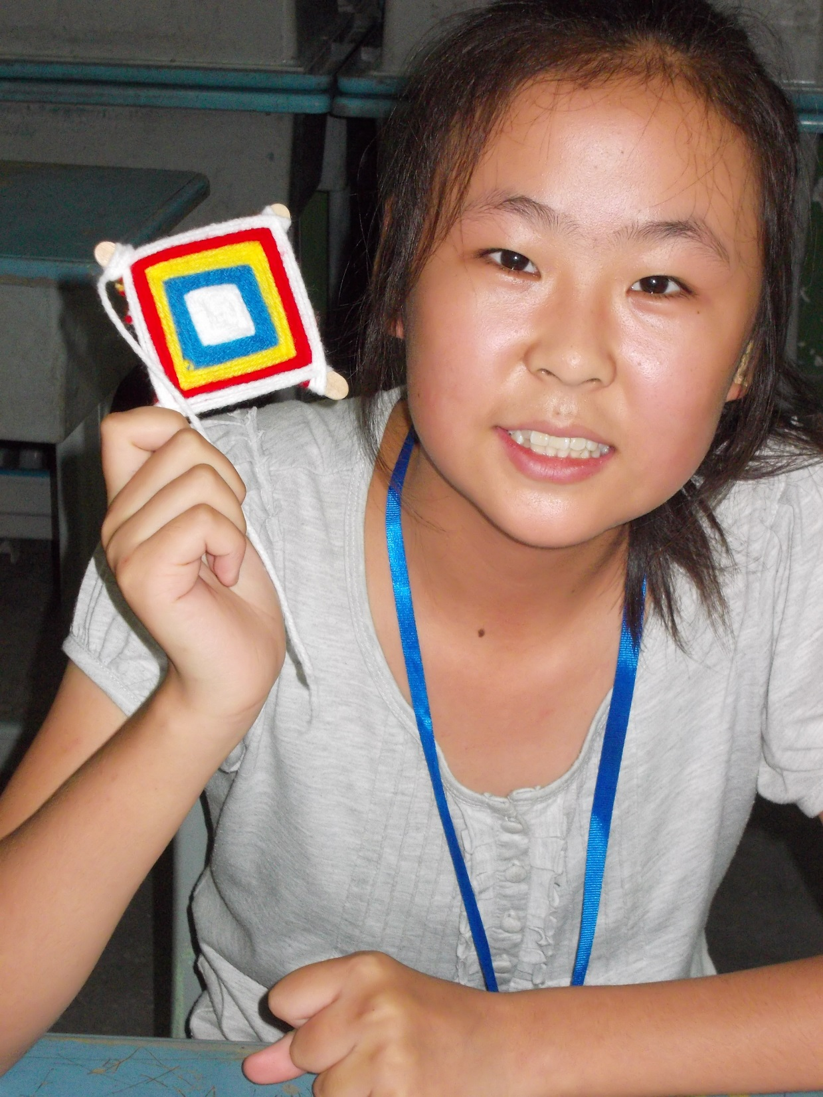
Ojo-De-Dio

Slide 23
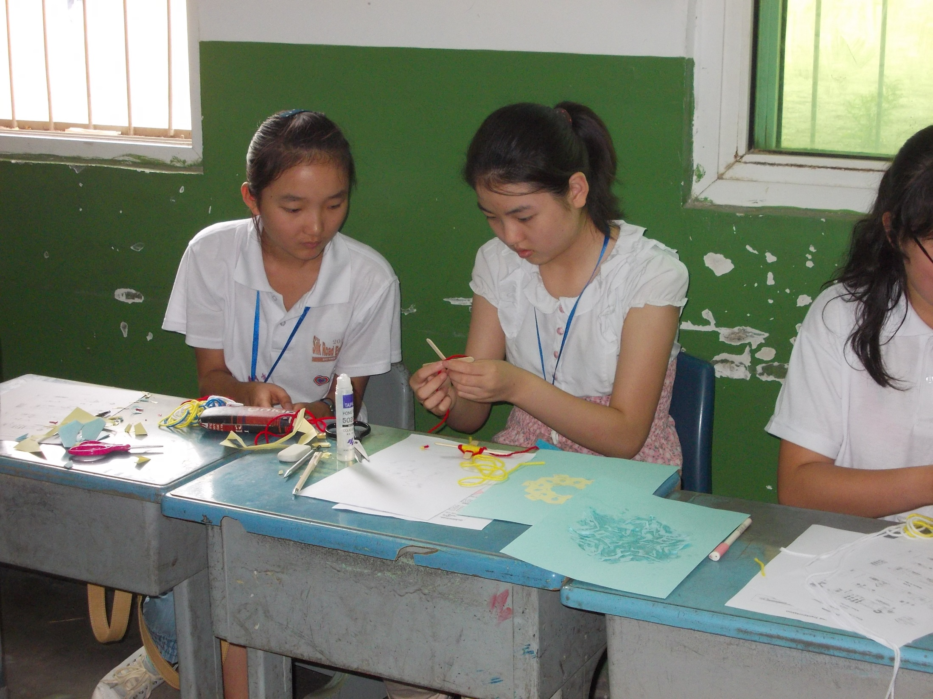

Slide 24
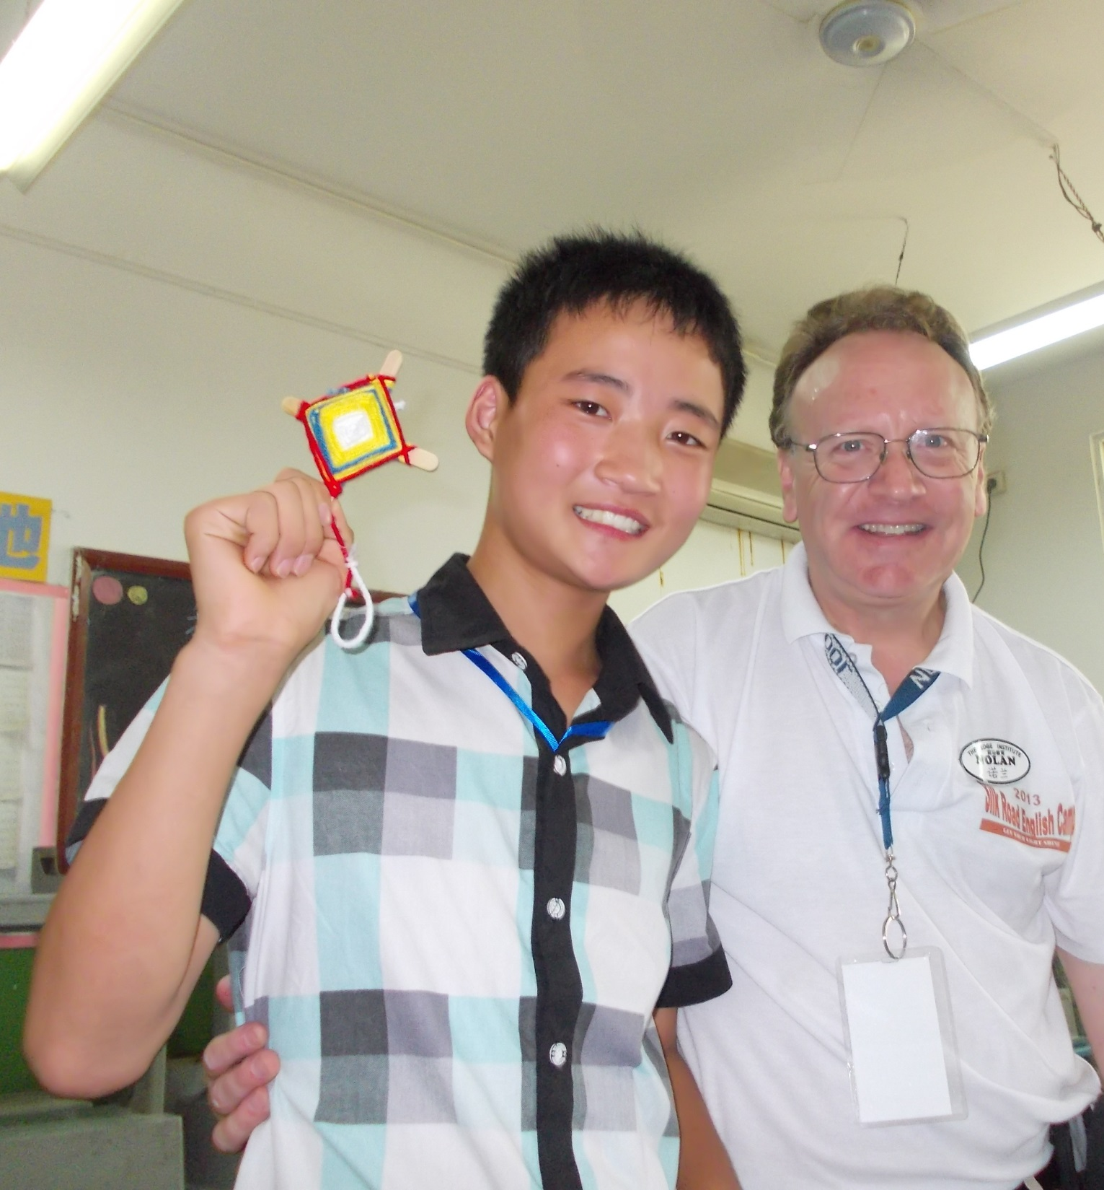

Slide 25
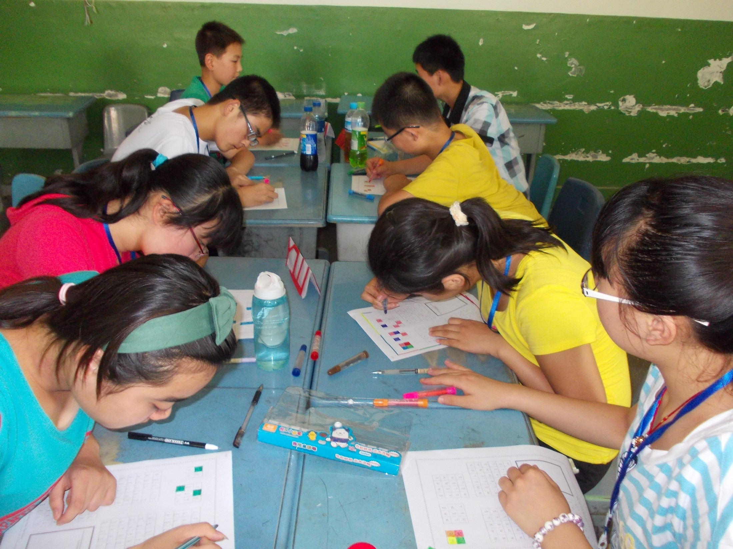
Something
About
That
Name

Slide 26
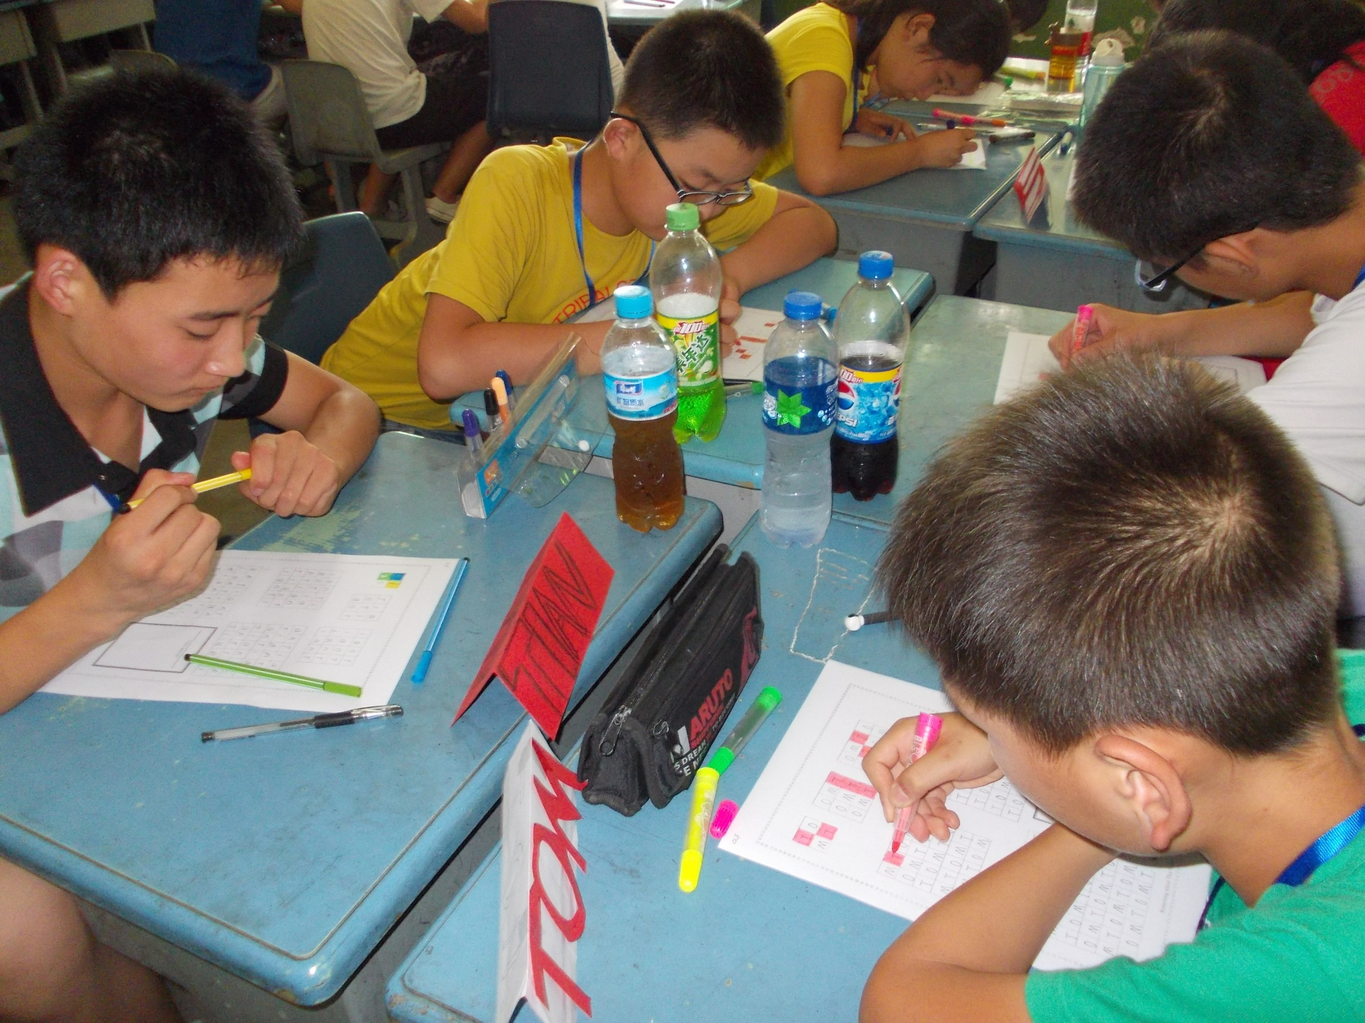

Slide 27
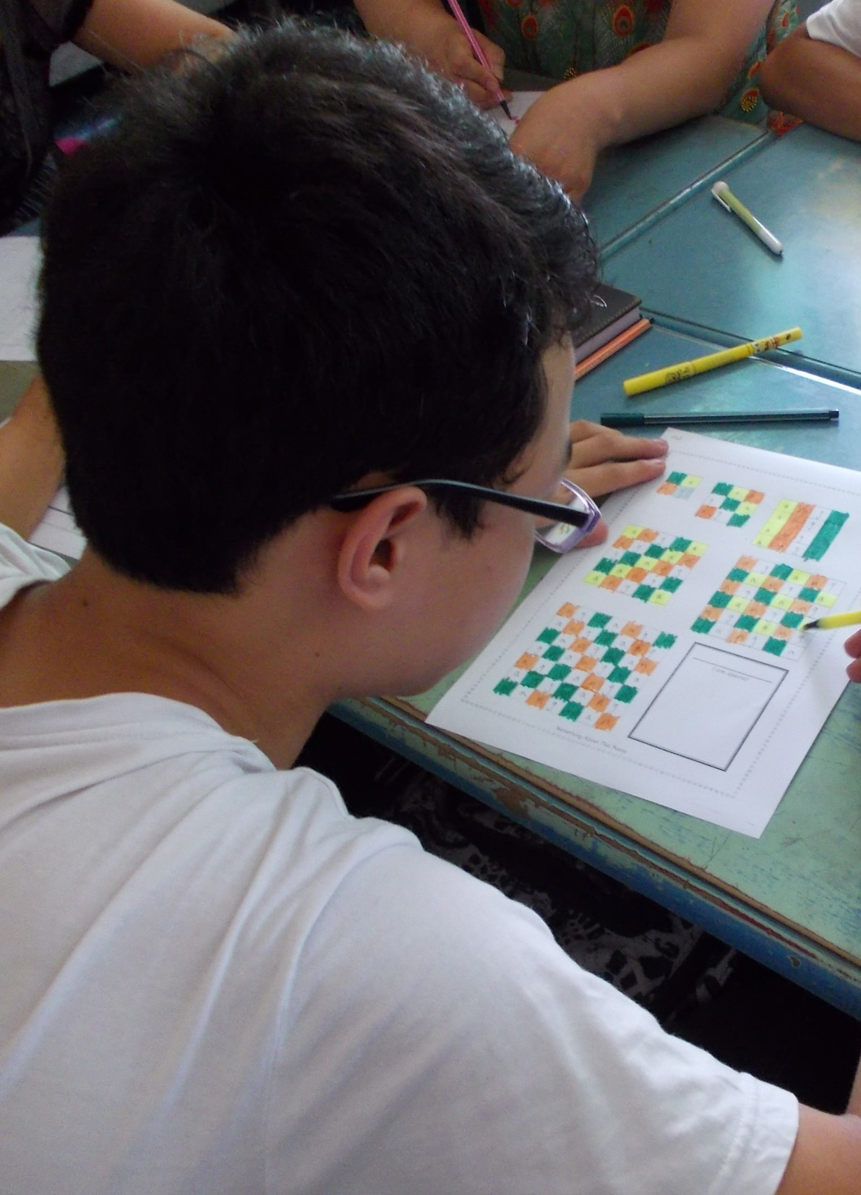

Slide 28
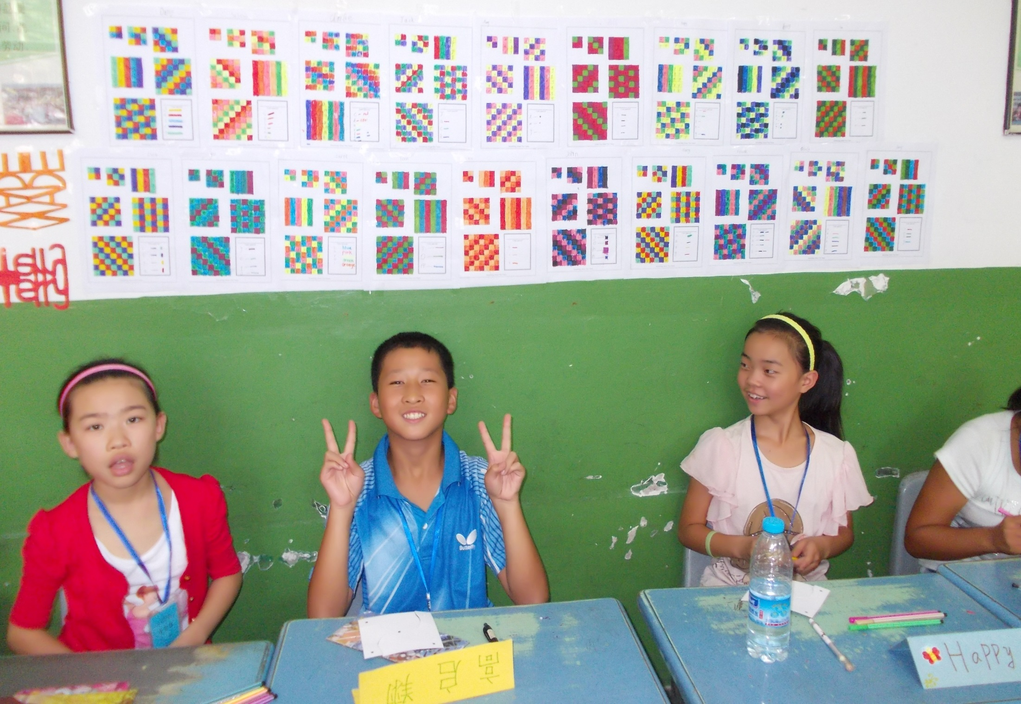
Every “NAME” becomes a unique pattern!

Slide 29
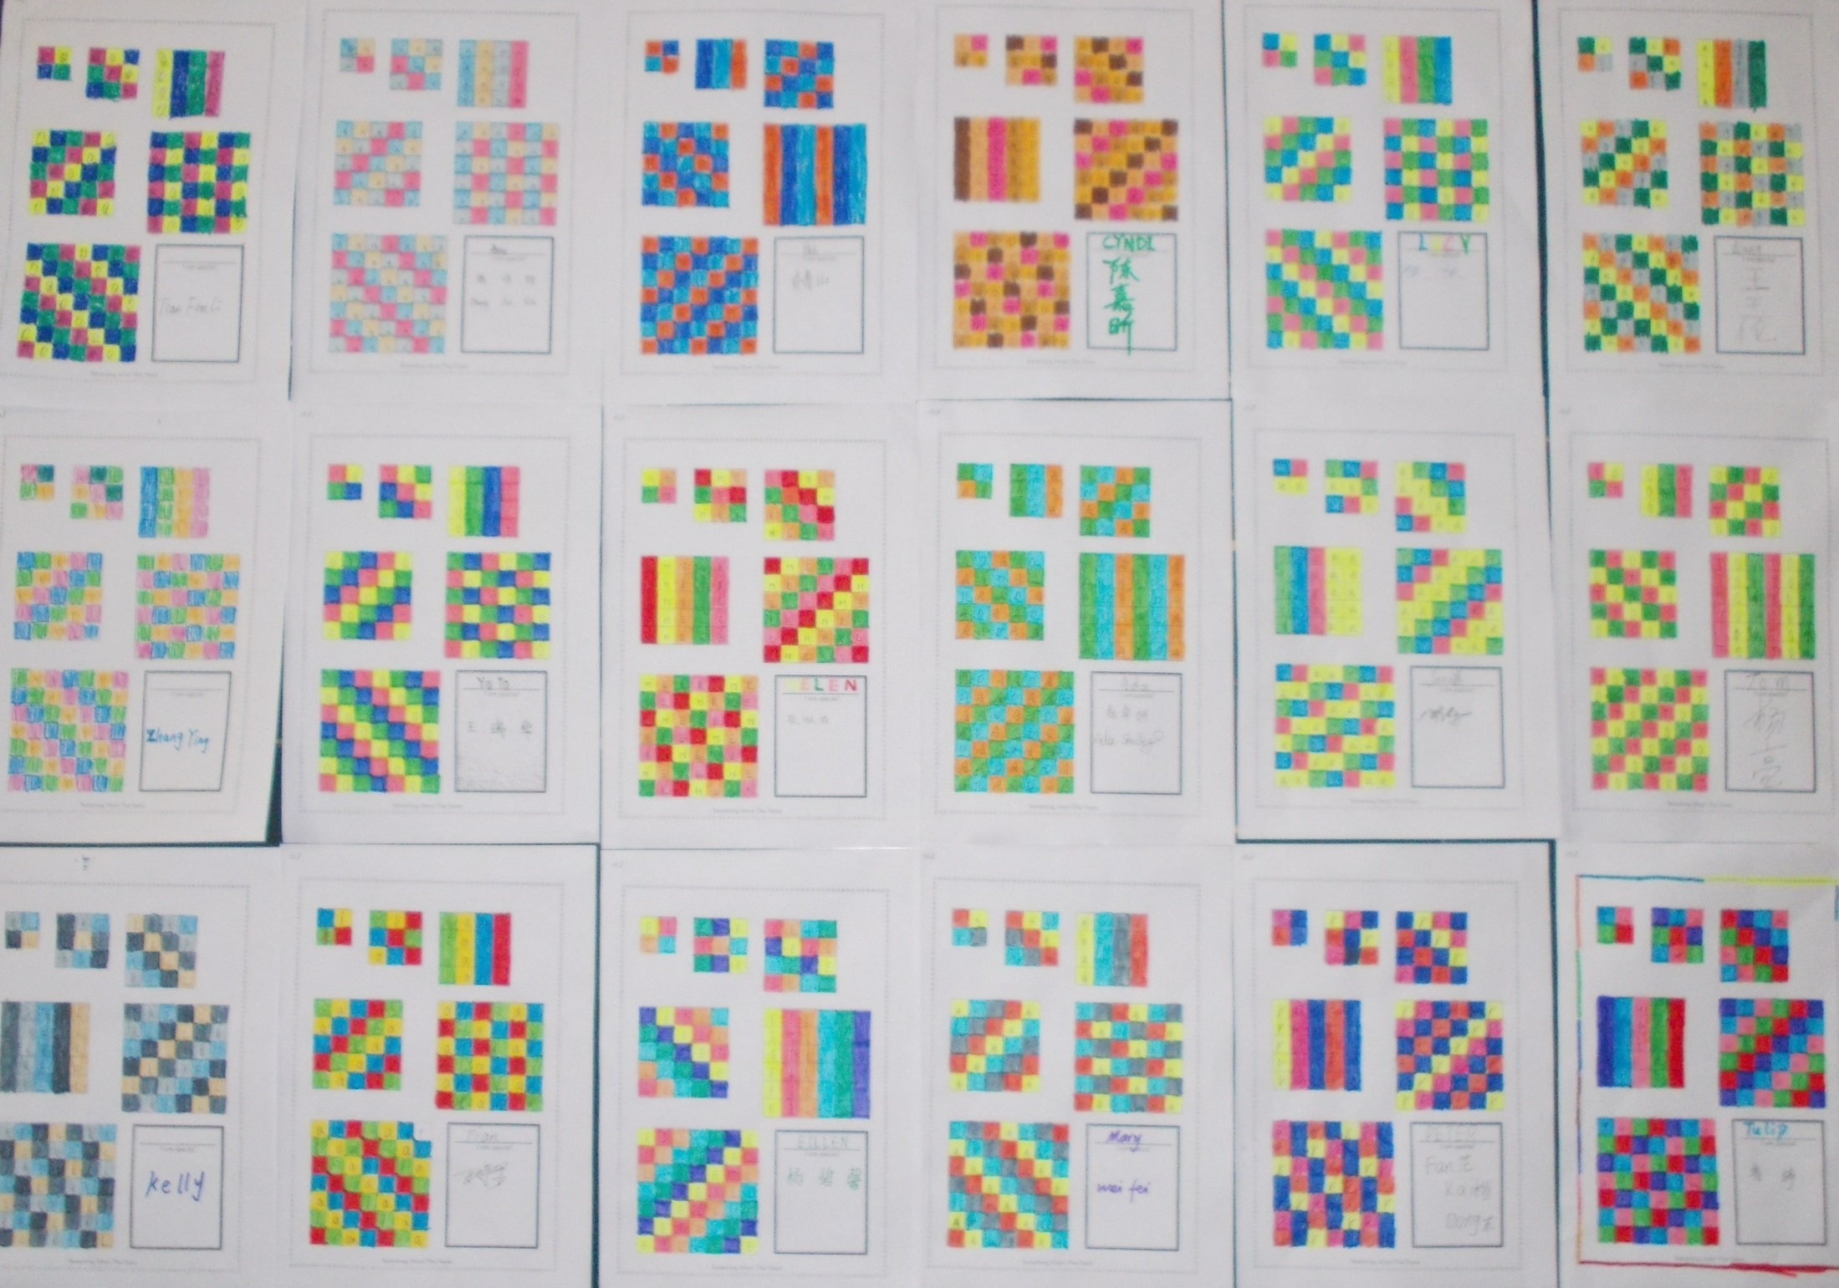
Something About That Name

Slide 30
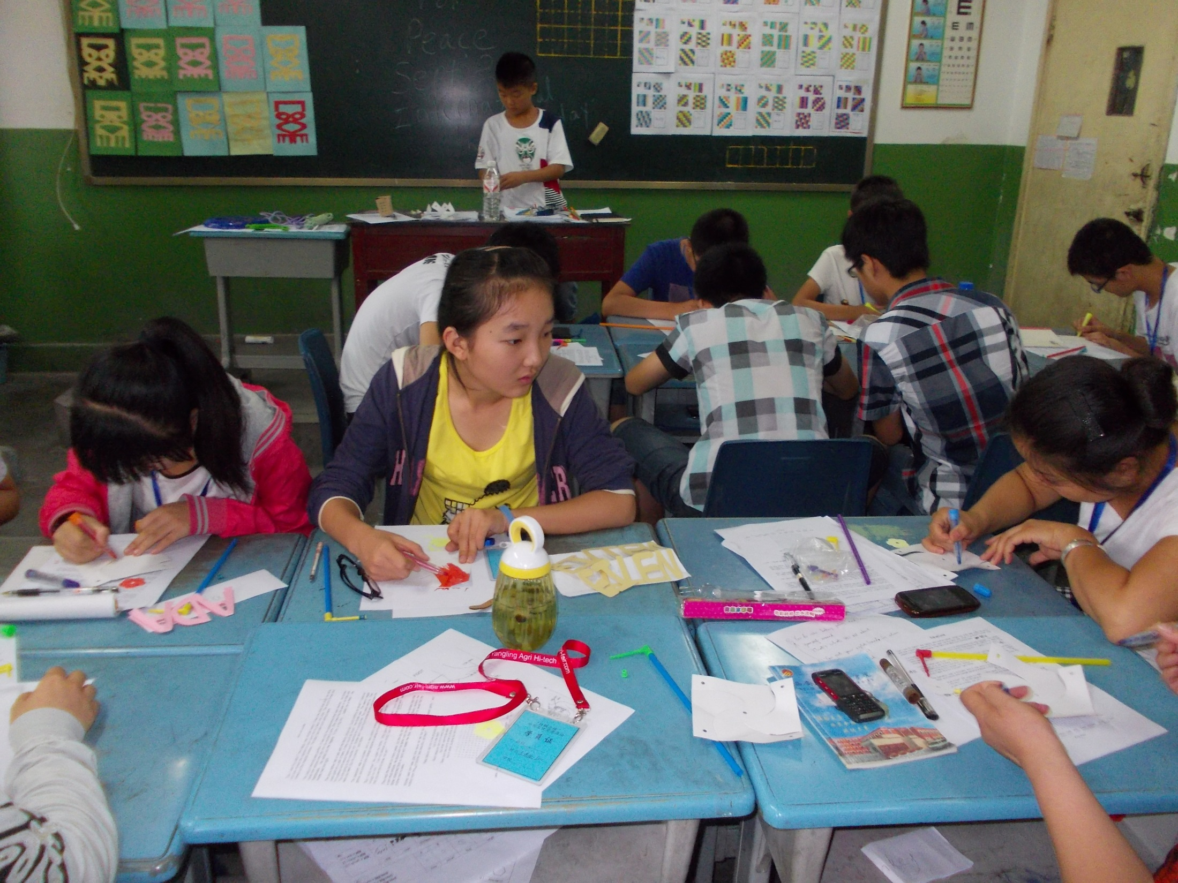

Slide 31
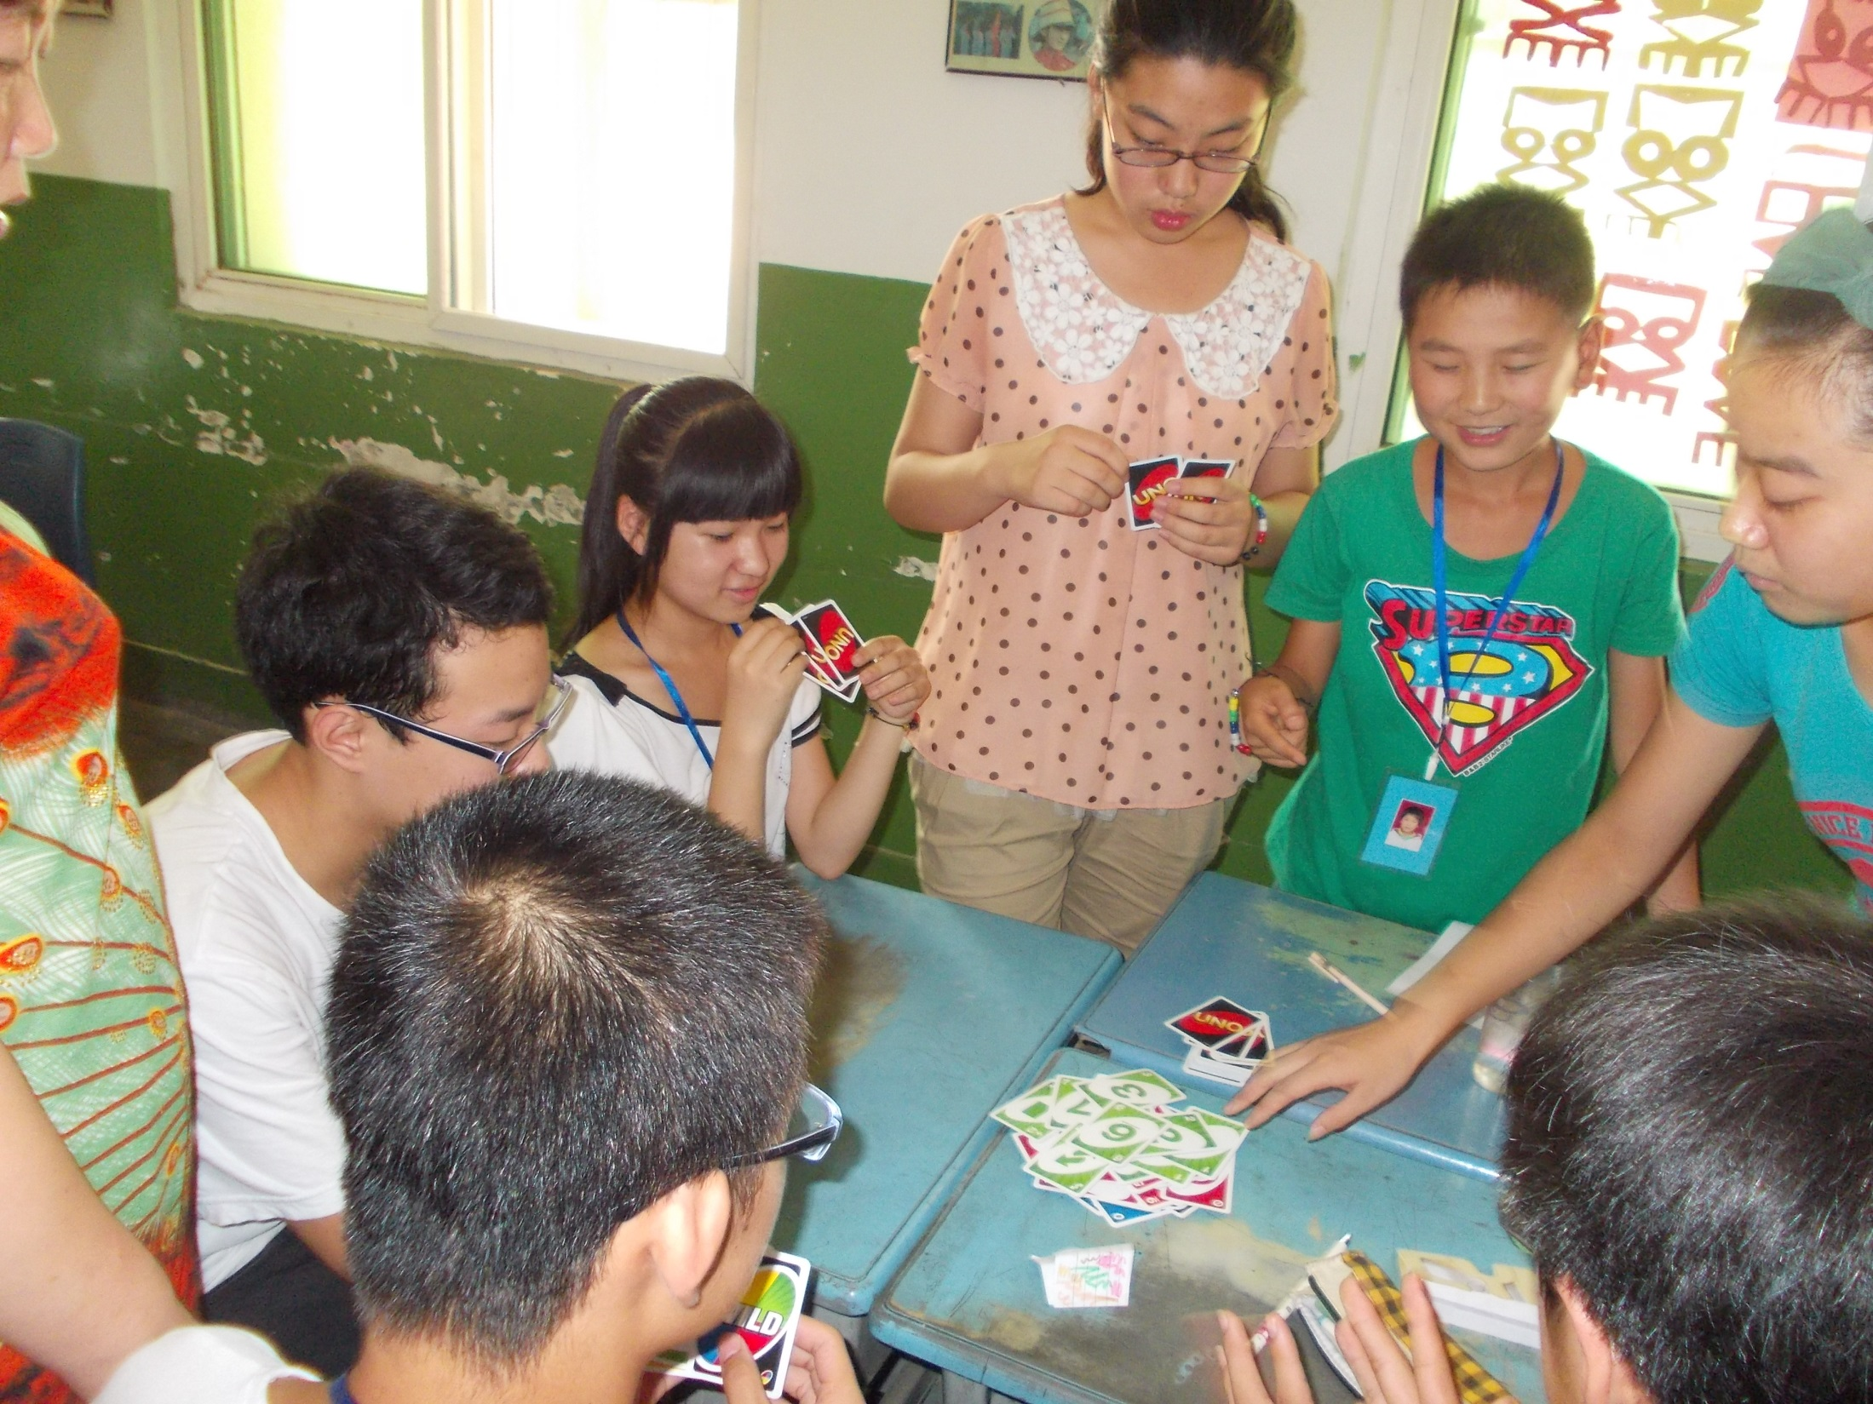
UNO
A popular game
For colors and numbers

Slide 32
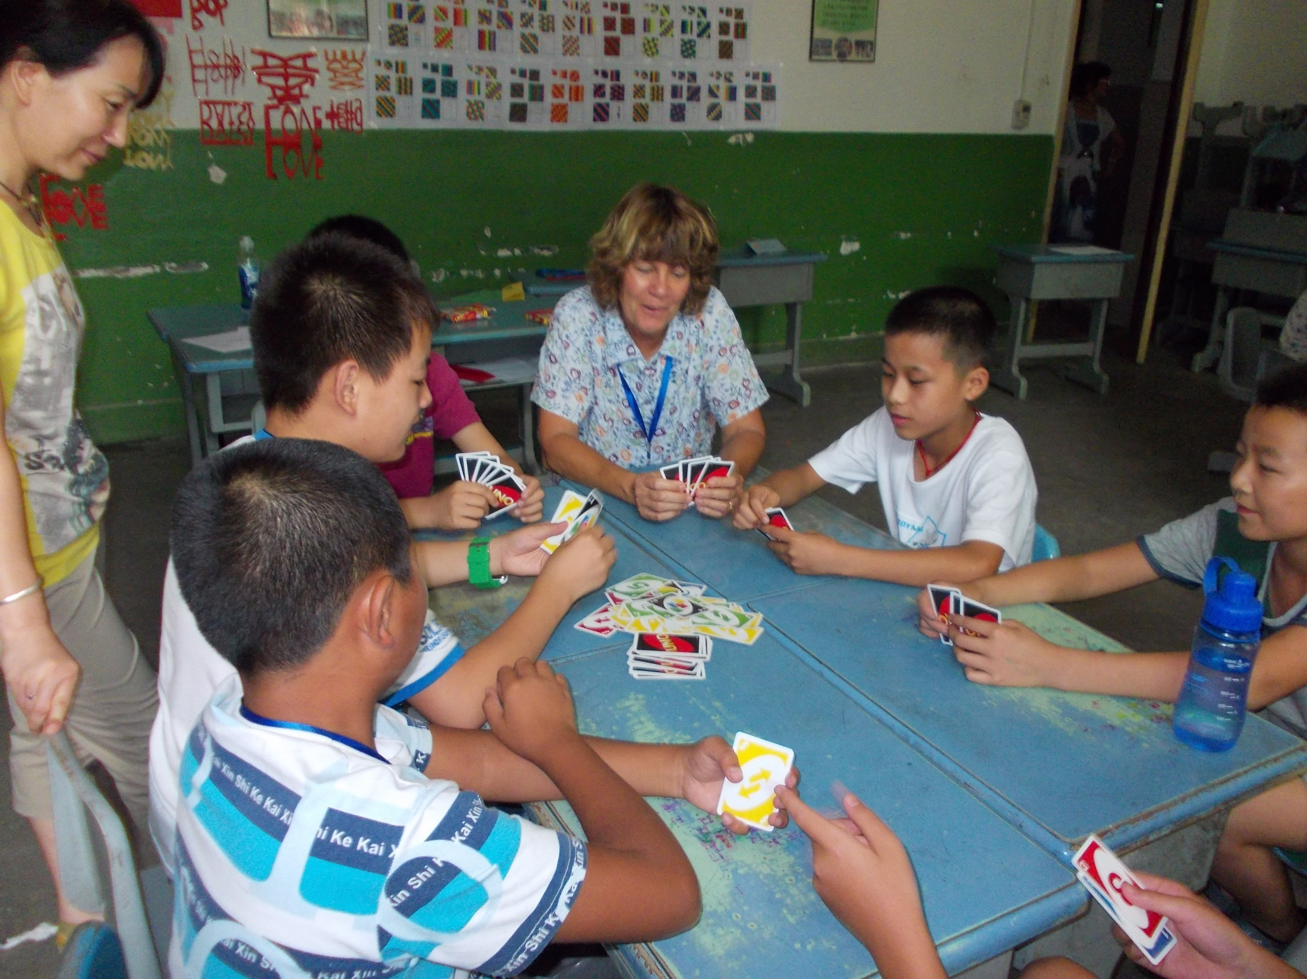

Slide 33
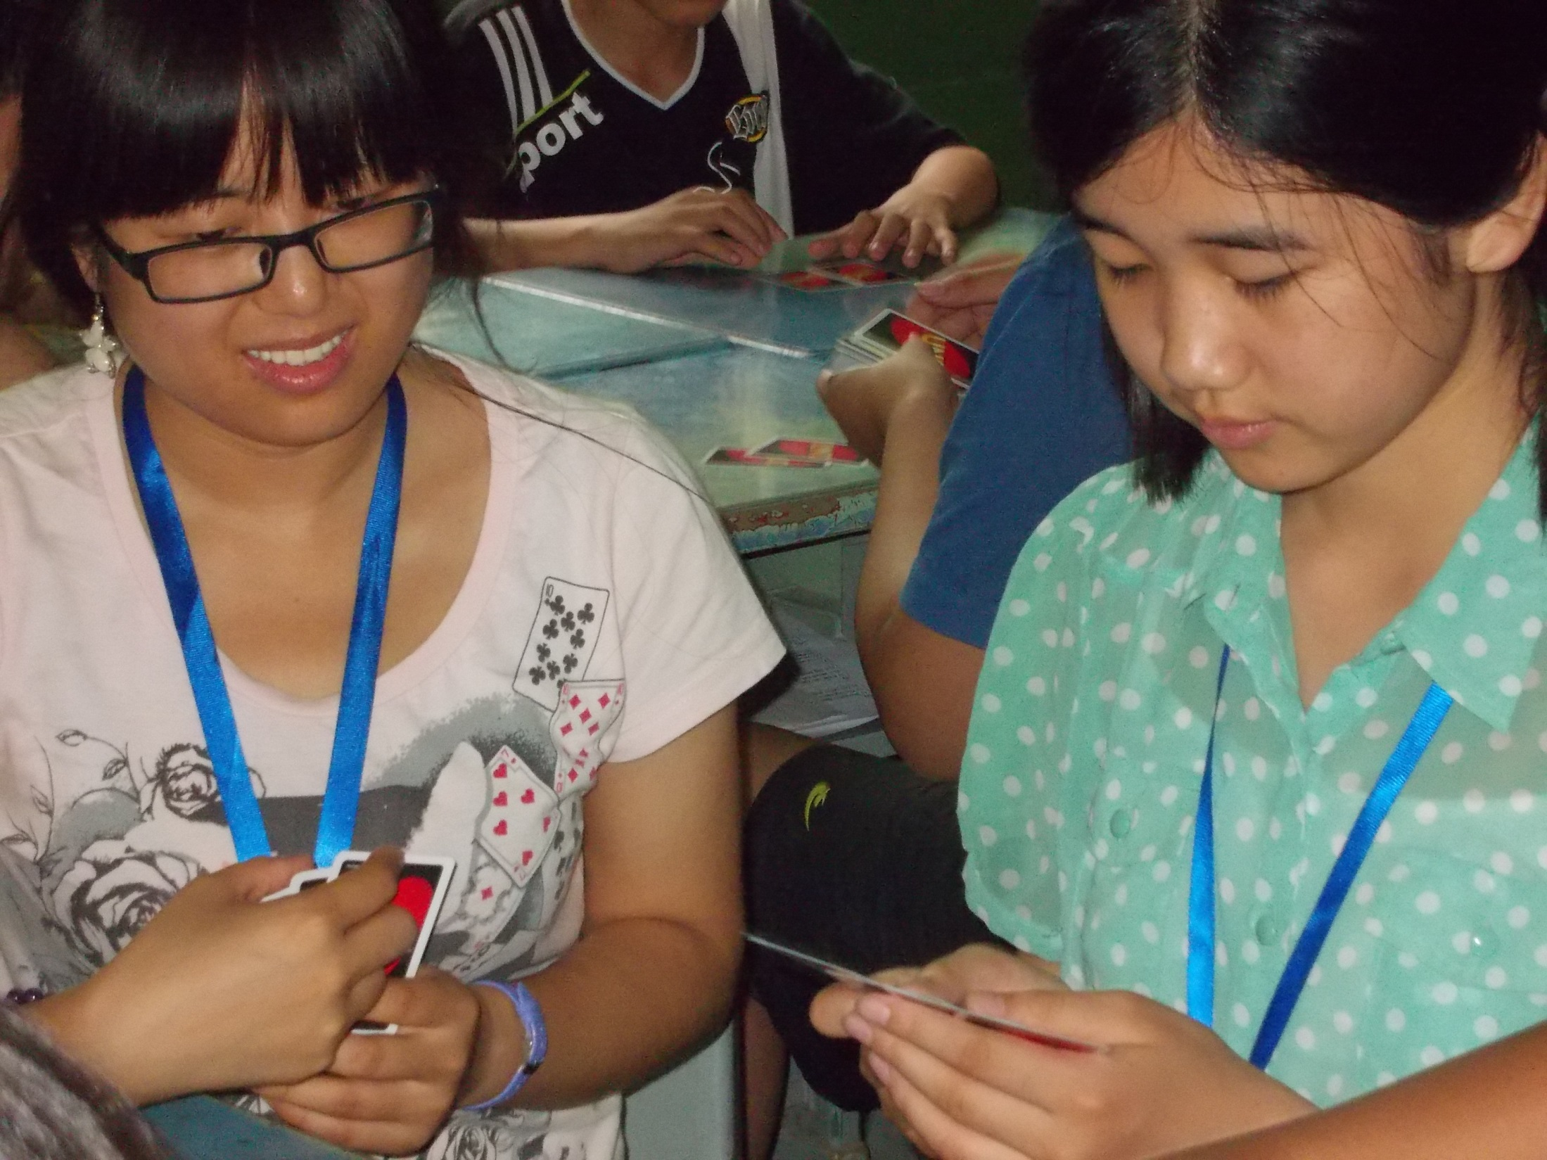

Slide 34
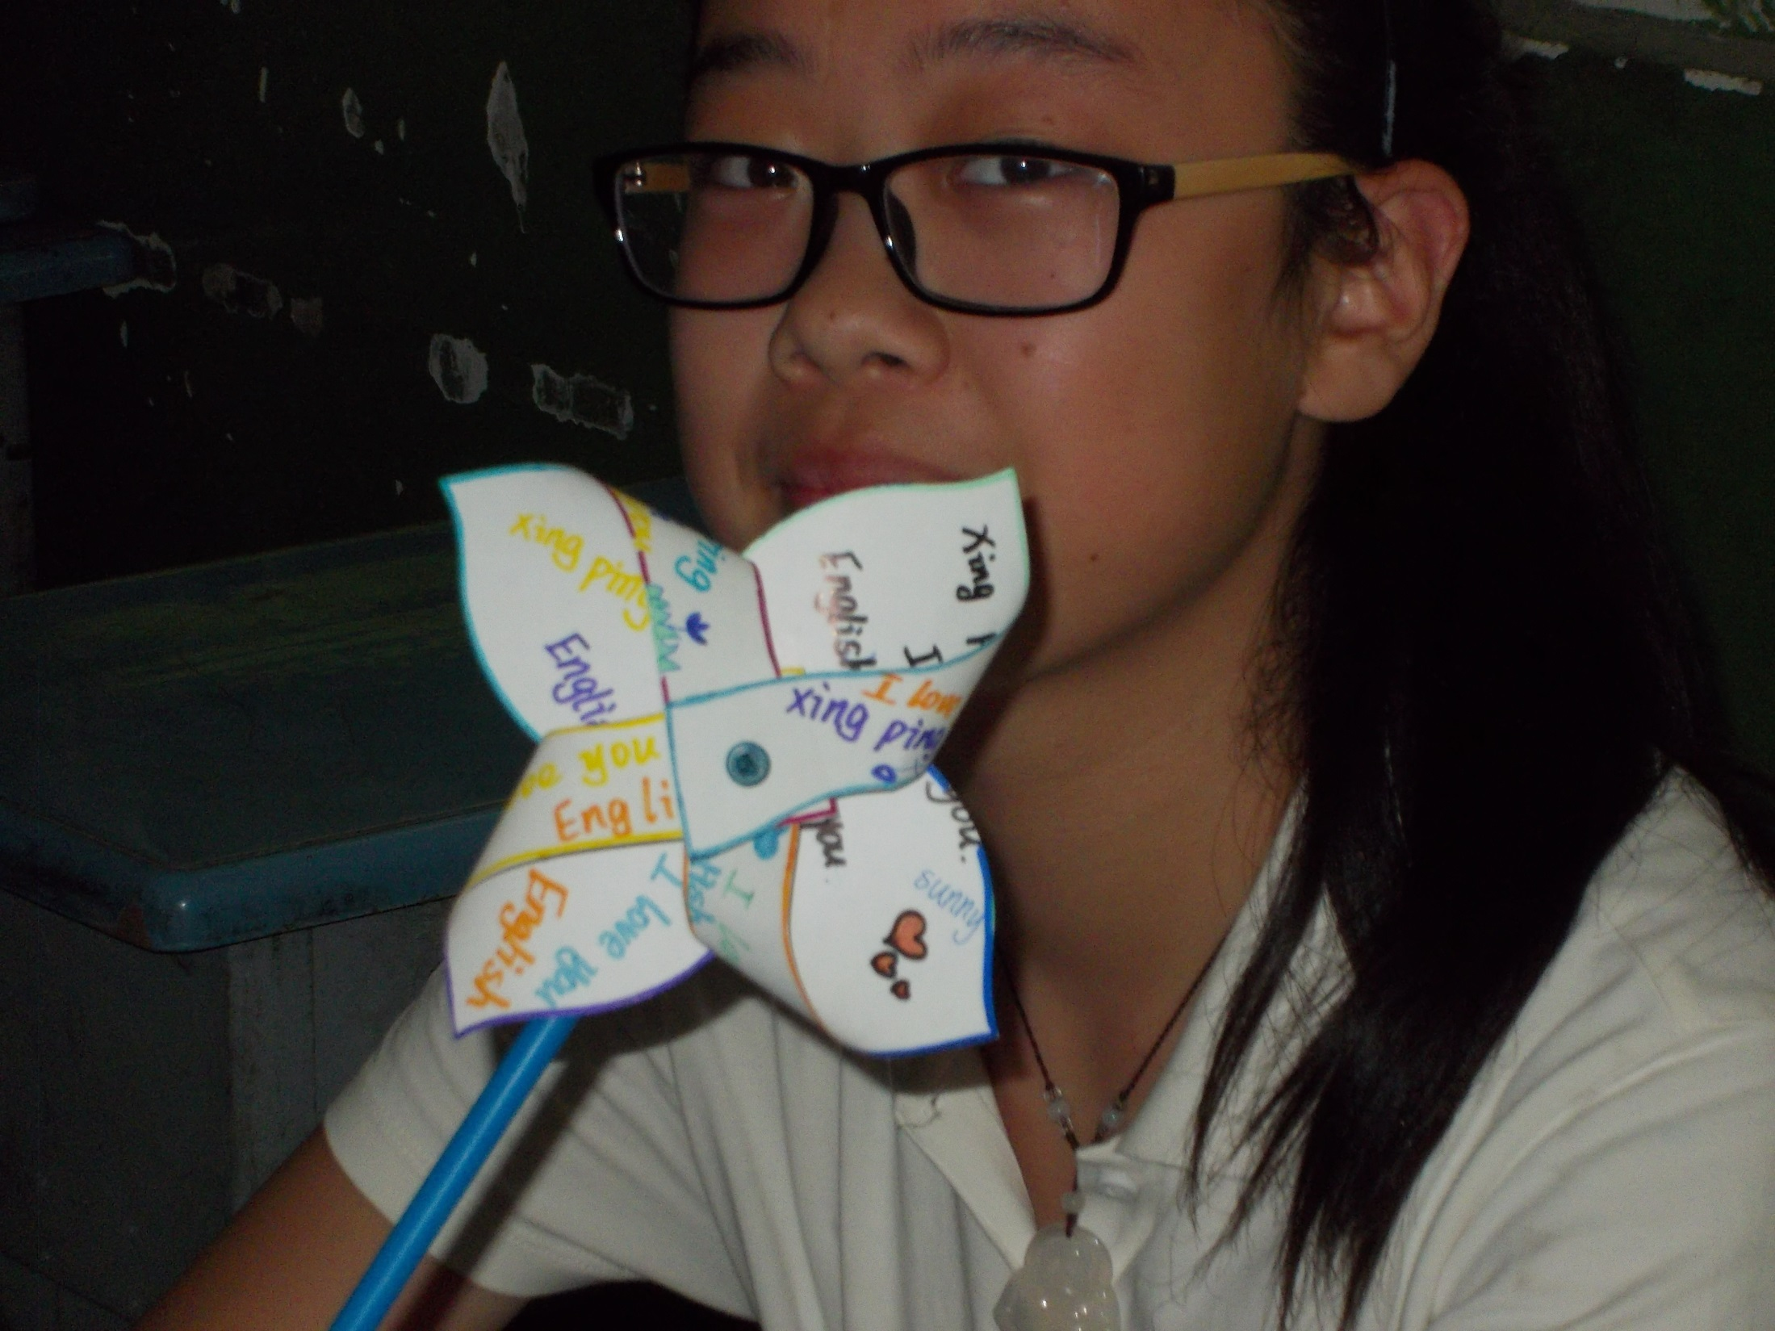
Pinwheels
For
Peace

Slide 35
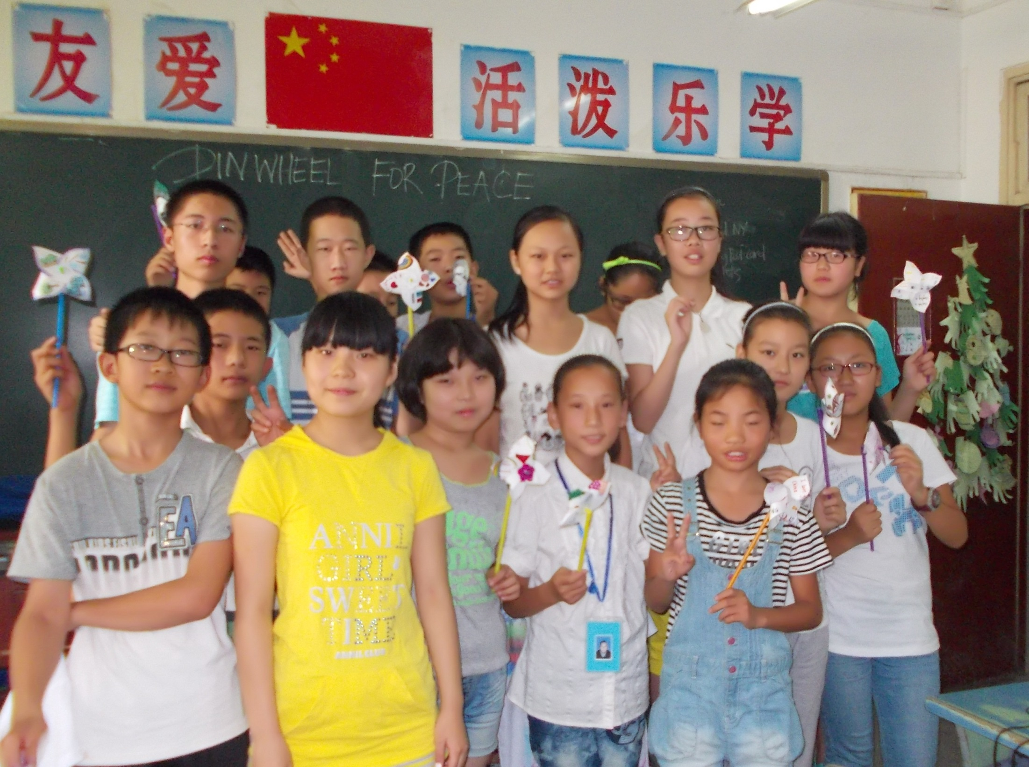

Slide 36
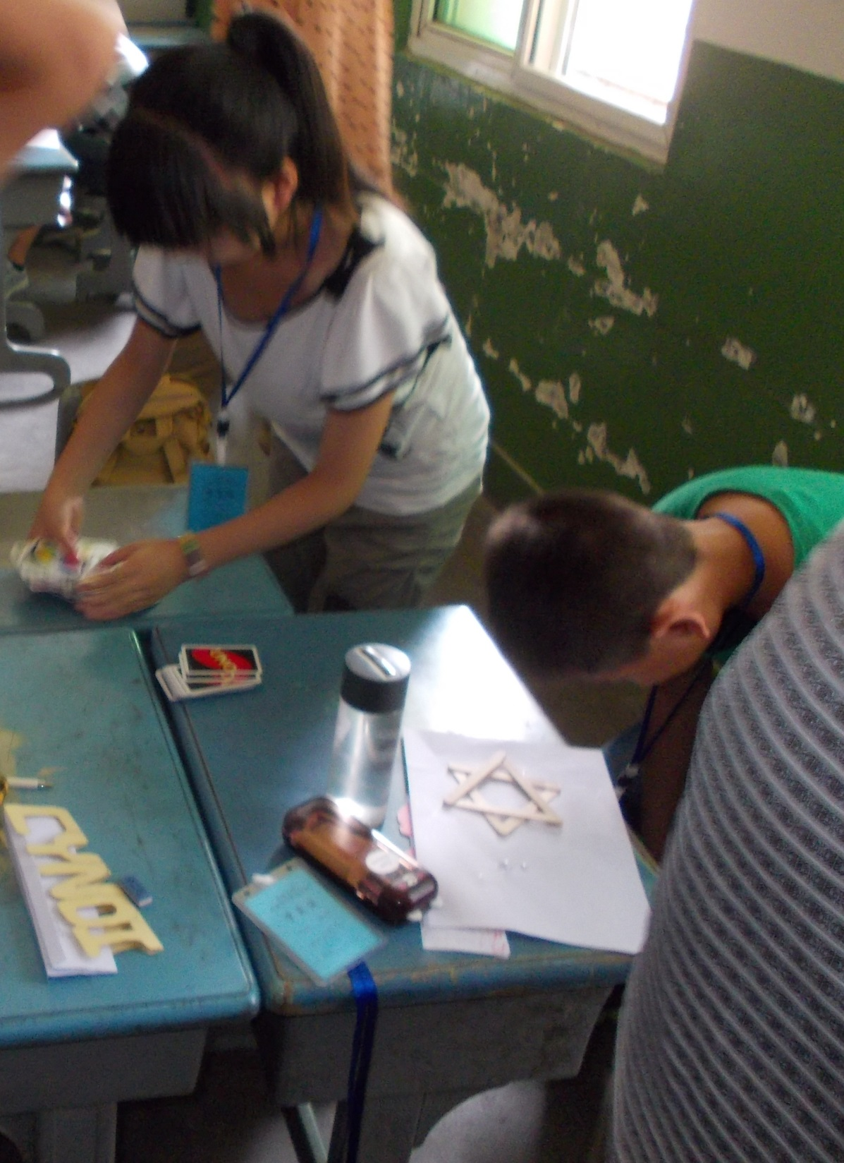
Star-of-David
& Christmas Crafts

Slide 37
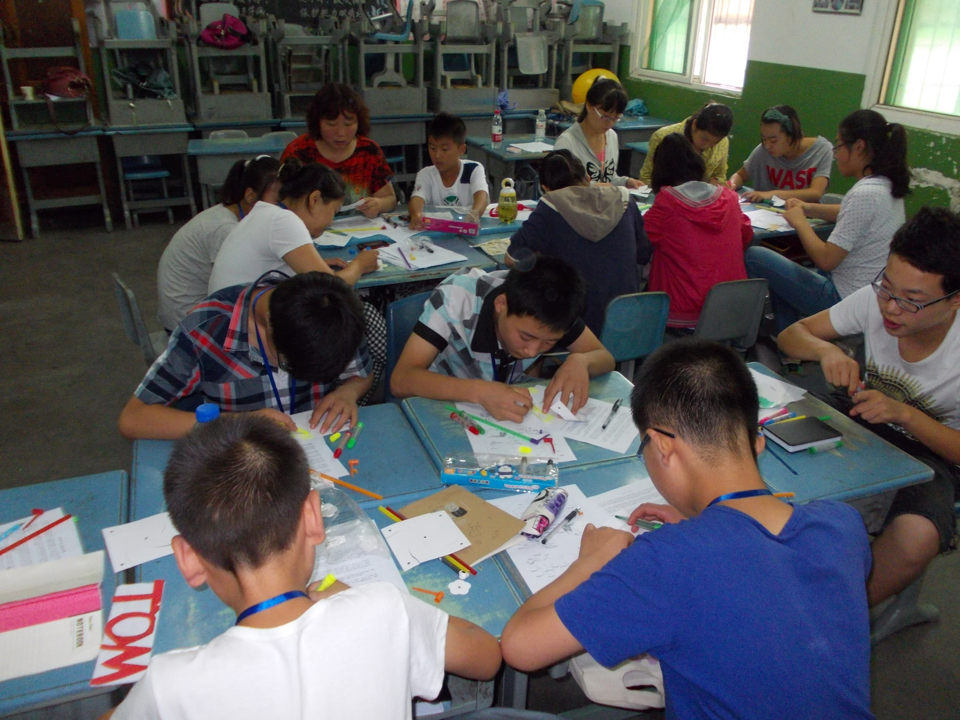

Slide 38
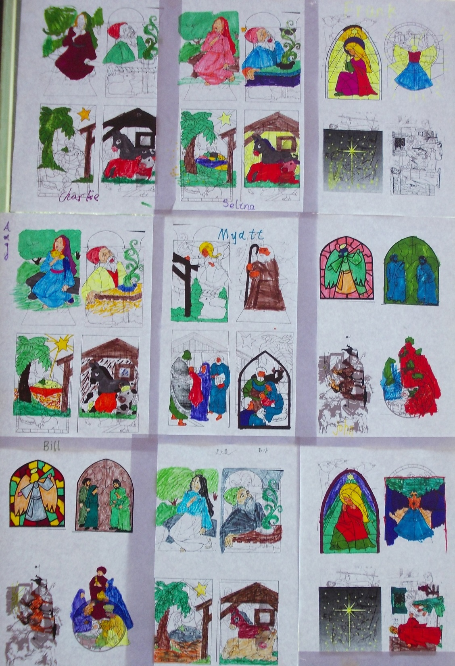

Slide 39
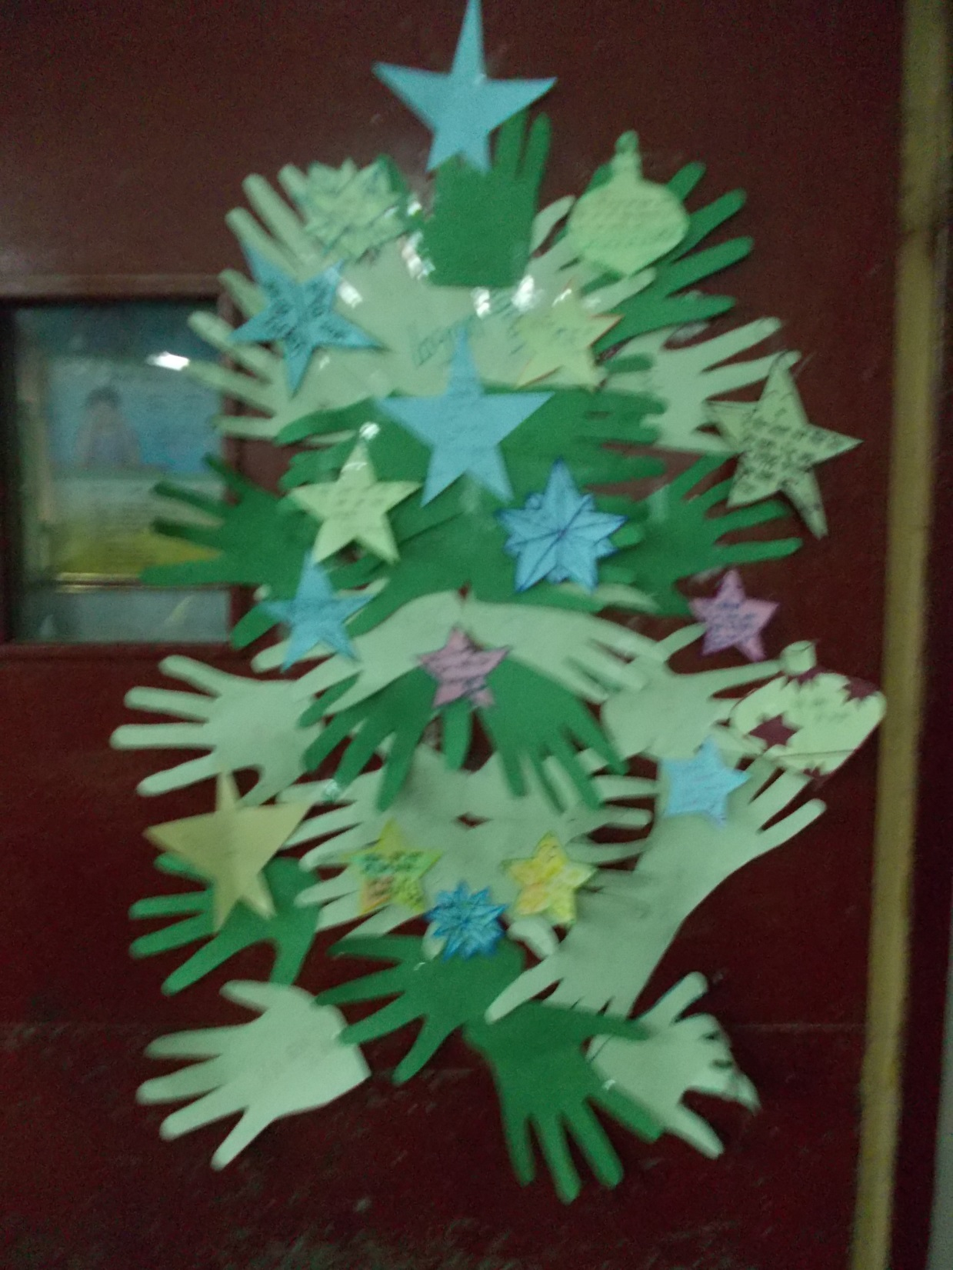

Slide 40
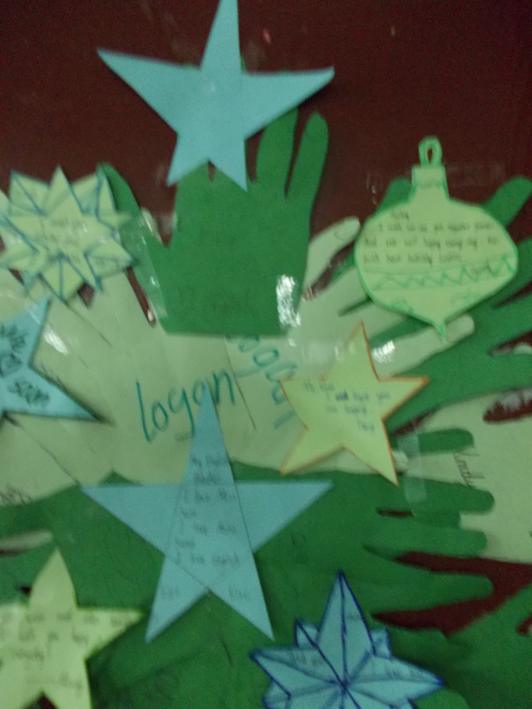

Slide 41
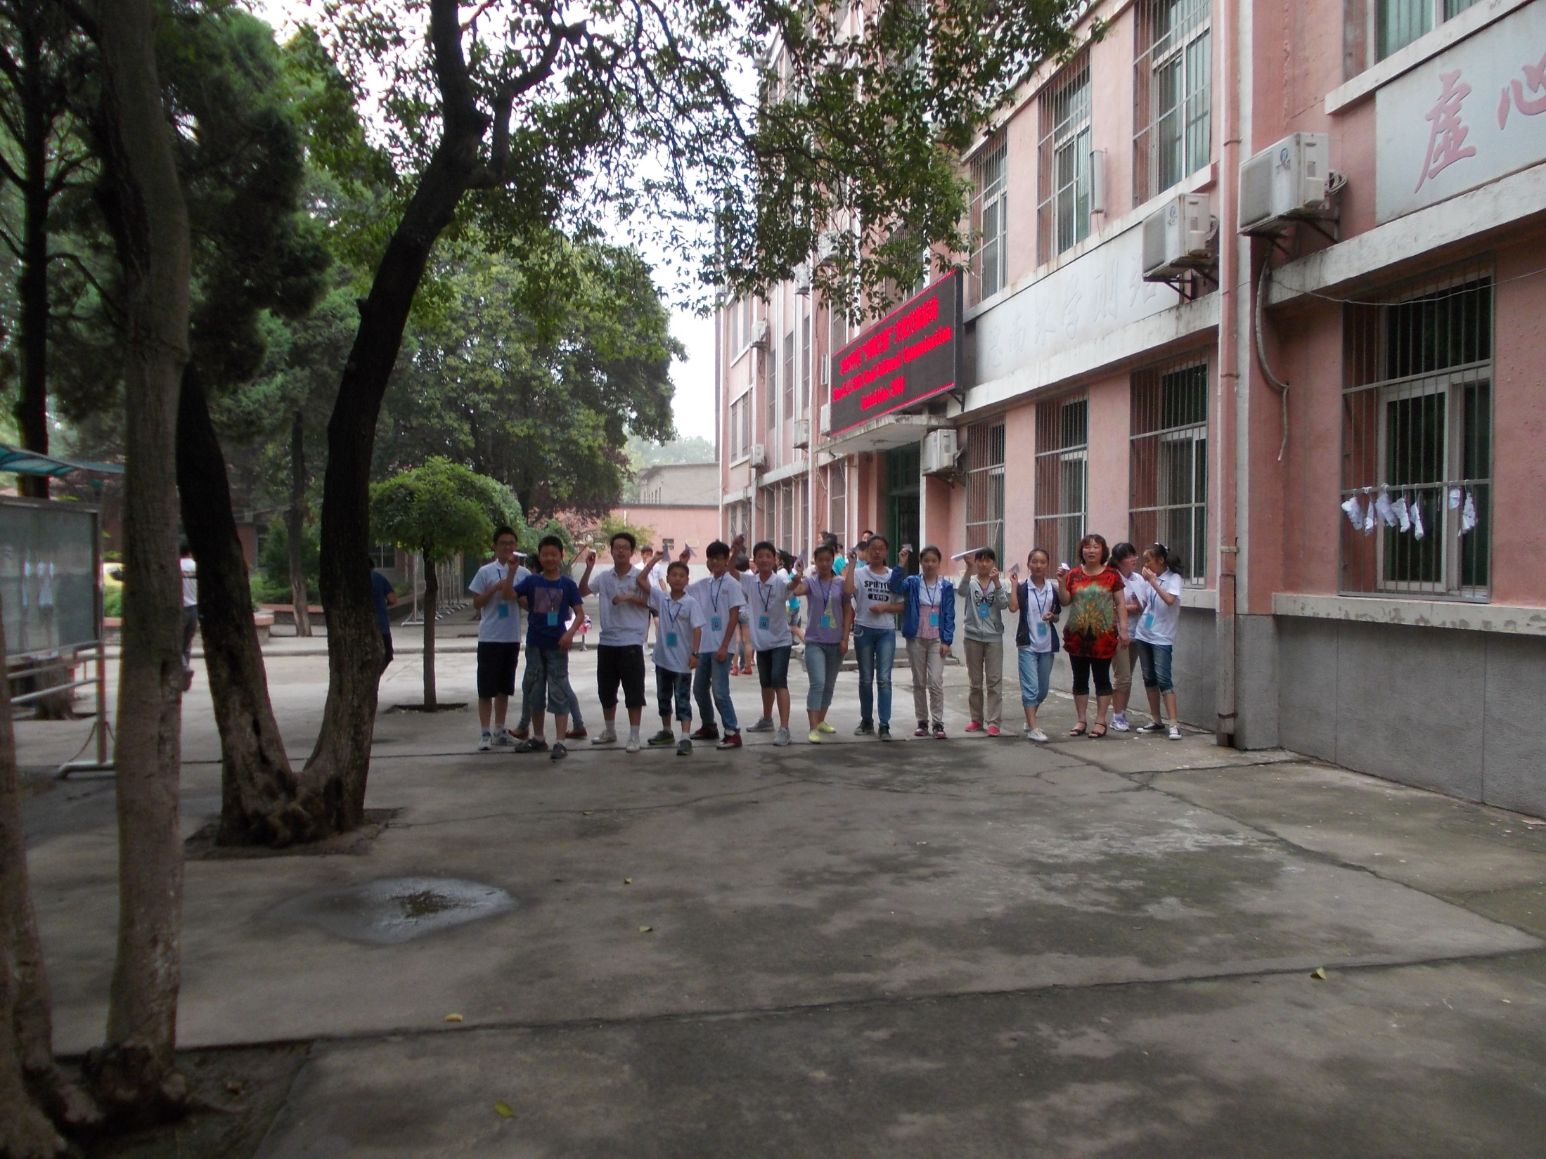
Paper Airplane Race

Slide 42
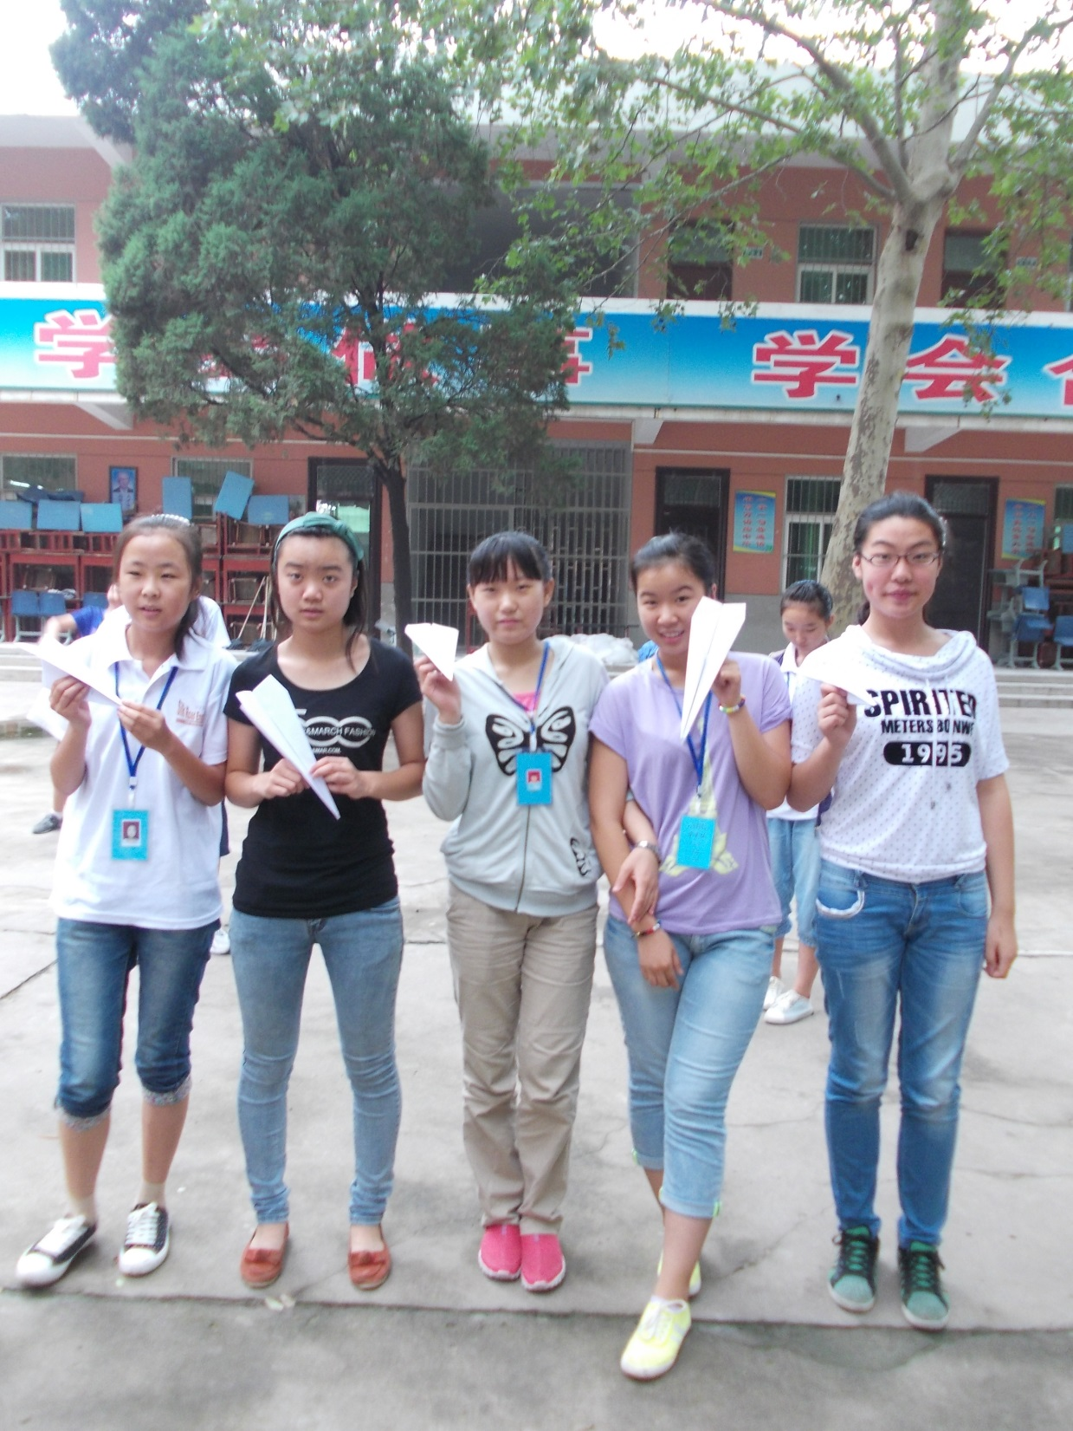

Slide 43
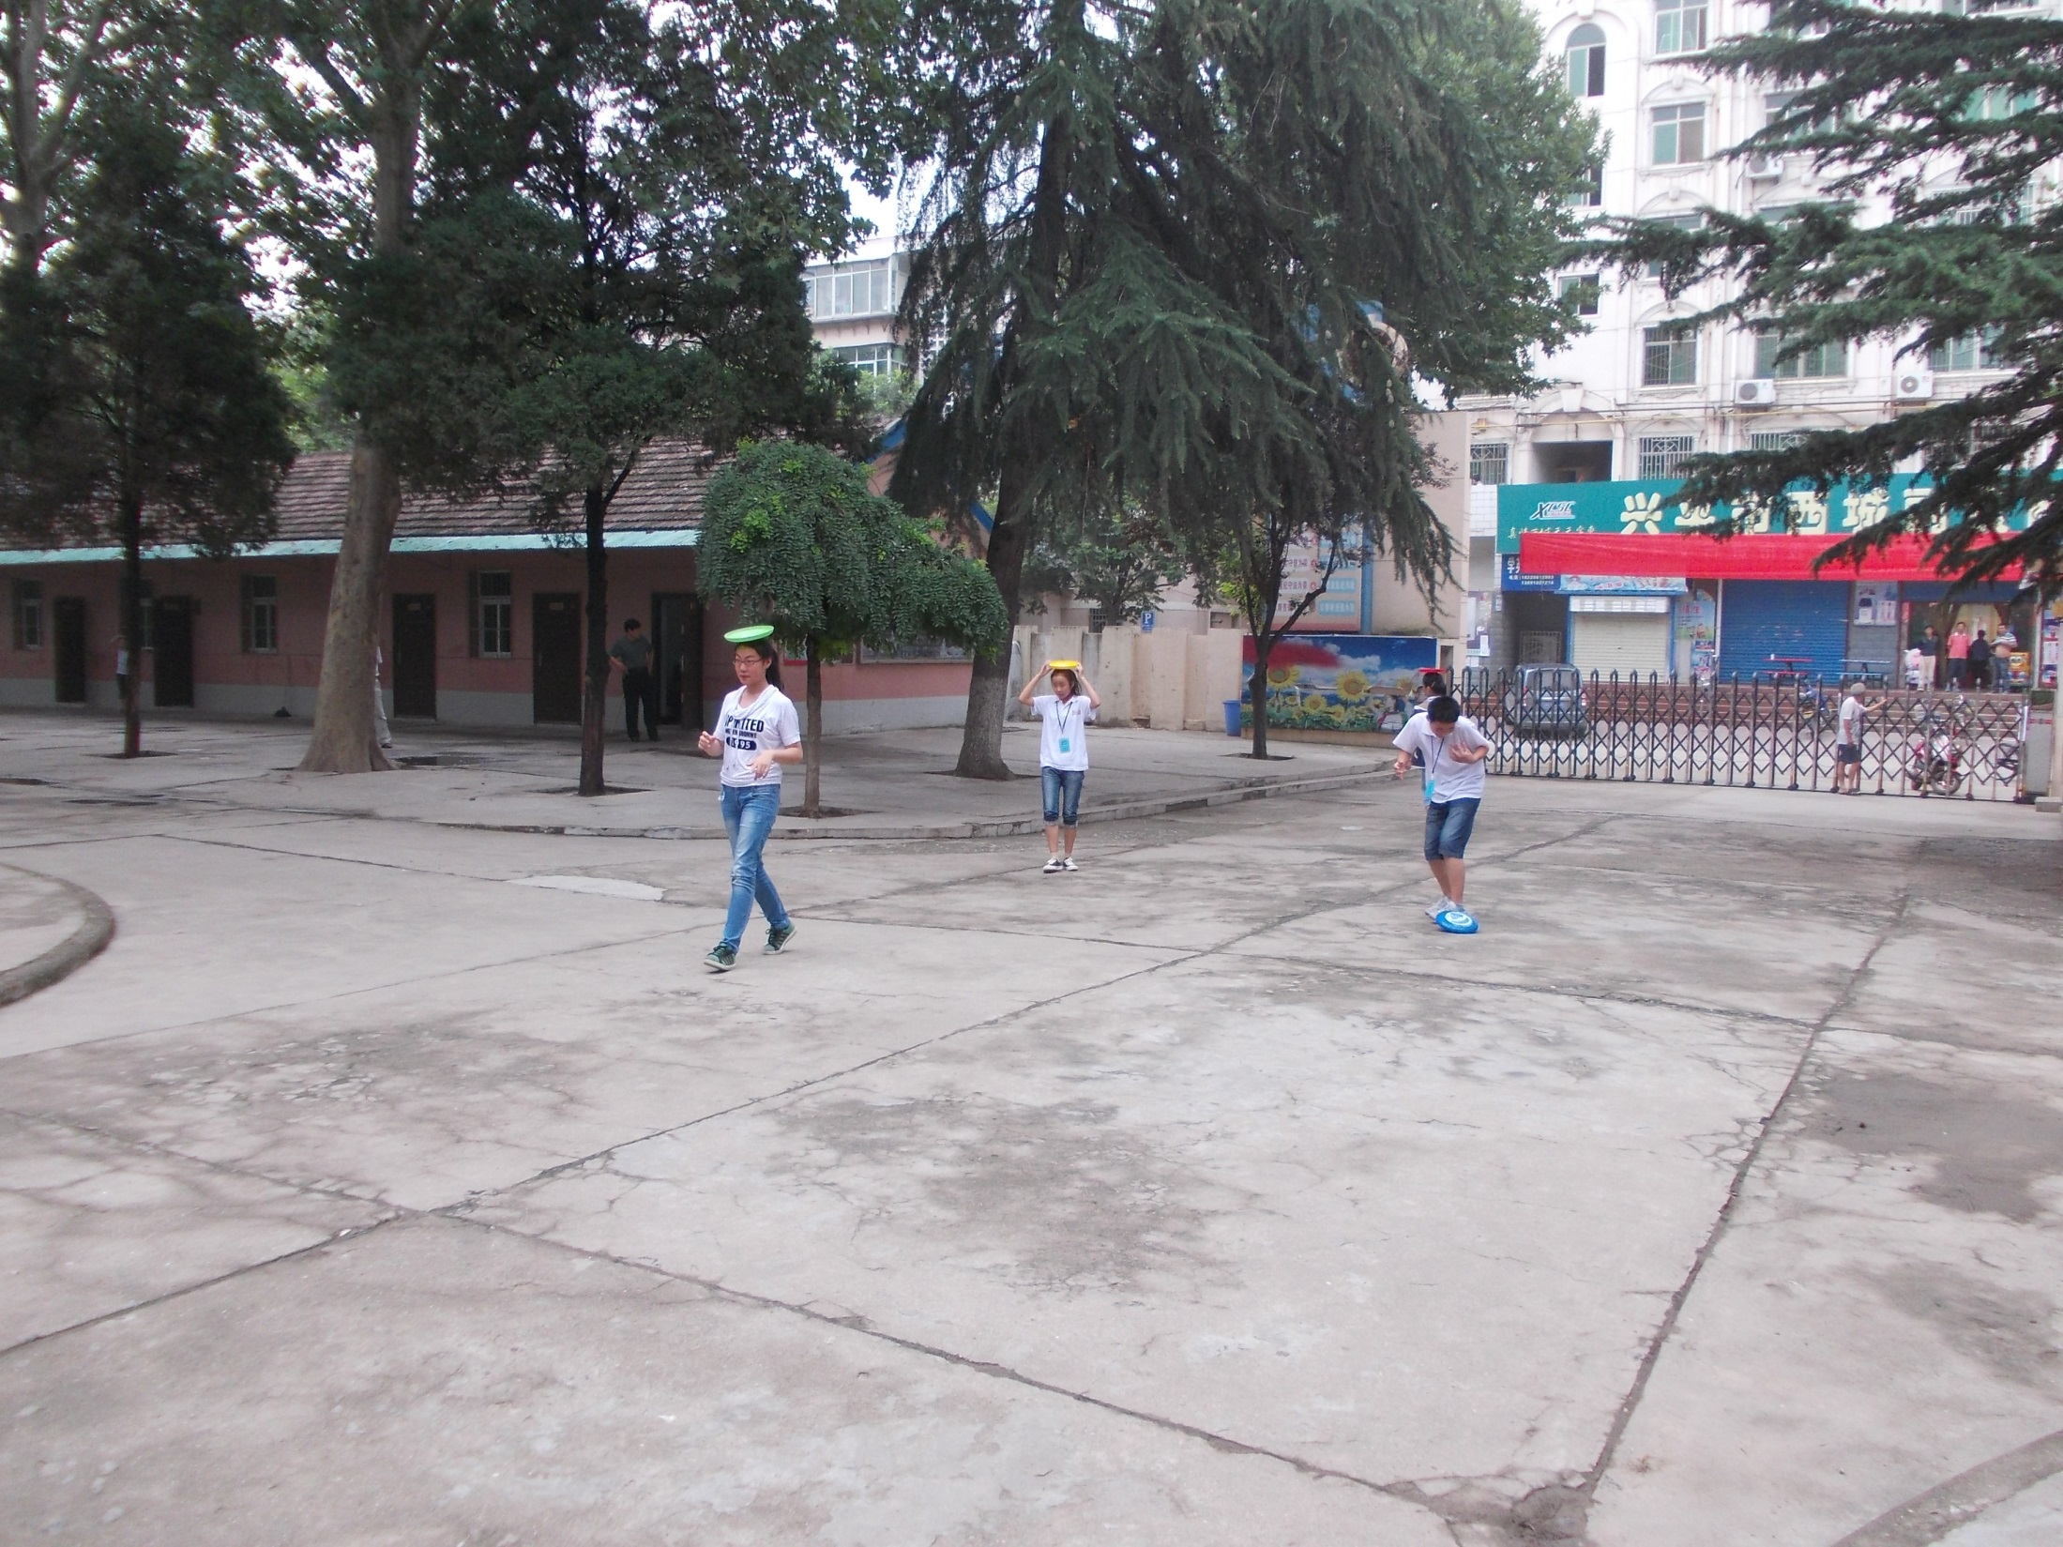
RELAY
RACES

Slide 44
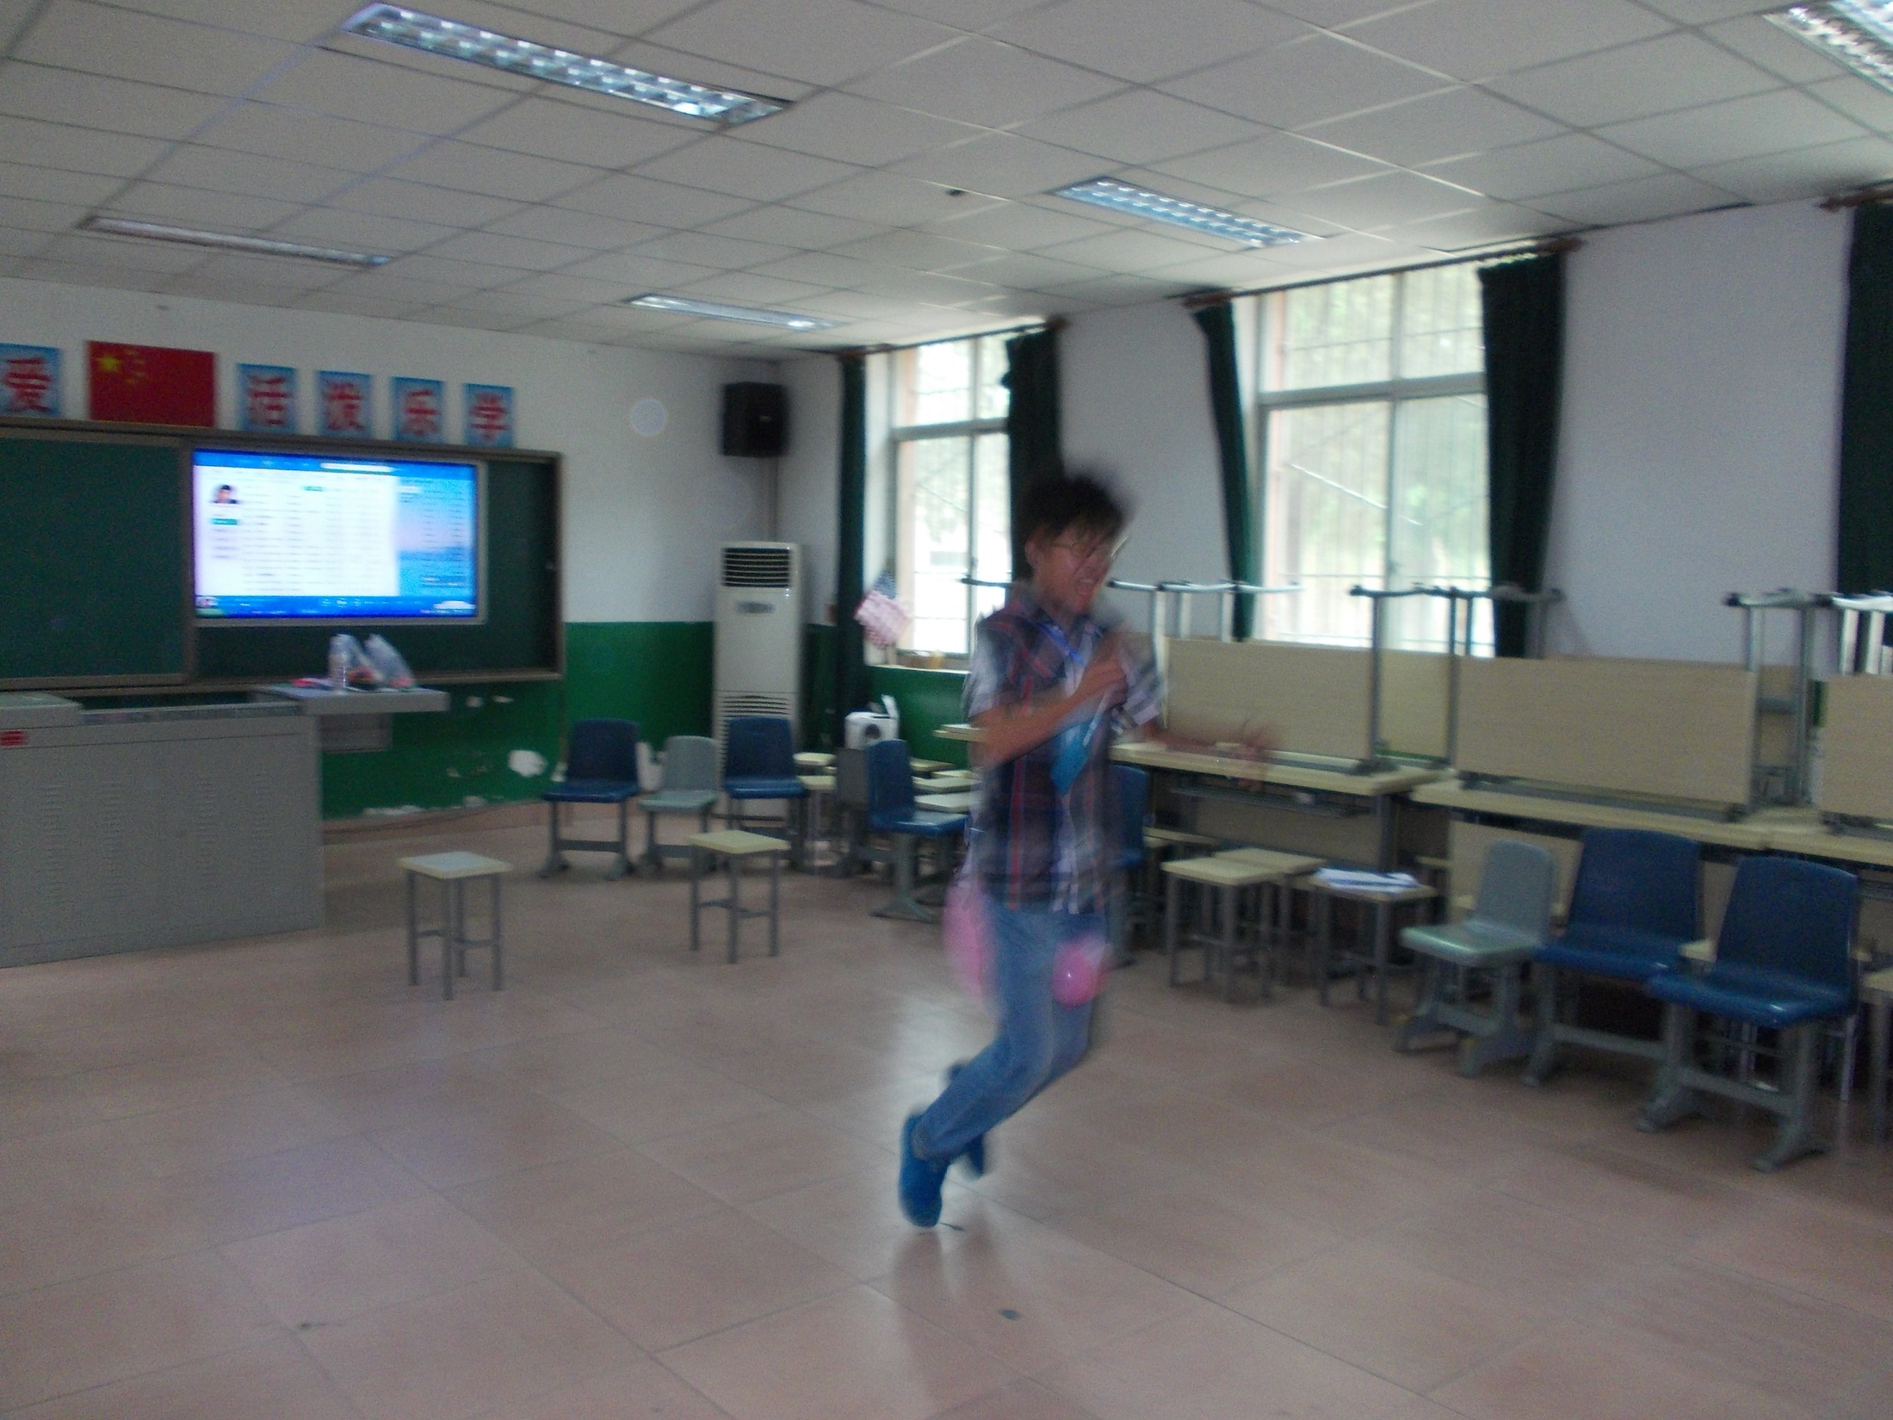

Slide 45
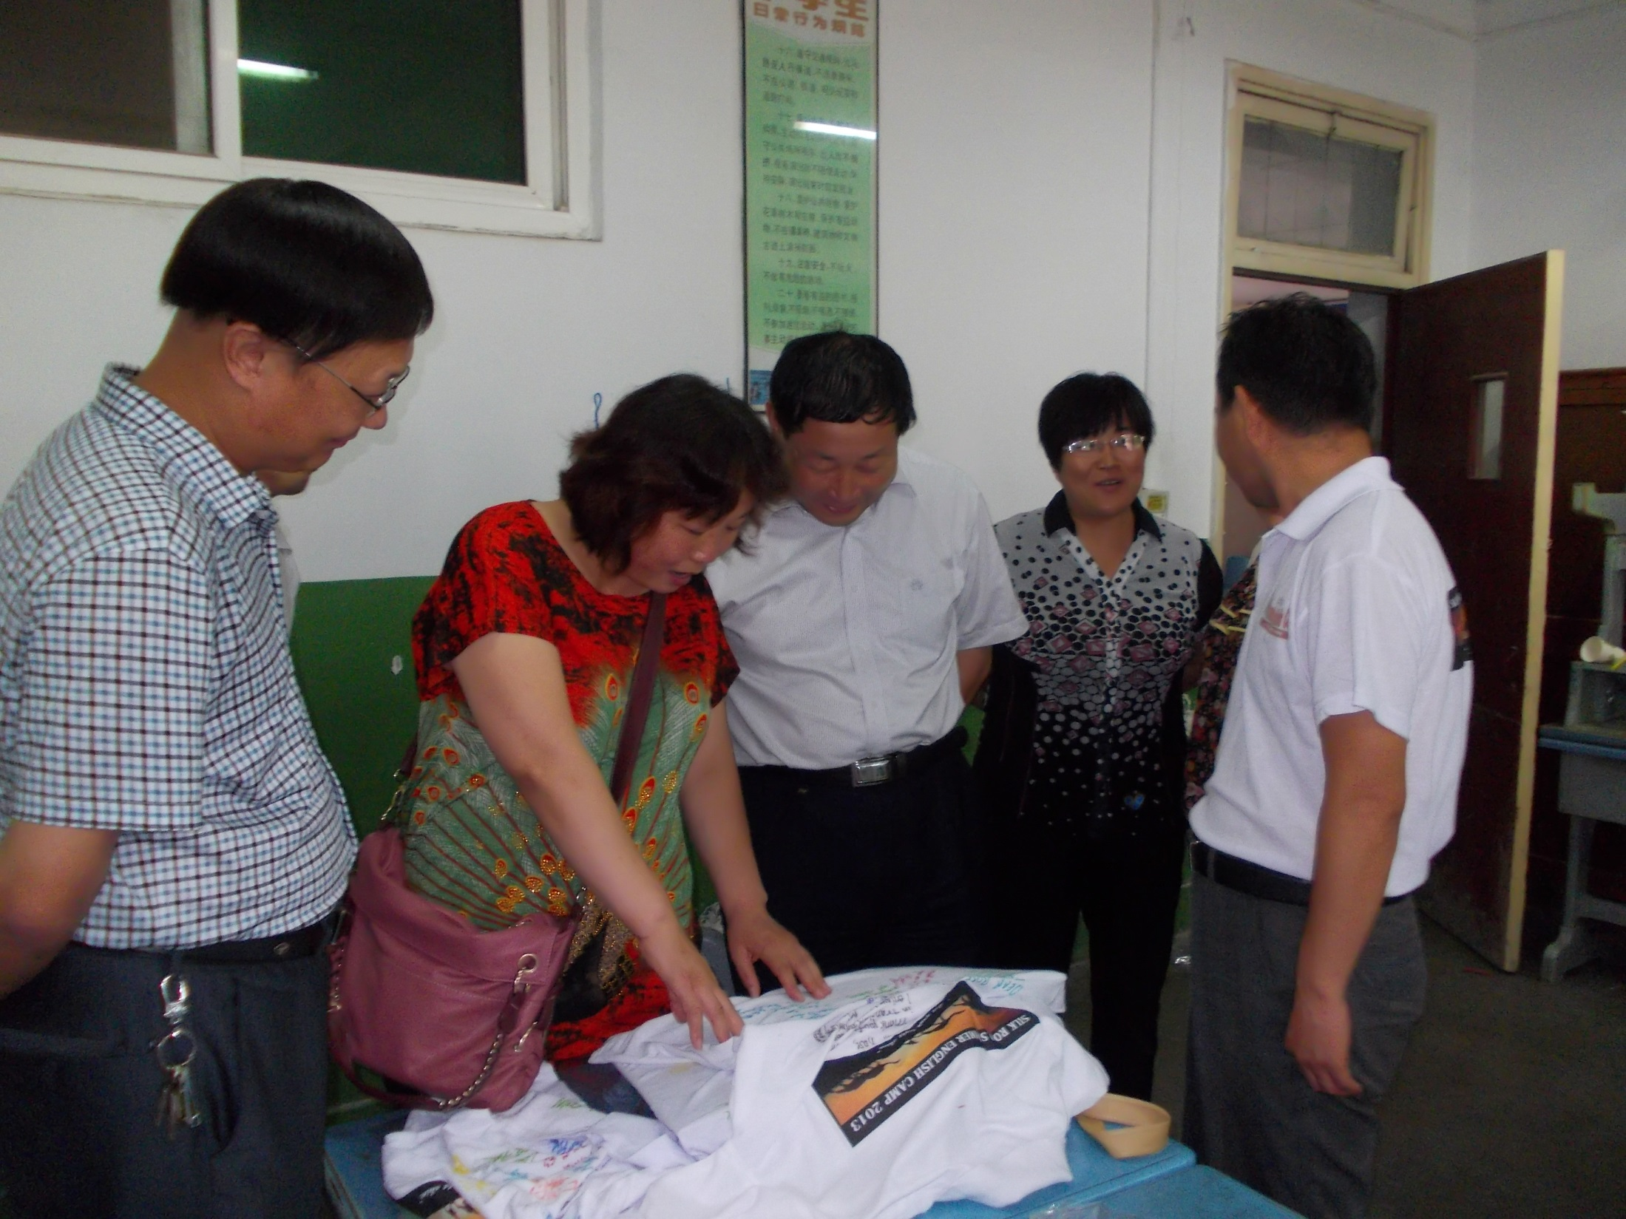
Shirt
Signing
Party

Slide 46
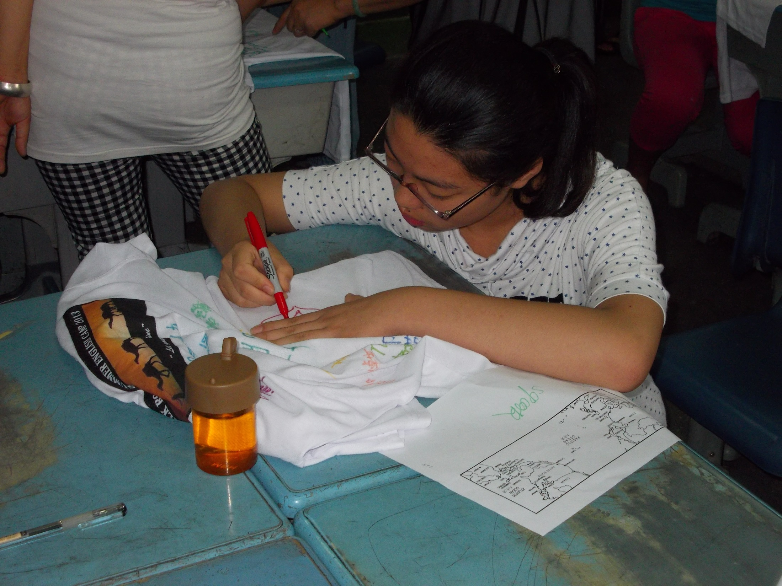

Slide 47
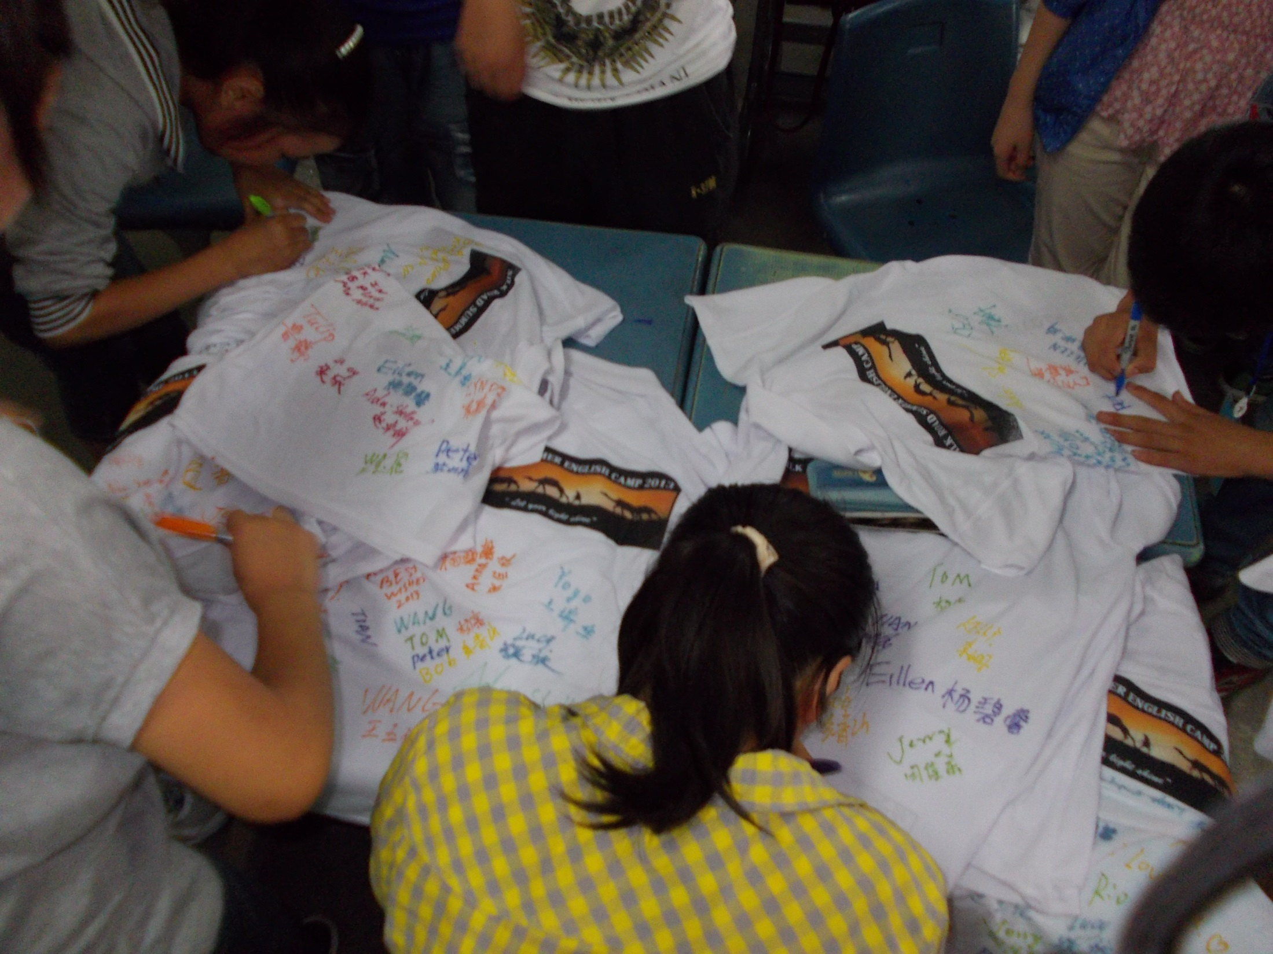

Slide 48
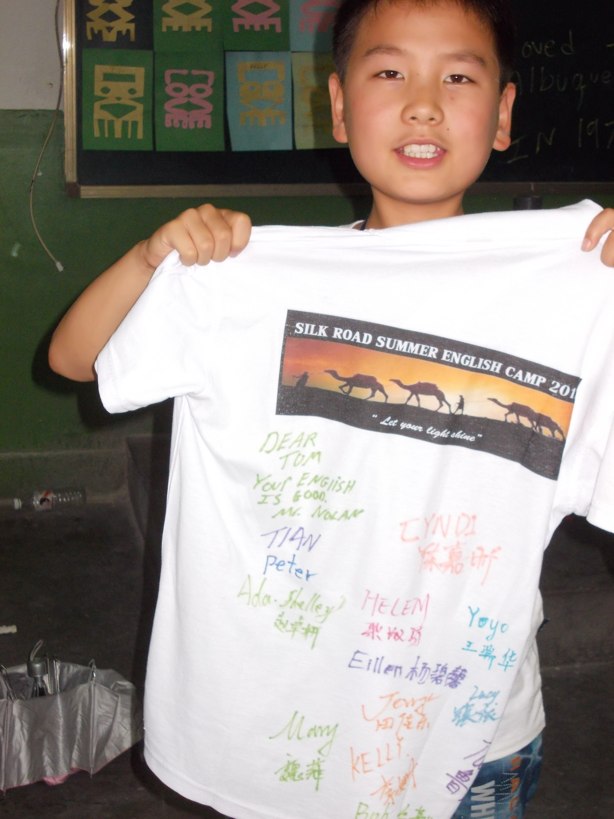

Slide 49
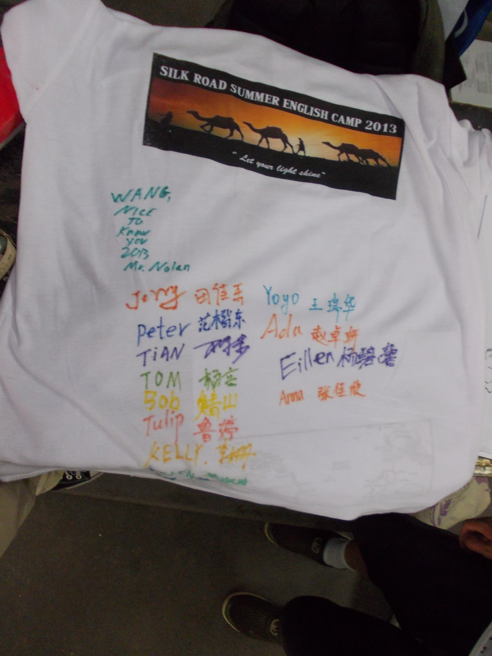

Slide 50
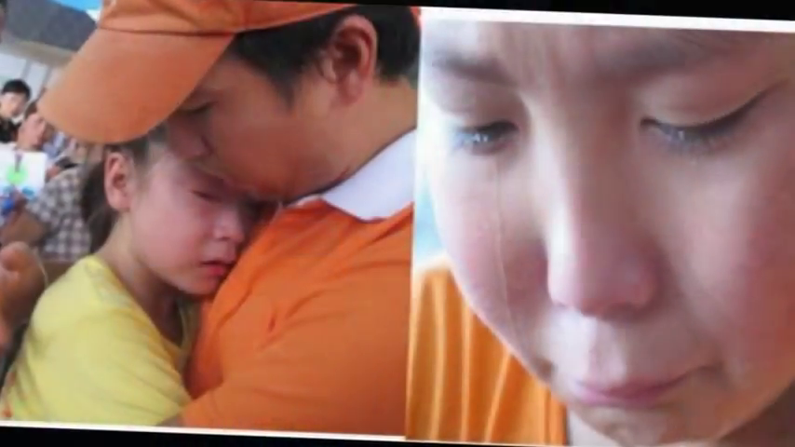
Saying “GOOD-BYE”!
How lives were changed –
Theirs and ours

Slide 52
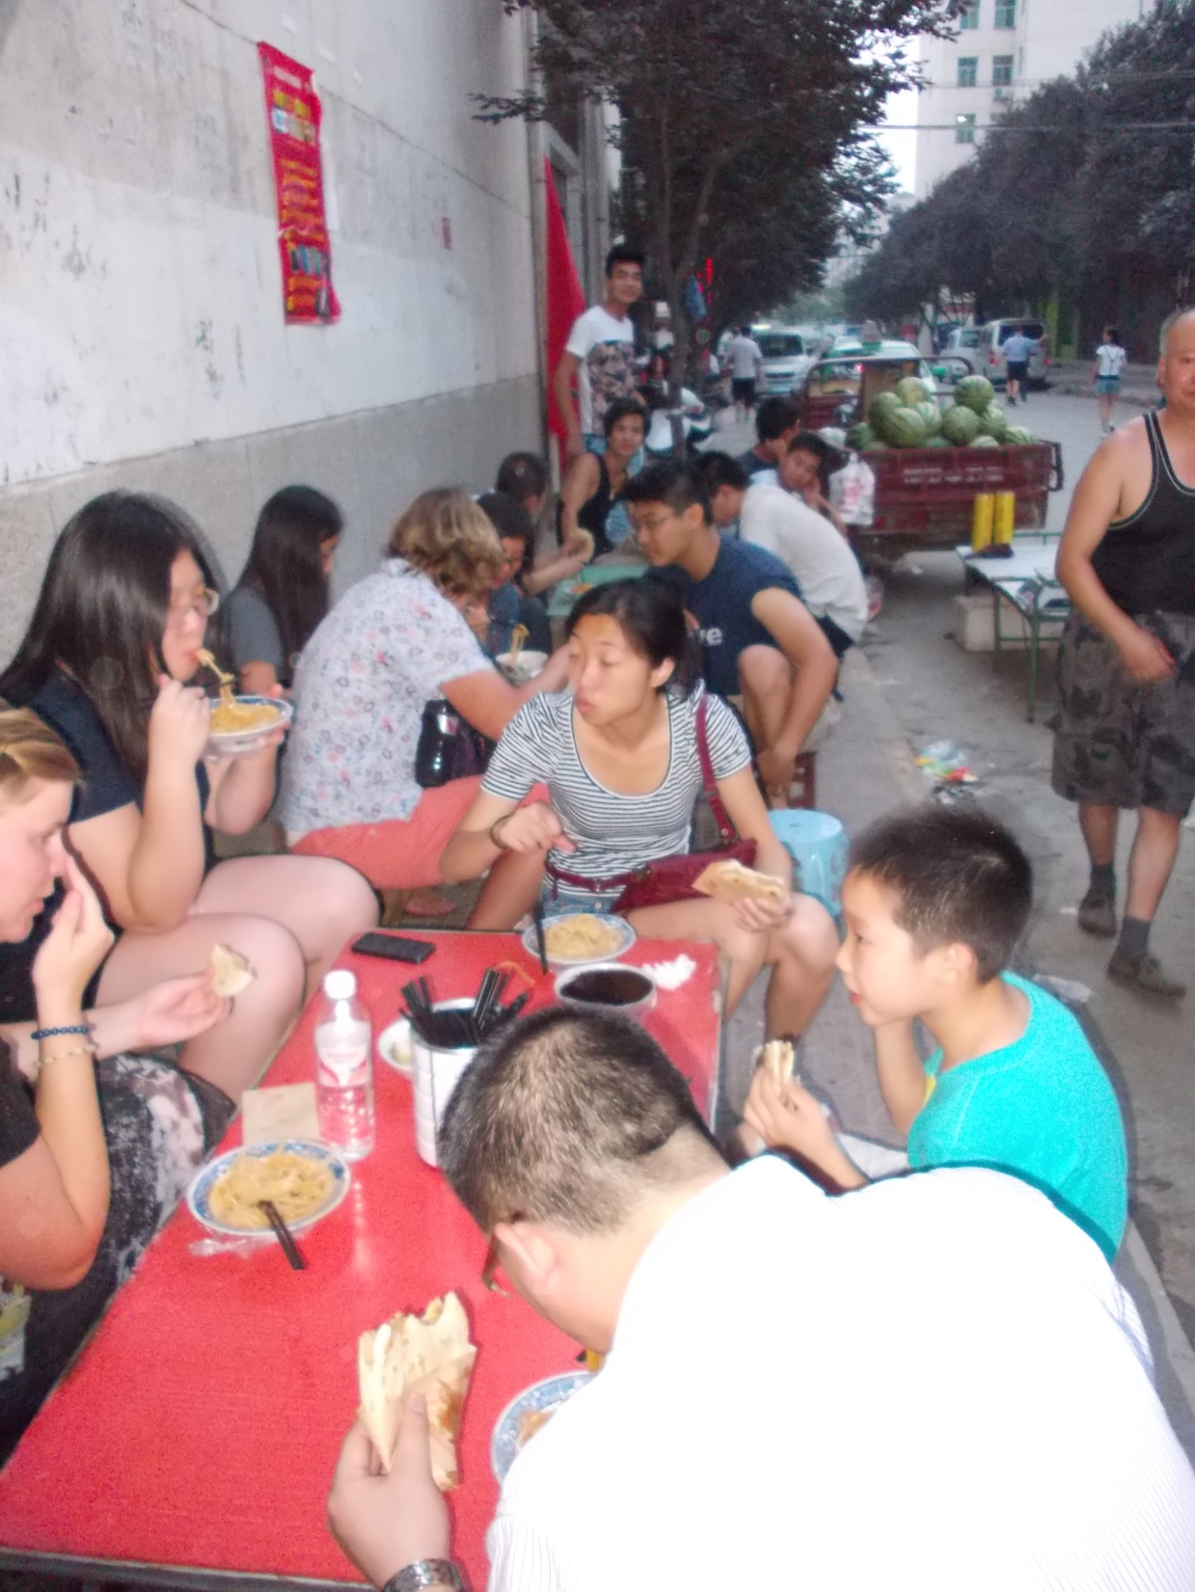
Eating a meal of COLD NOODLES
on the street

Slide 53
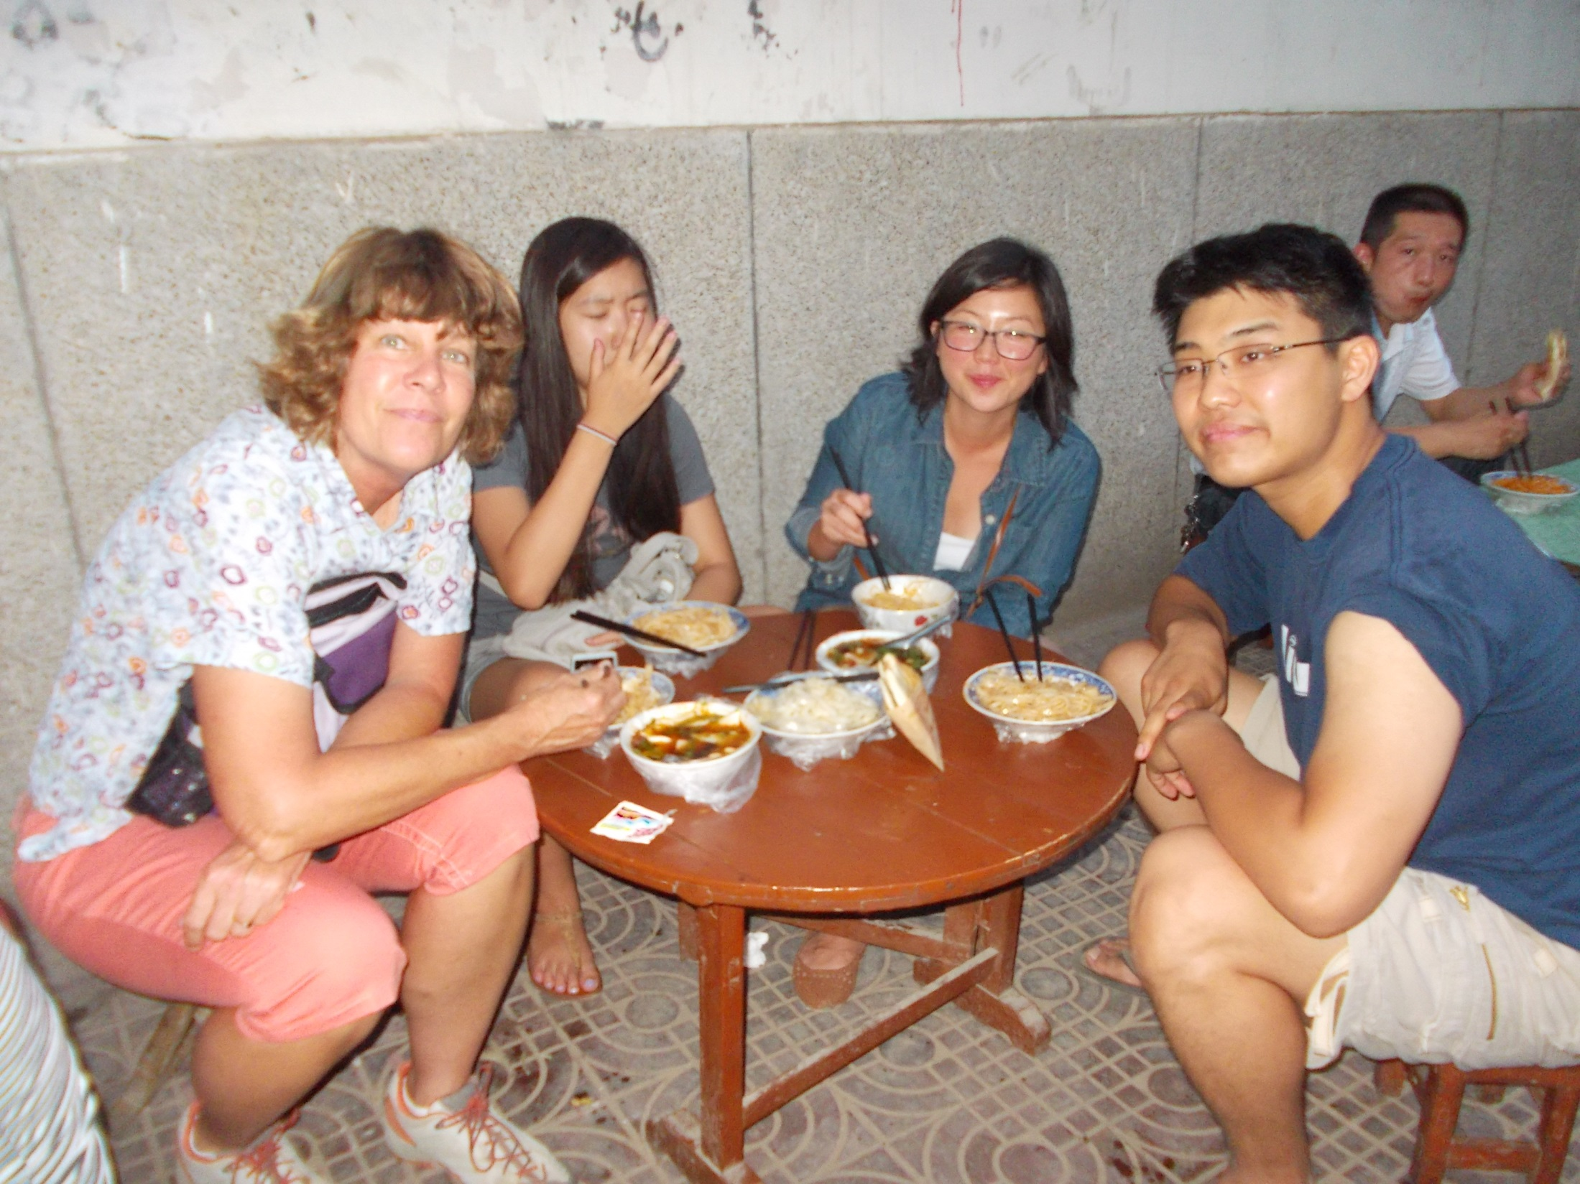
Kate, Nancy, JoJo and Bryan

Slide 54
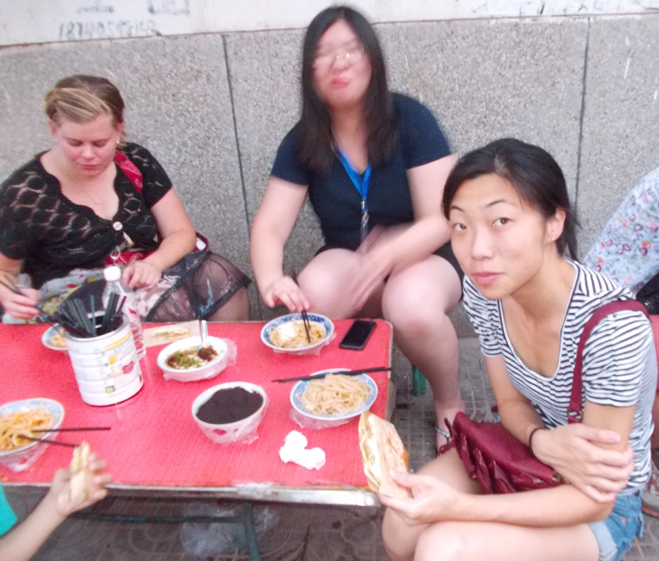
Sam, Susan and Arianne

Slide 55
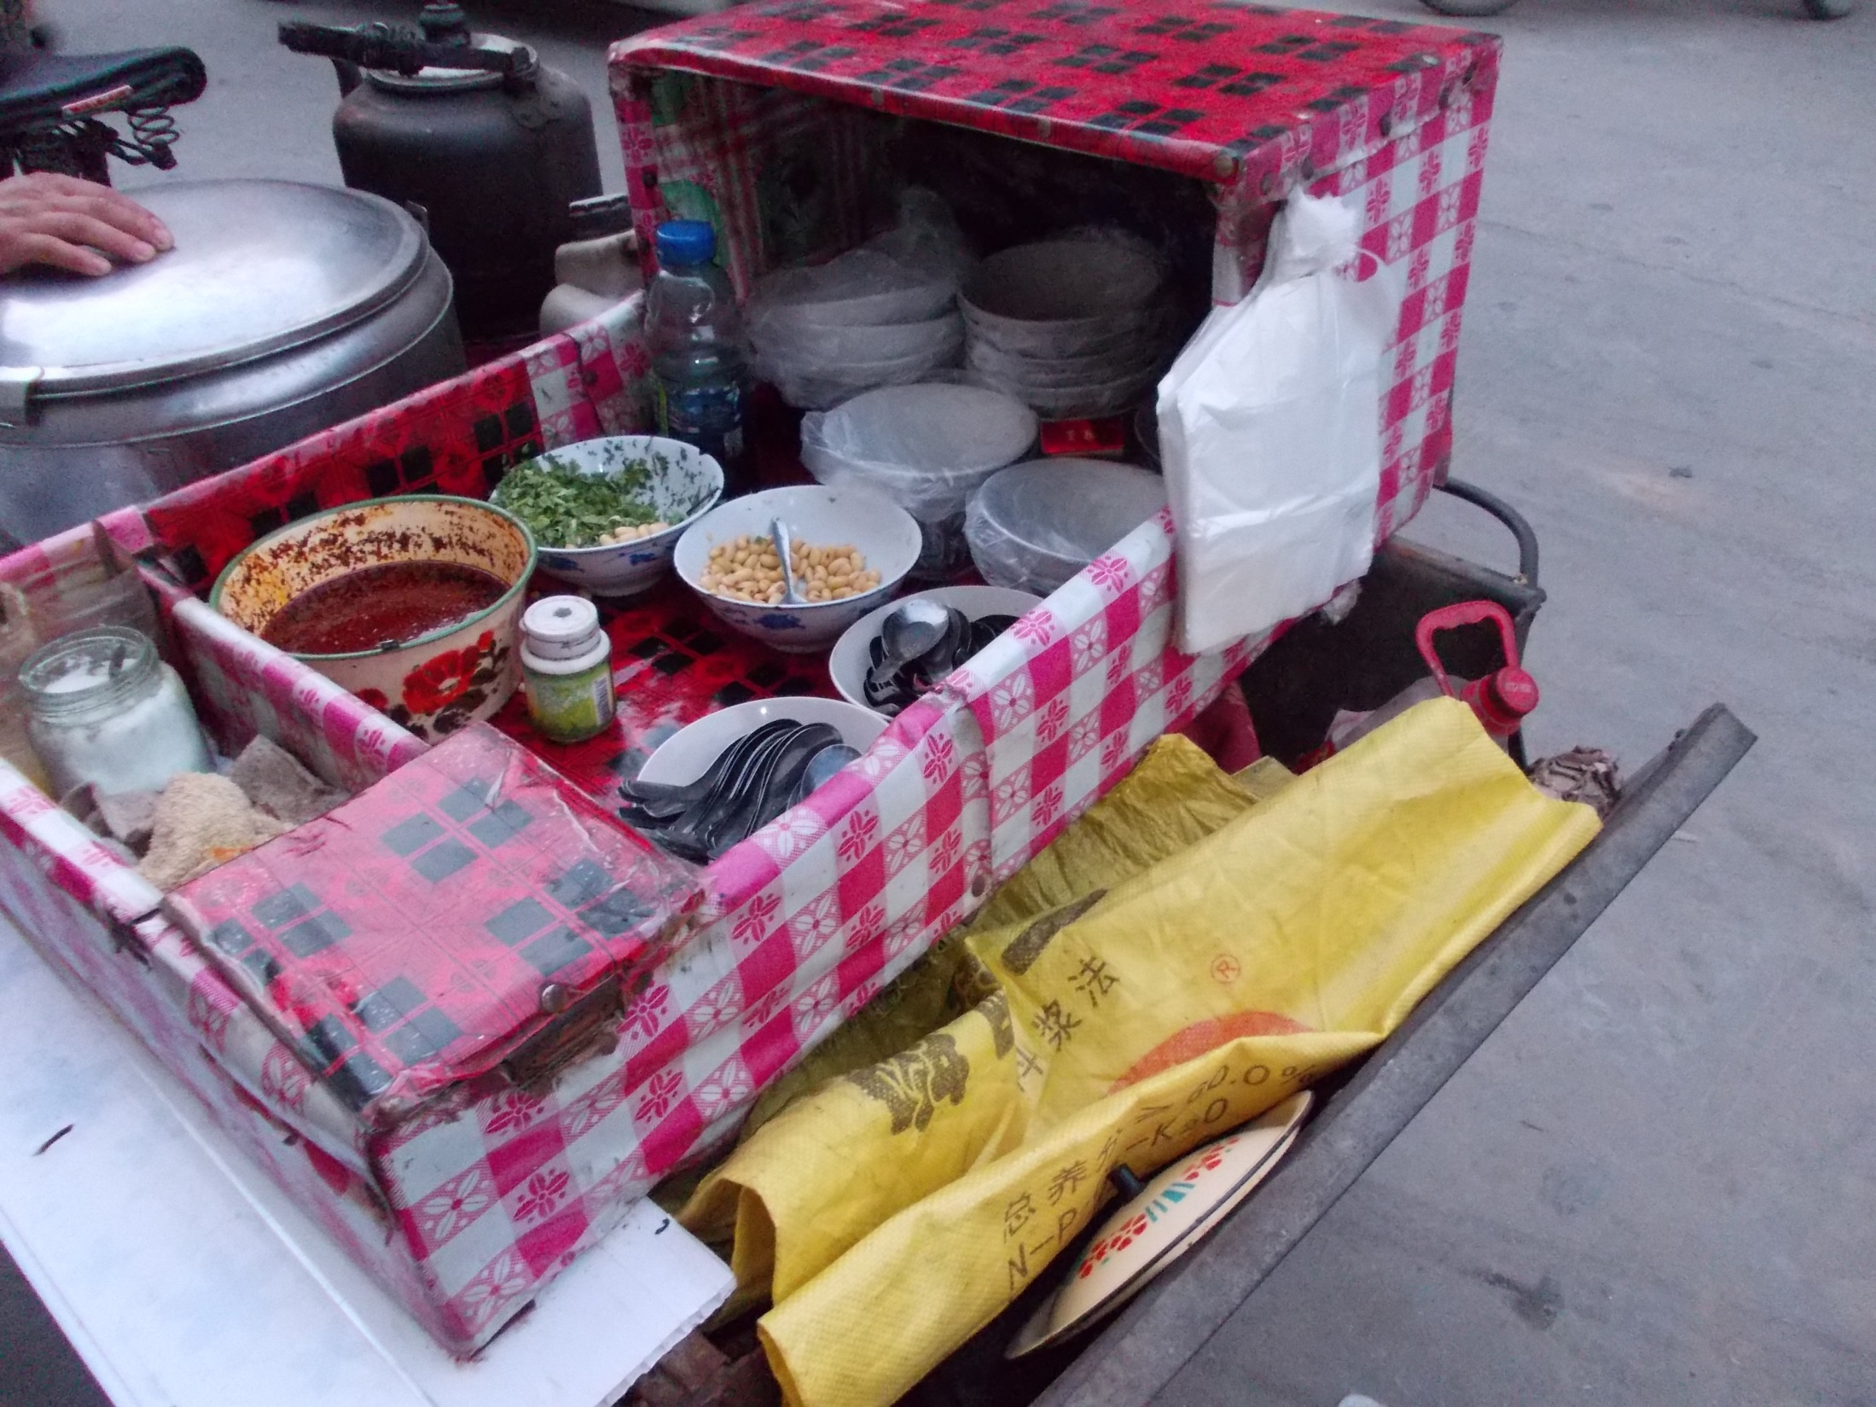

Slide 56
Walking along the street back to the hotel.
Walls, Bars, Fences

Slide 60
High School Administration Building

Slide 63
School Cafeteria.
5,000+ students
live at the school

Slide 65
US / SINO basketball game with XingPing Fire Department.
(Bryan and Rio)
We also played badminton.

Slide 67
FRIENDSHIP
BRACELETS

Slide 68
Nolan and Mr. Tian,
our #1 Security officer and car driver.

Slide 69
Nancy, with our Chinese Assistant, MARGARET, and her dad and mom in one of their shoe stores.

Slide 70
Reaching Through Teaching
Building cultural bridges
and changing lives.
Silk Road Camp
NOLAN@TEEI.org
Can you go?
Can you help financially?
Can you share the vision and tell others?

