Slide 2
In partnership with
TEEI.org

Slide 3
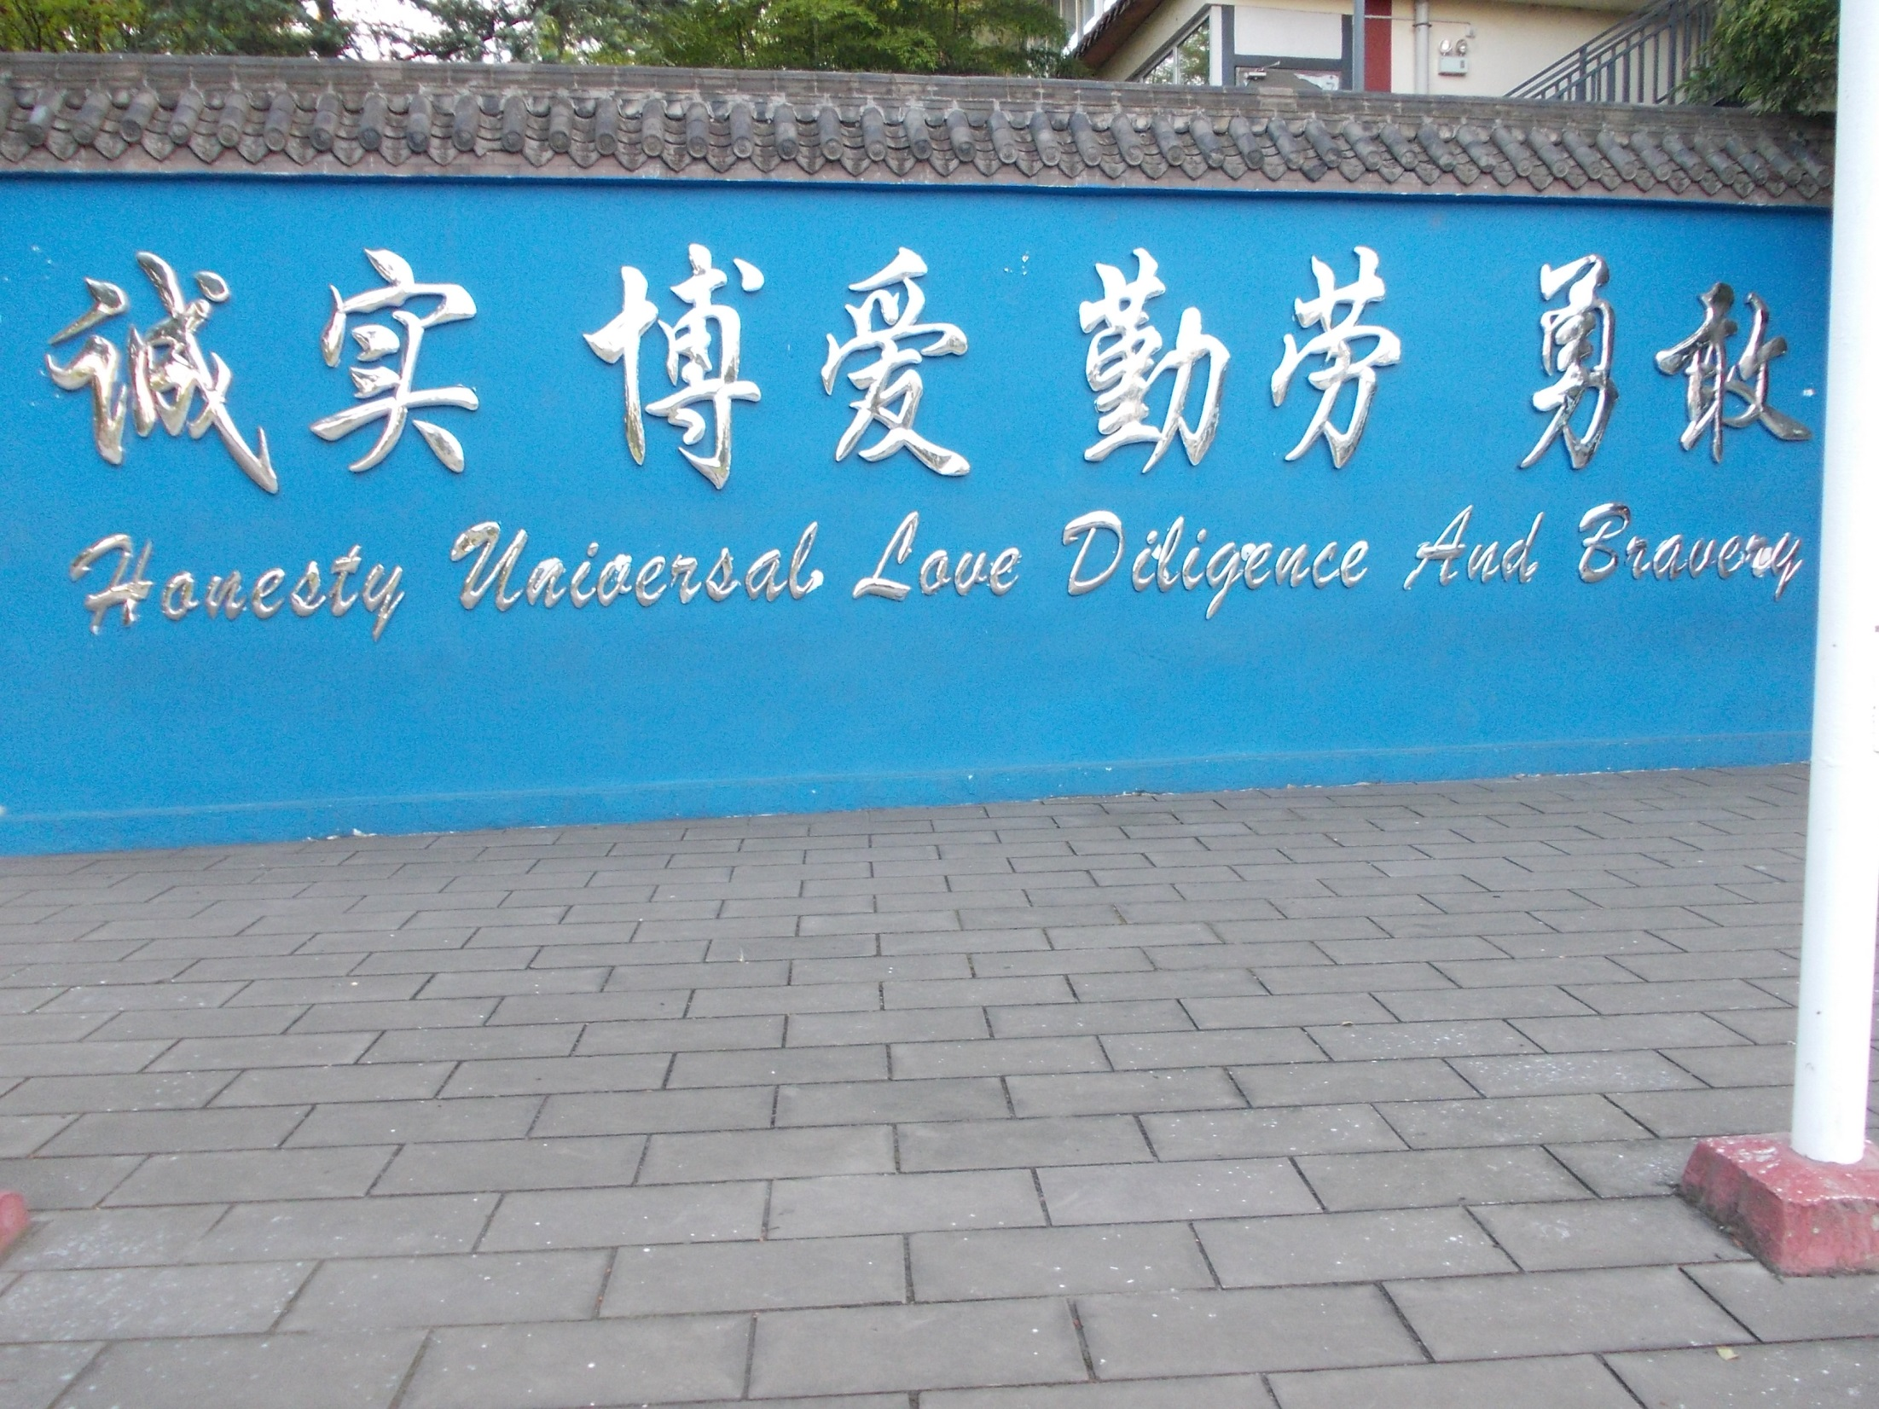
GuangyaSchool.com
Dujiangyan,
Sichuan, China

Slide 4
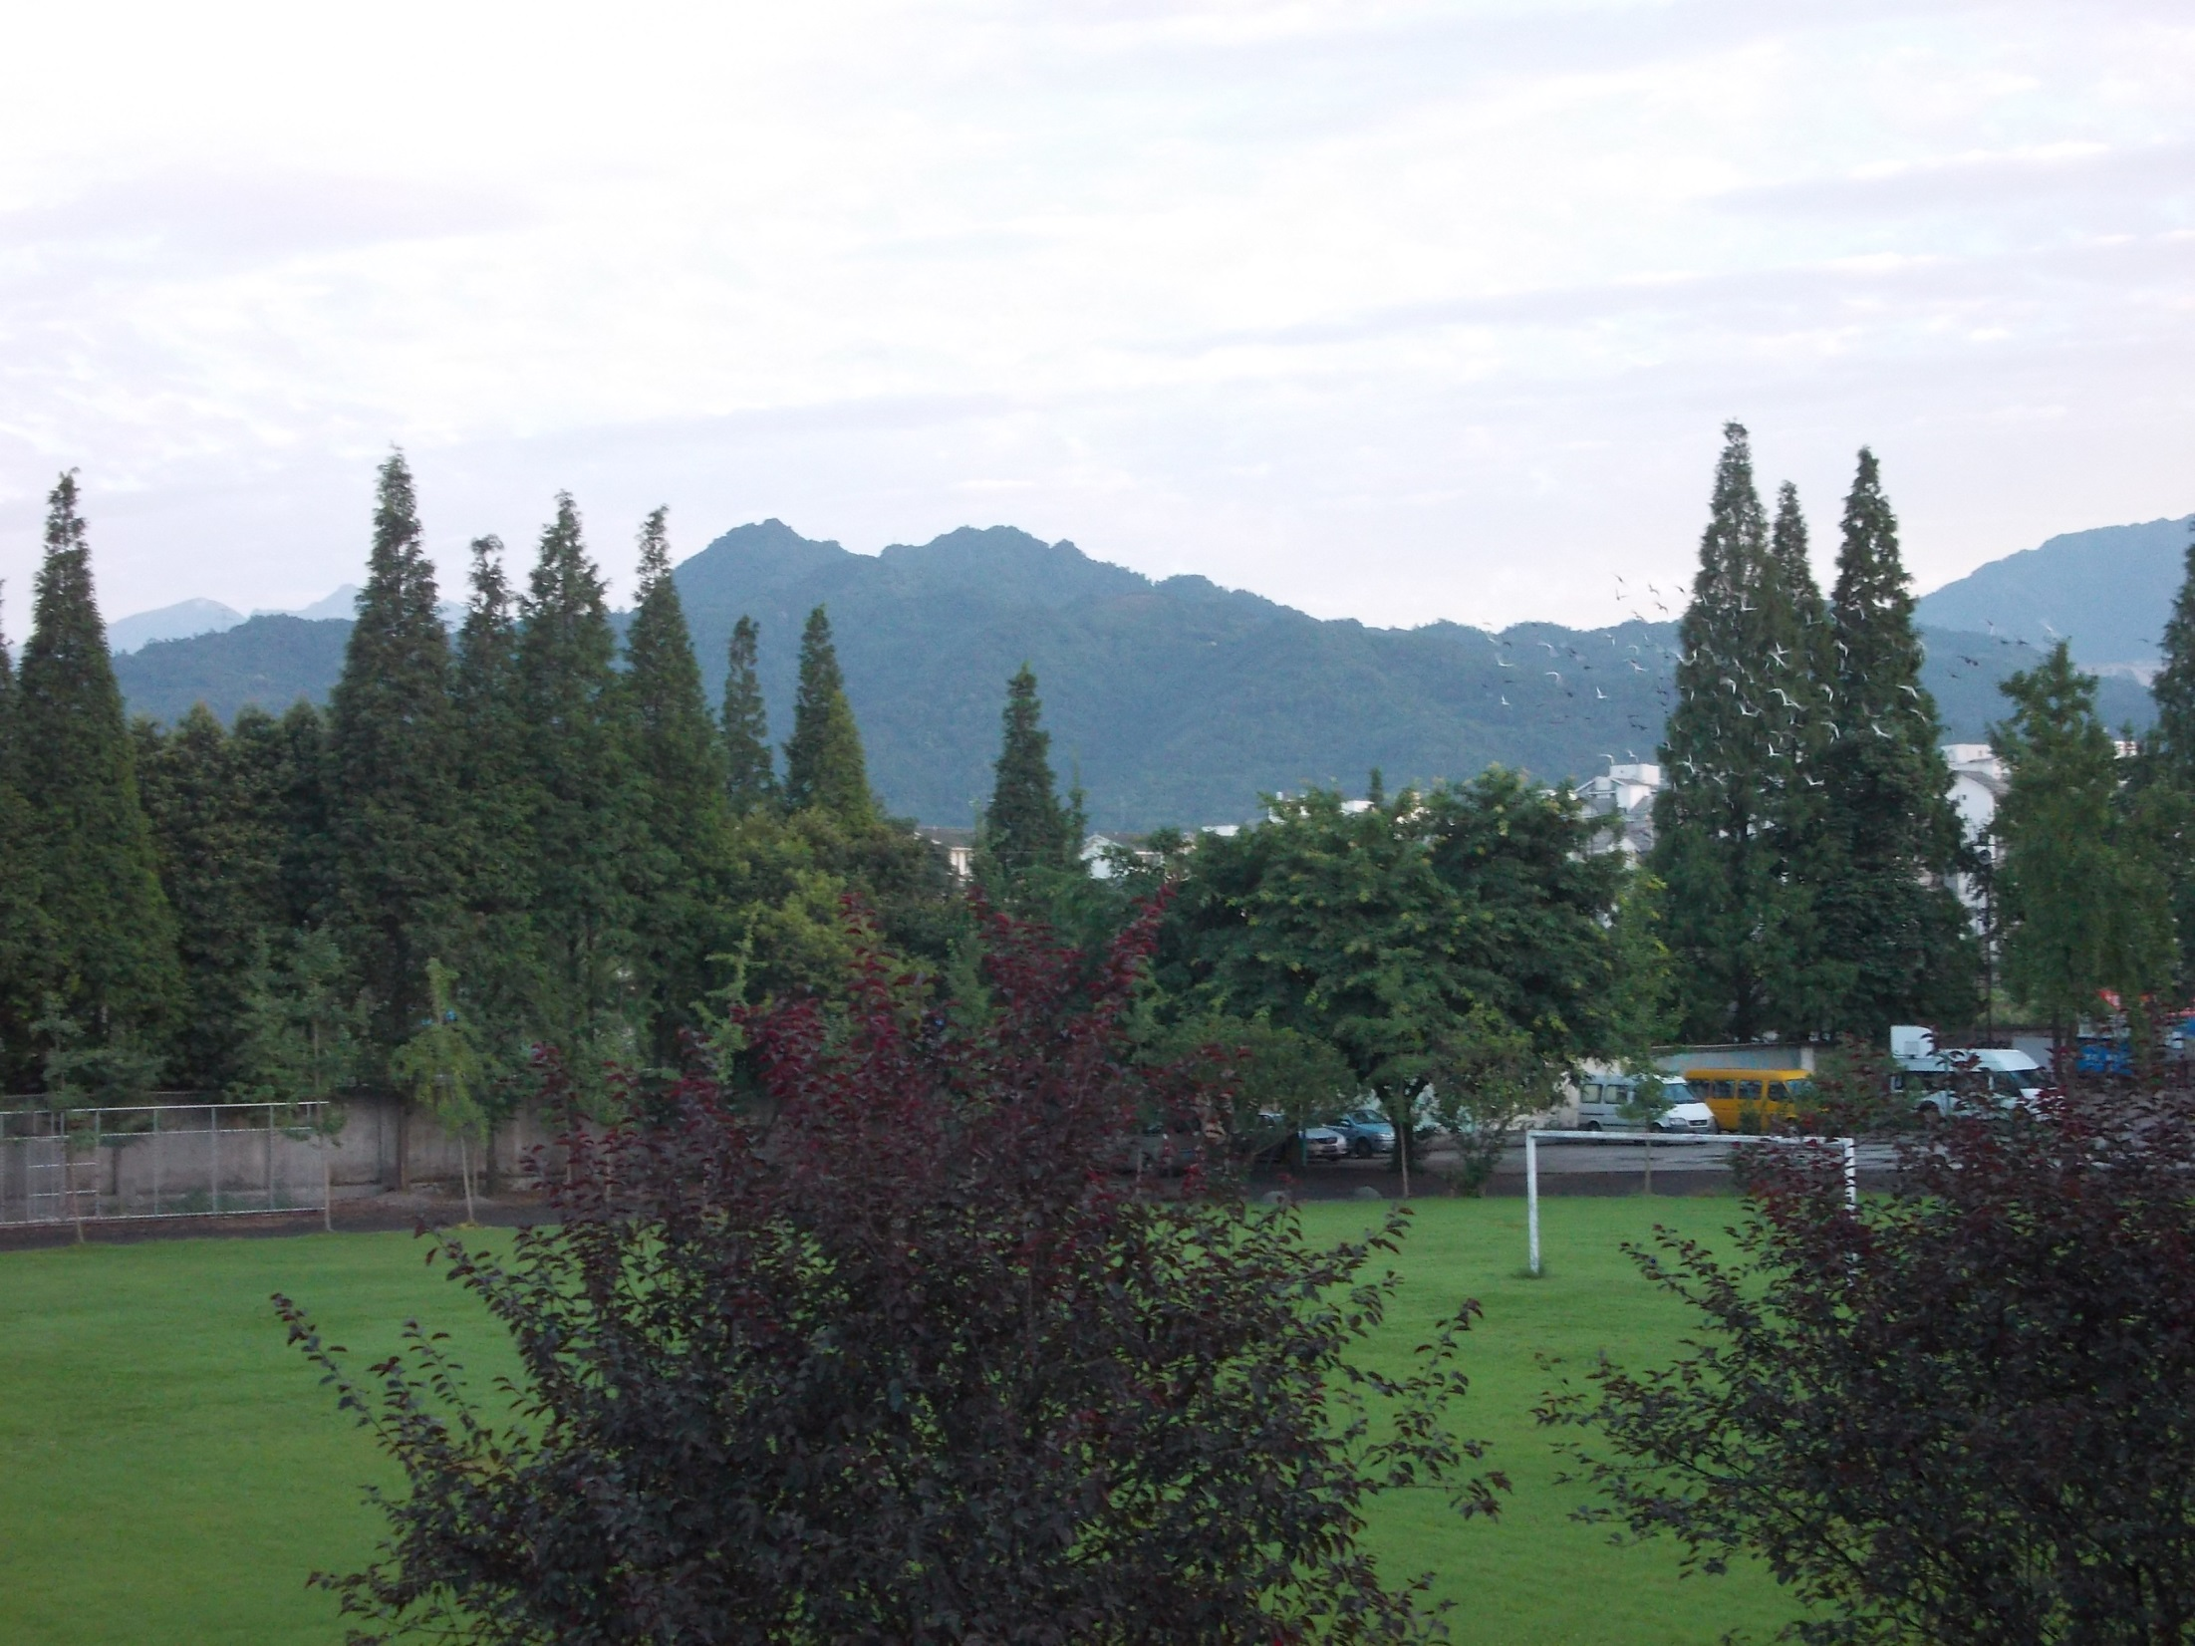
Sunrise at Guangya campus from dorm room

Slide 5
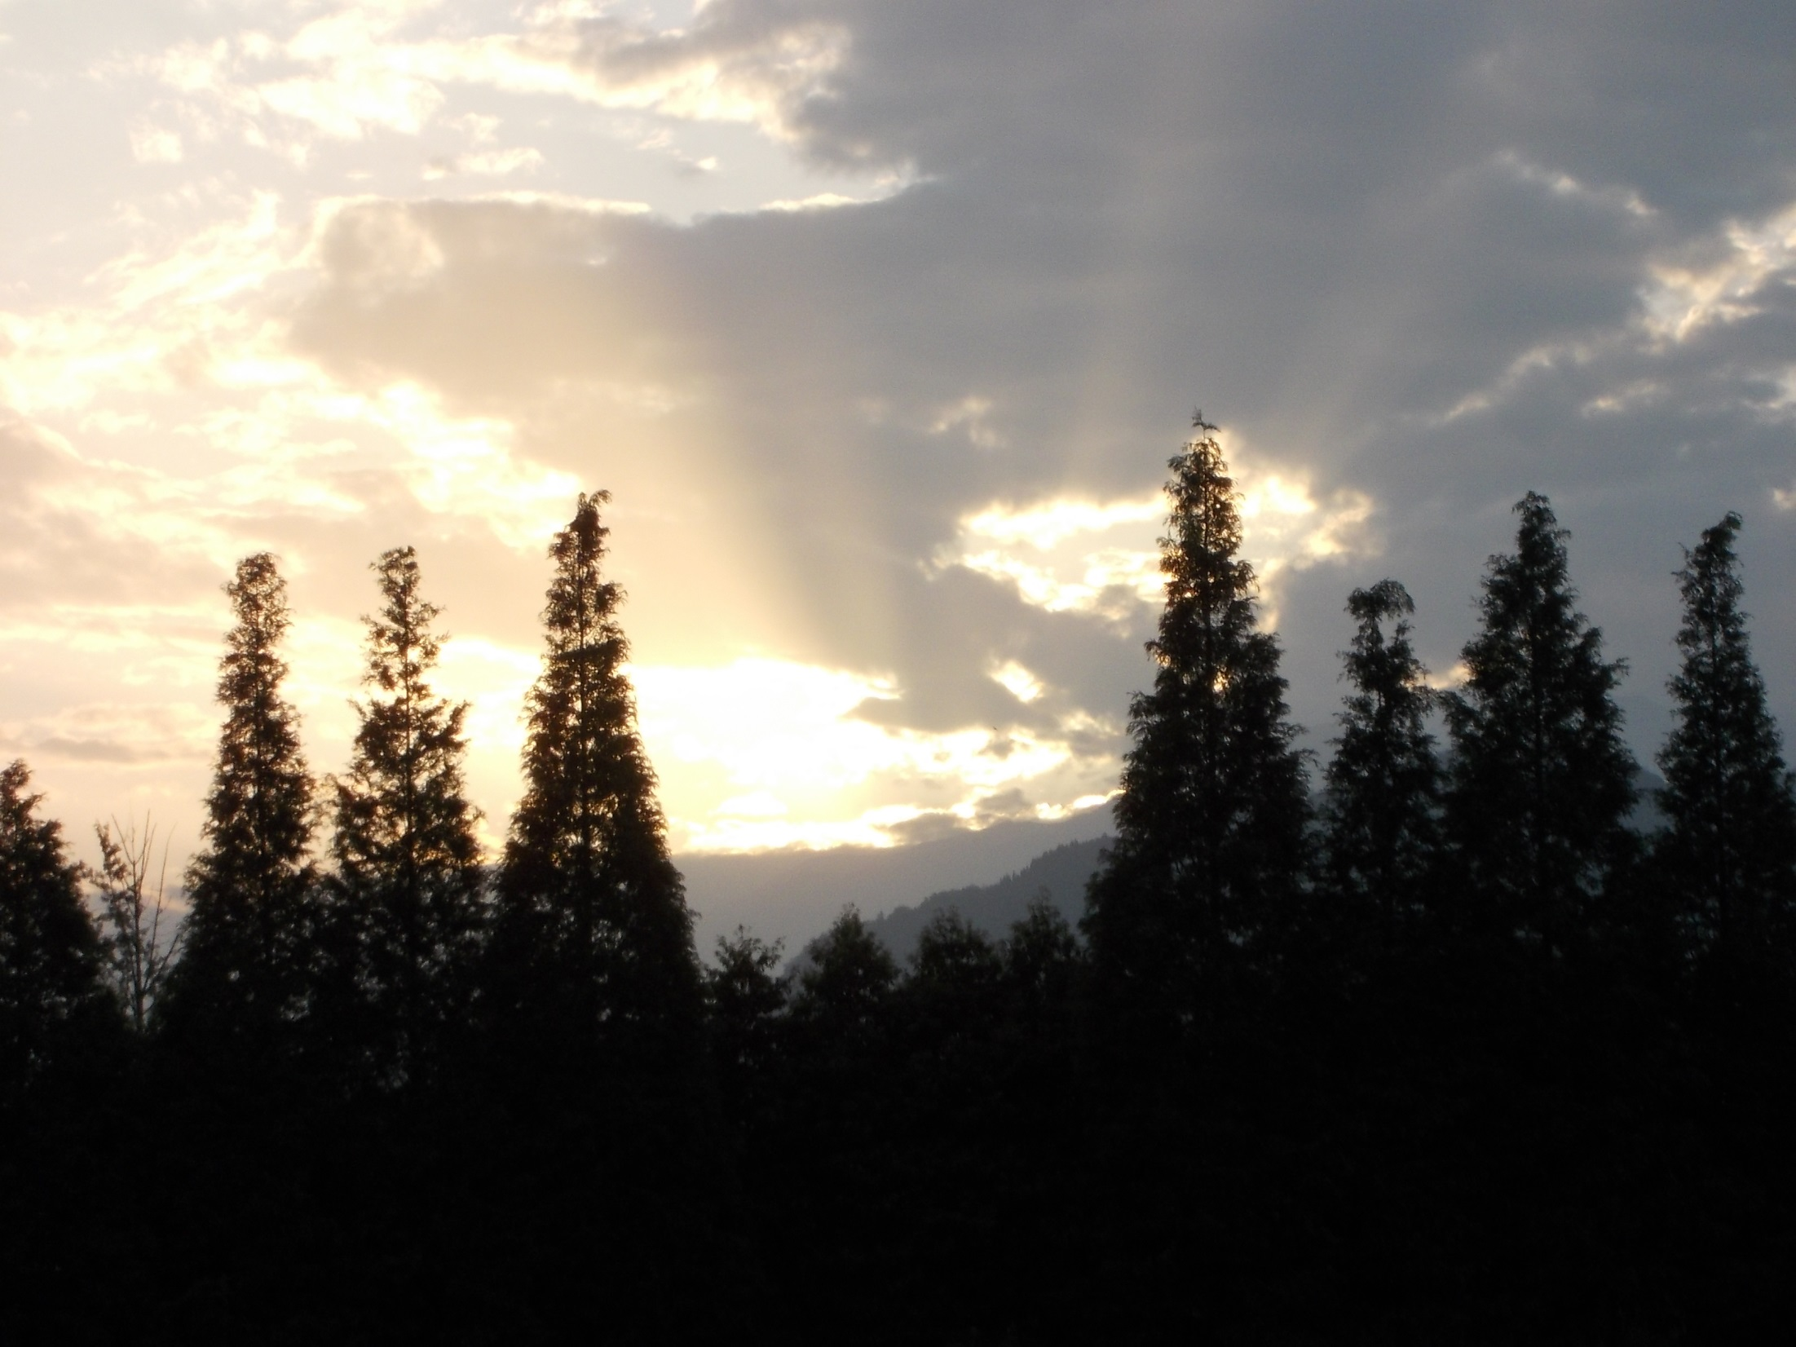
Sunset over mountains at Guangya School

Slide 6
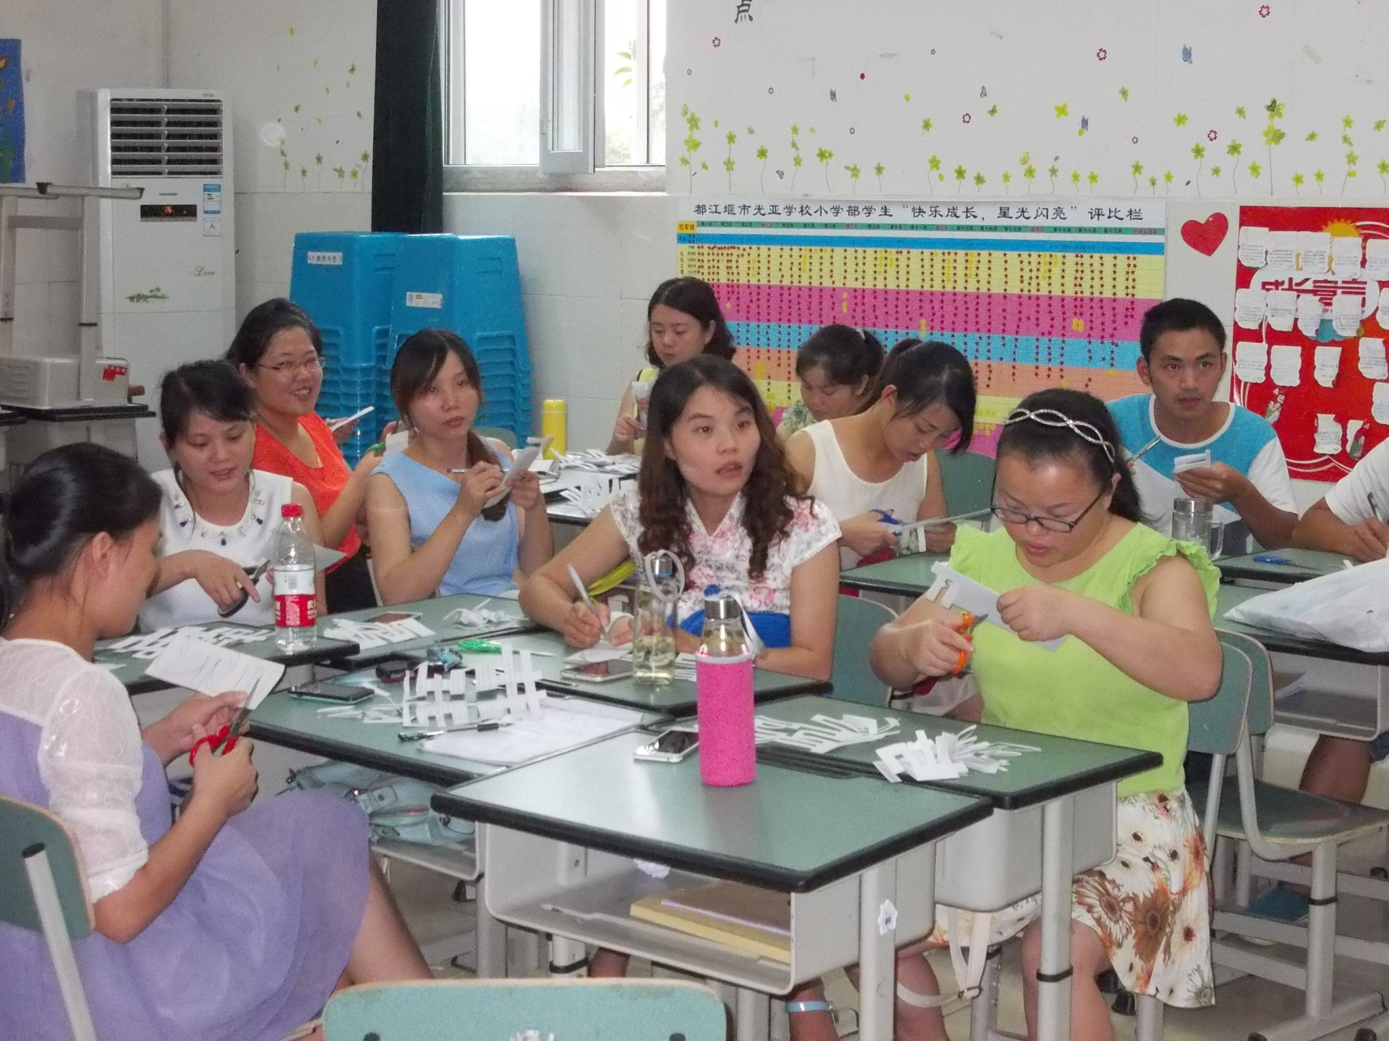
Teachers working on
Chinese cut-out art

Slide 7
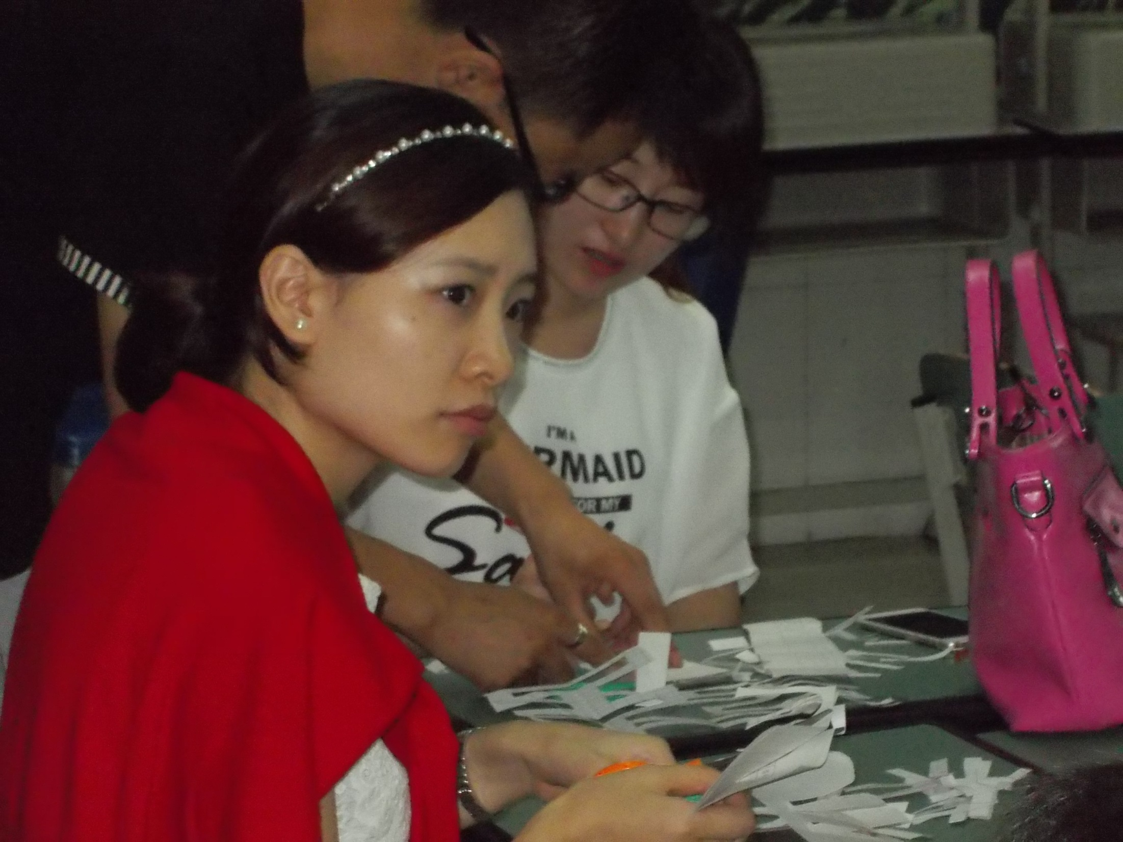
Juanita and Jessica

Slide 8
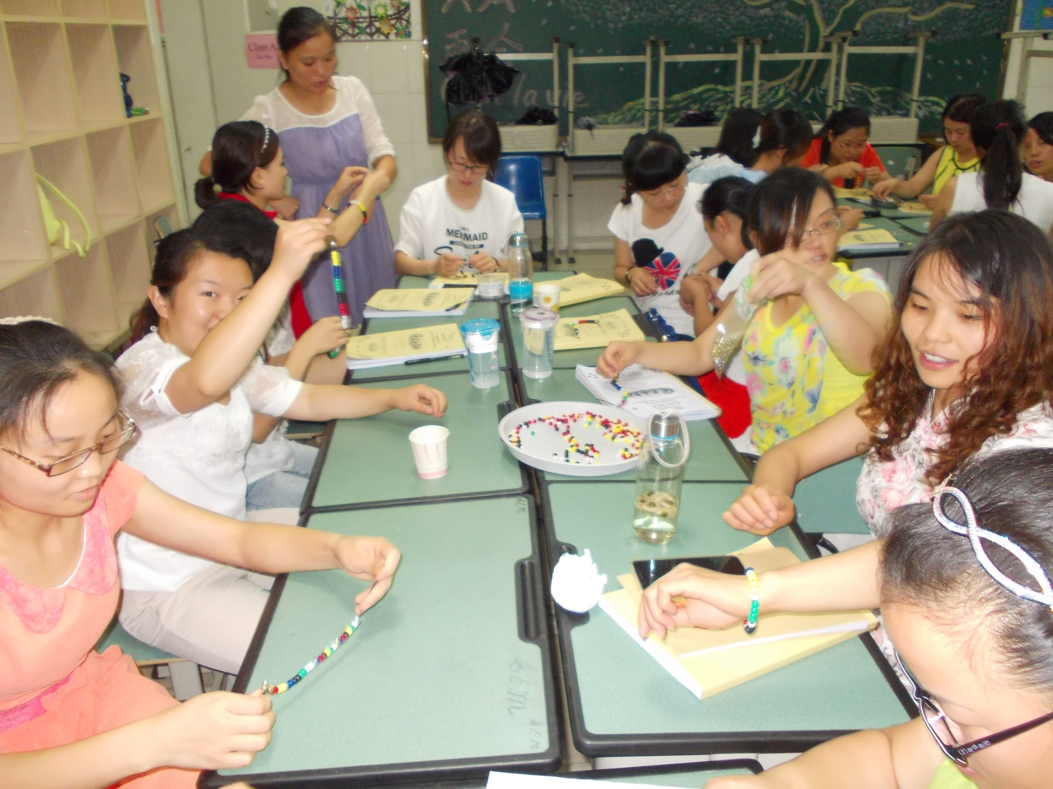
Teachers working on “Friendship” Bracelets

Slide 9
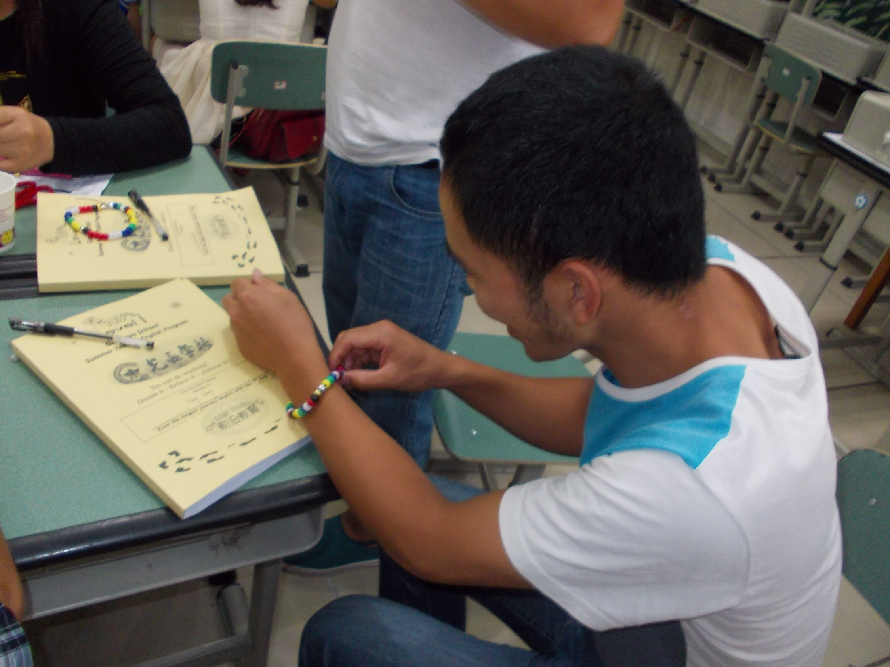

Slide 10
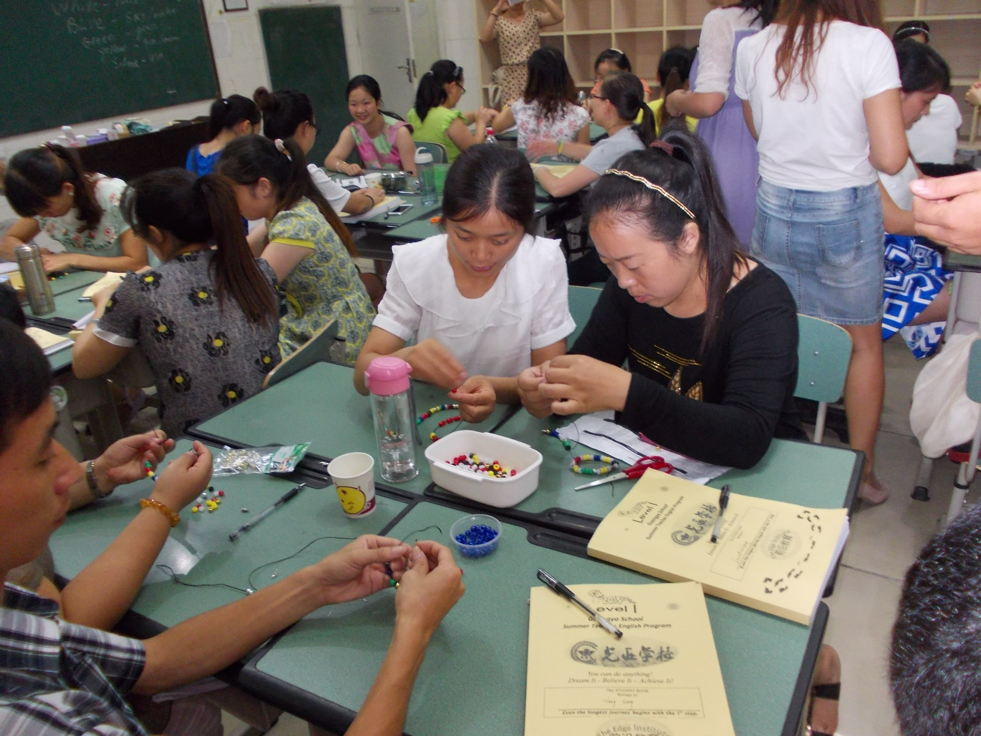

Slide 11
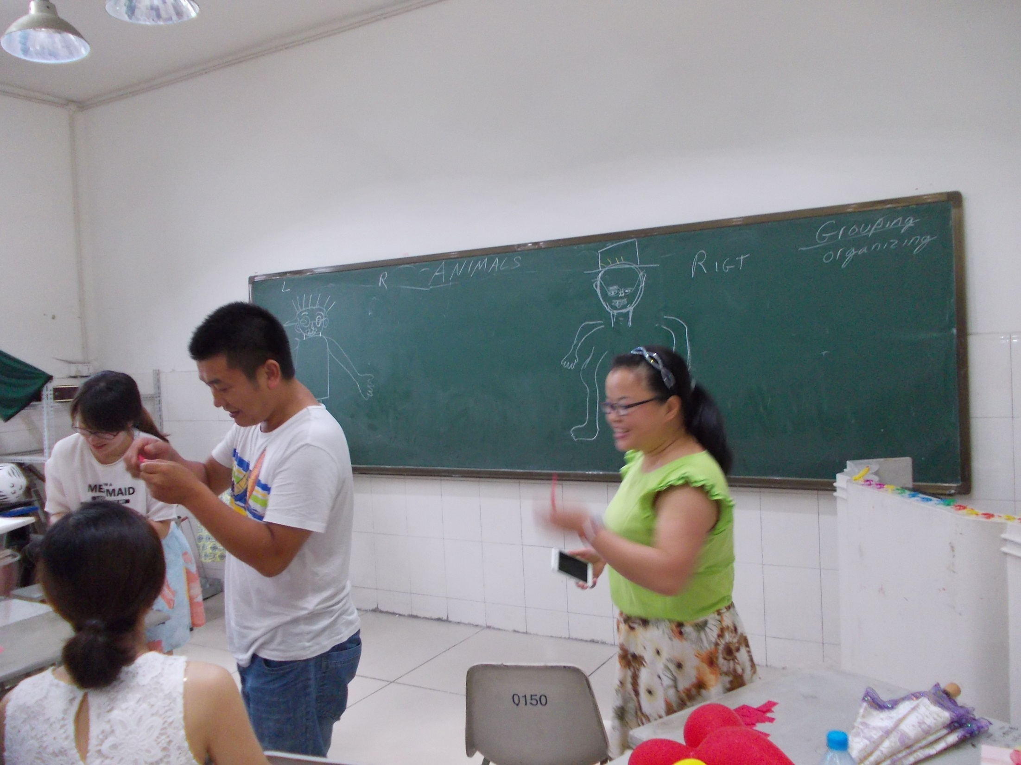
Playing the “BODY PART” Game

Slide 12
Having fun playing LIMBO

Slide 13
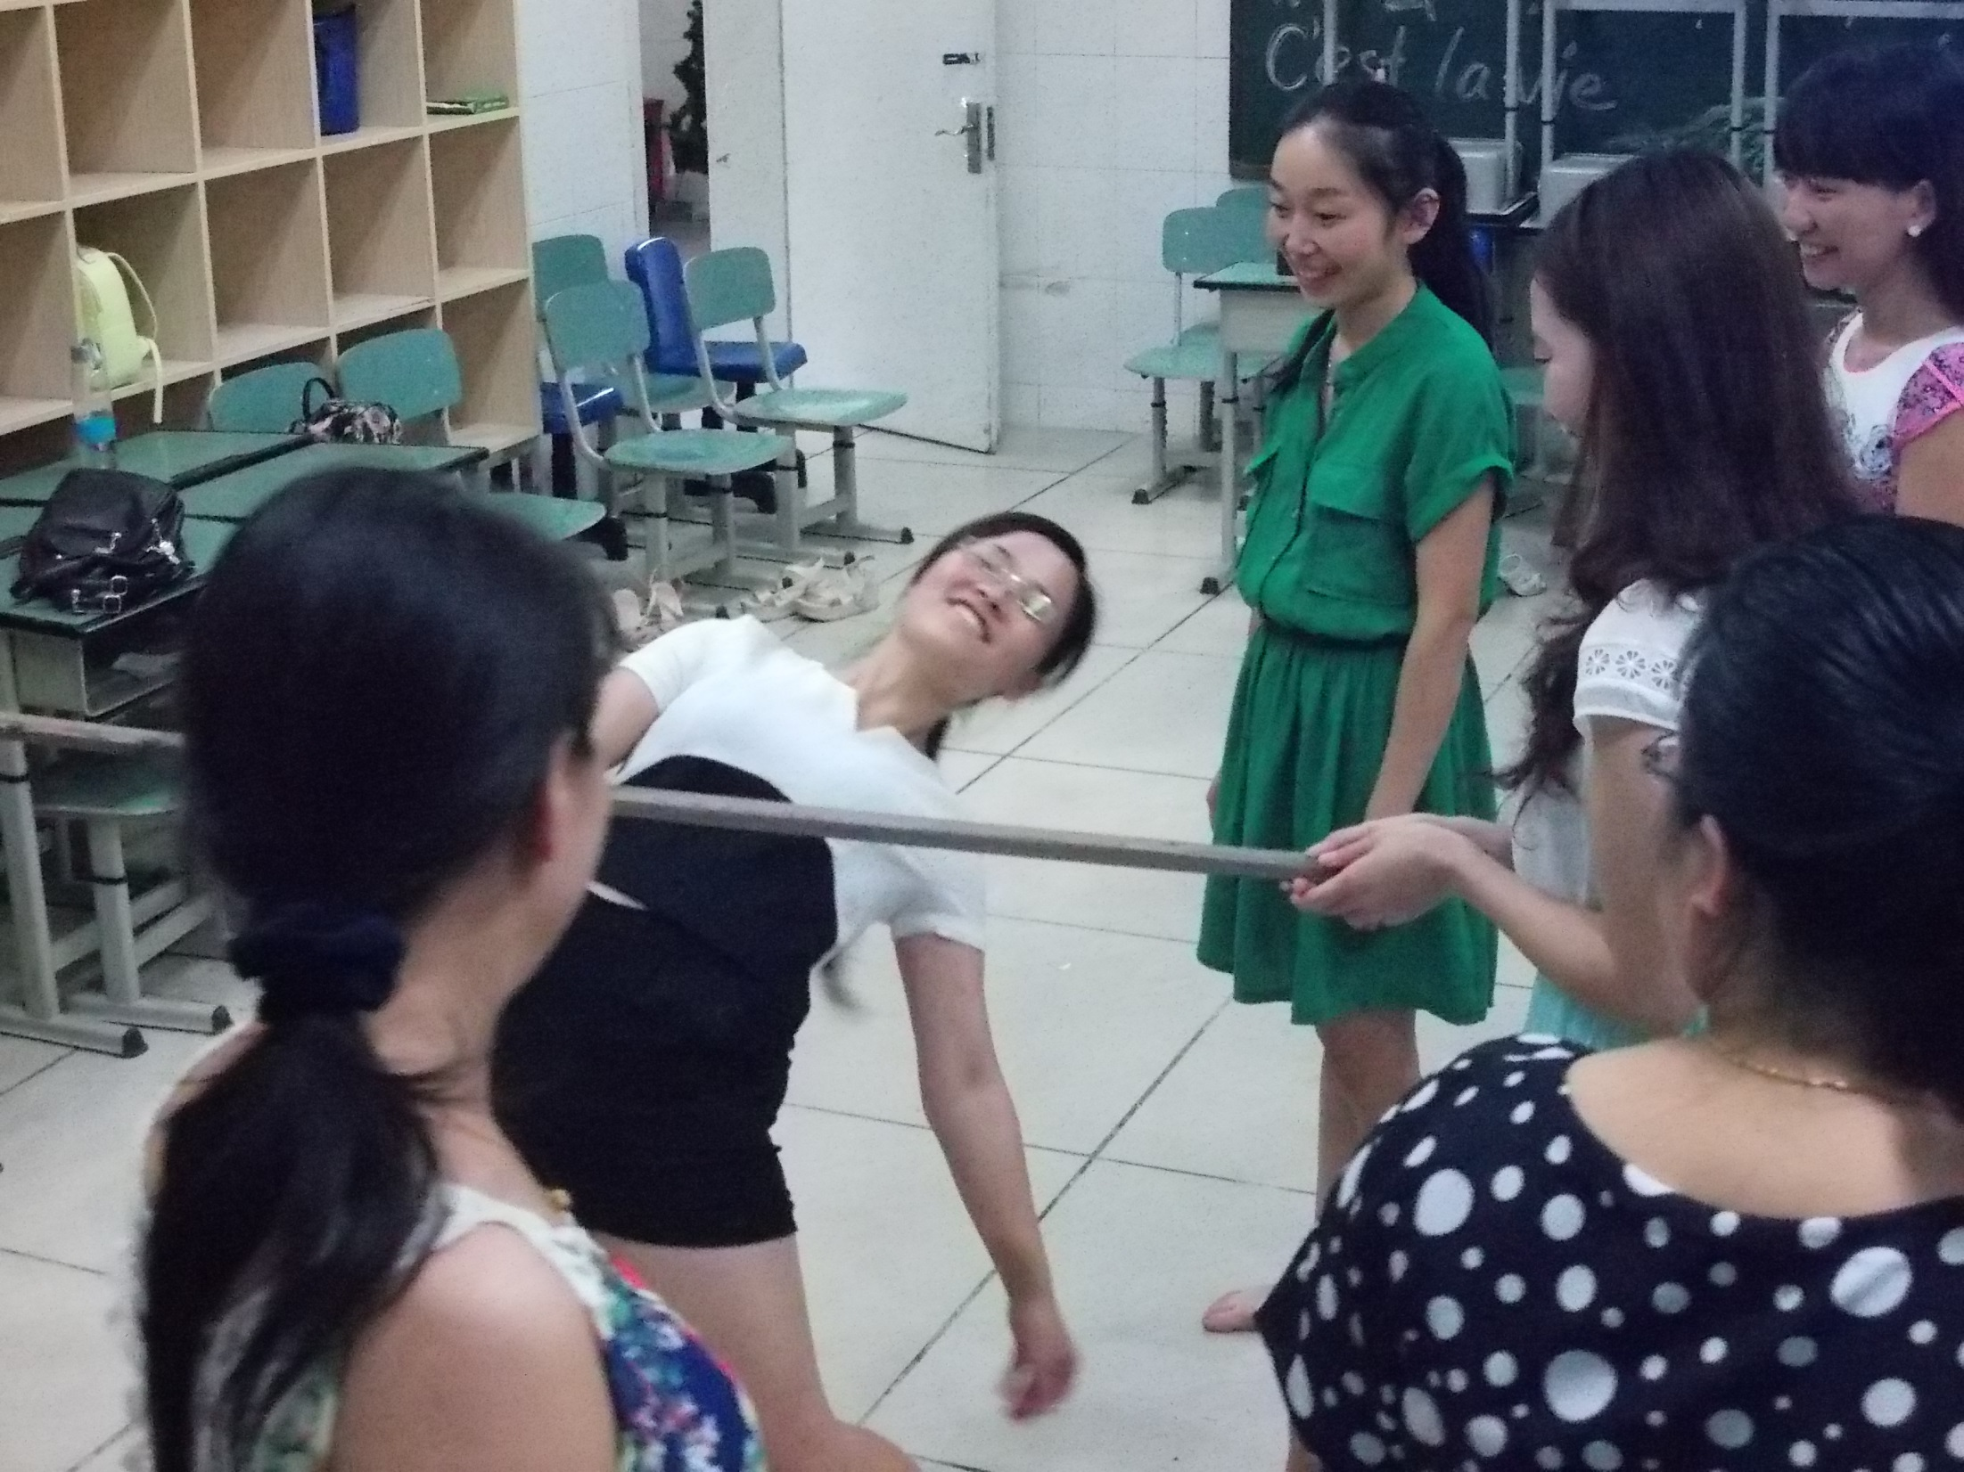

Slide 14
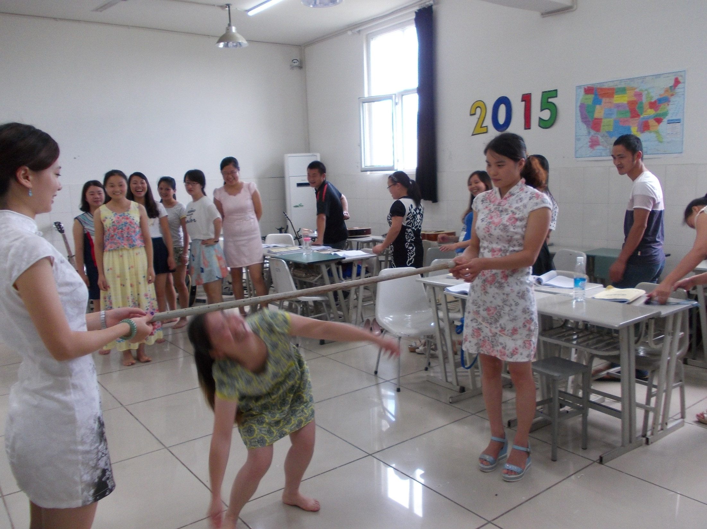

Slide 15
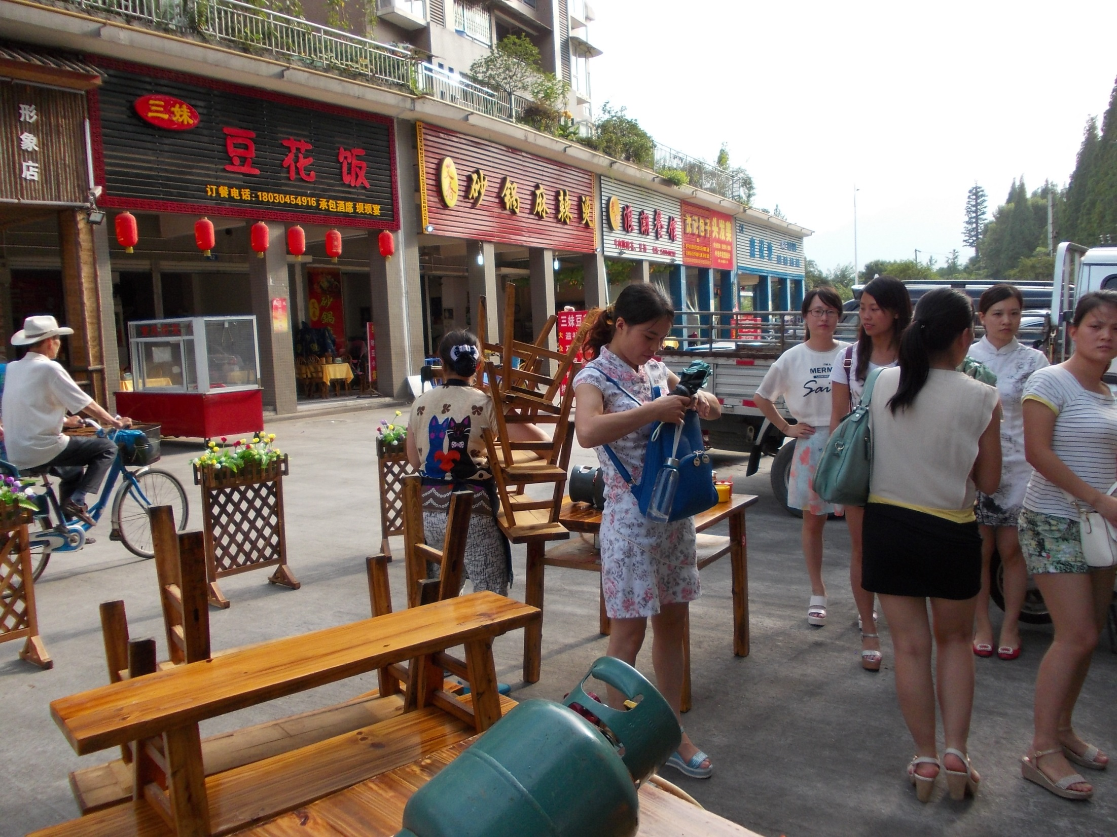
Visit to a “HOT POT” restaurant near
campus. Good food and fellowship with teachers.

Slide 16
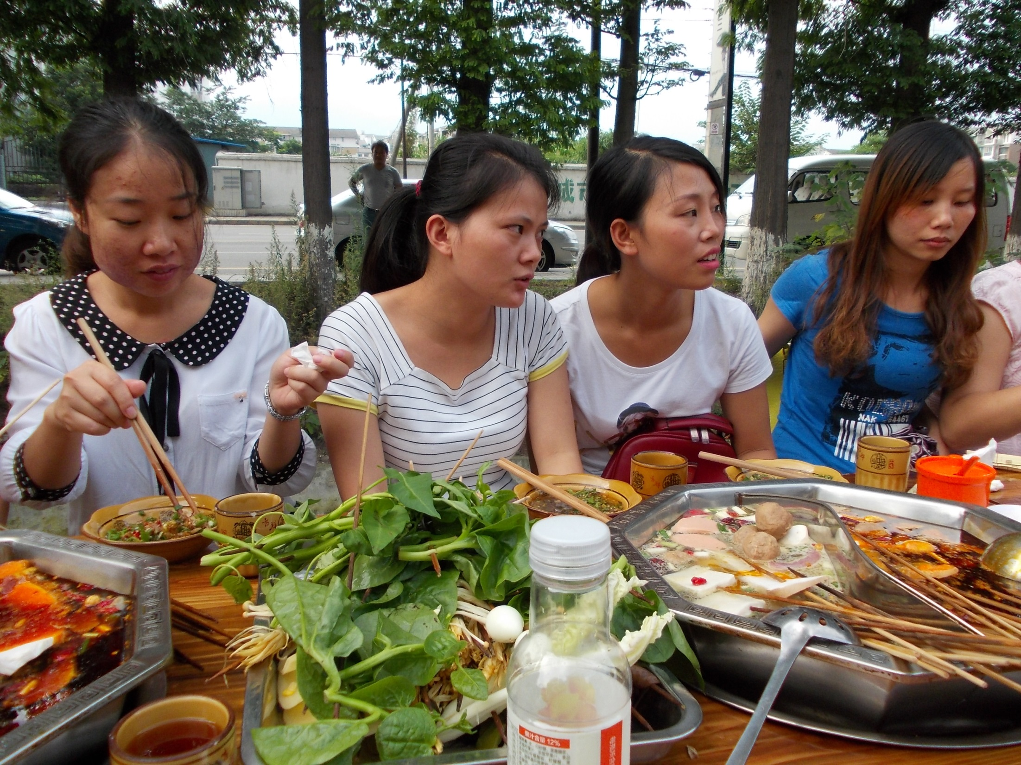

Slide 17
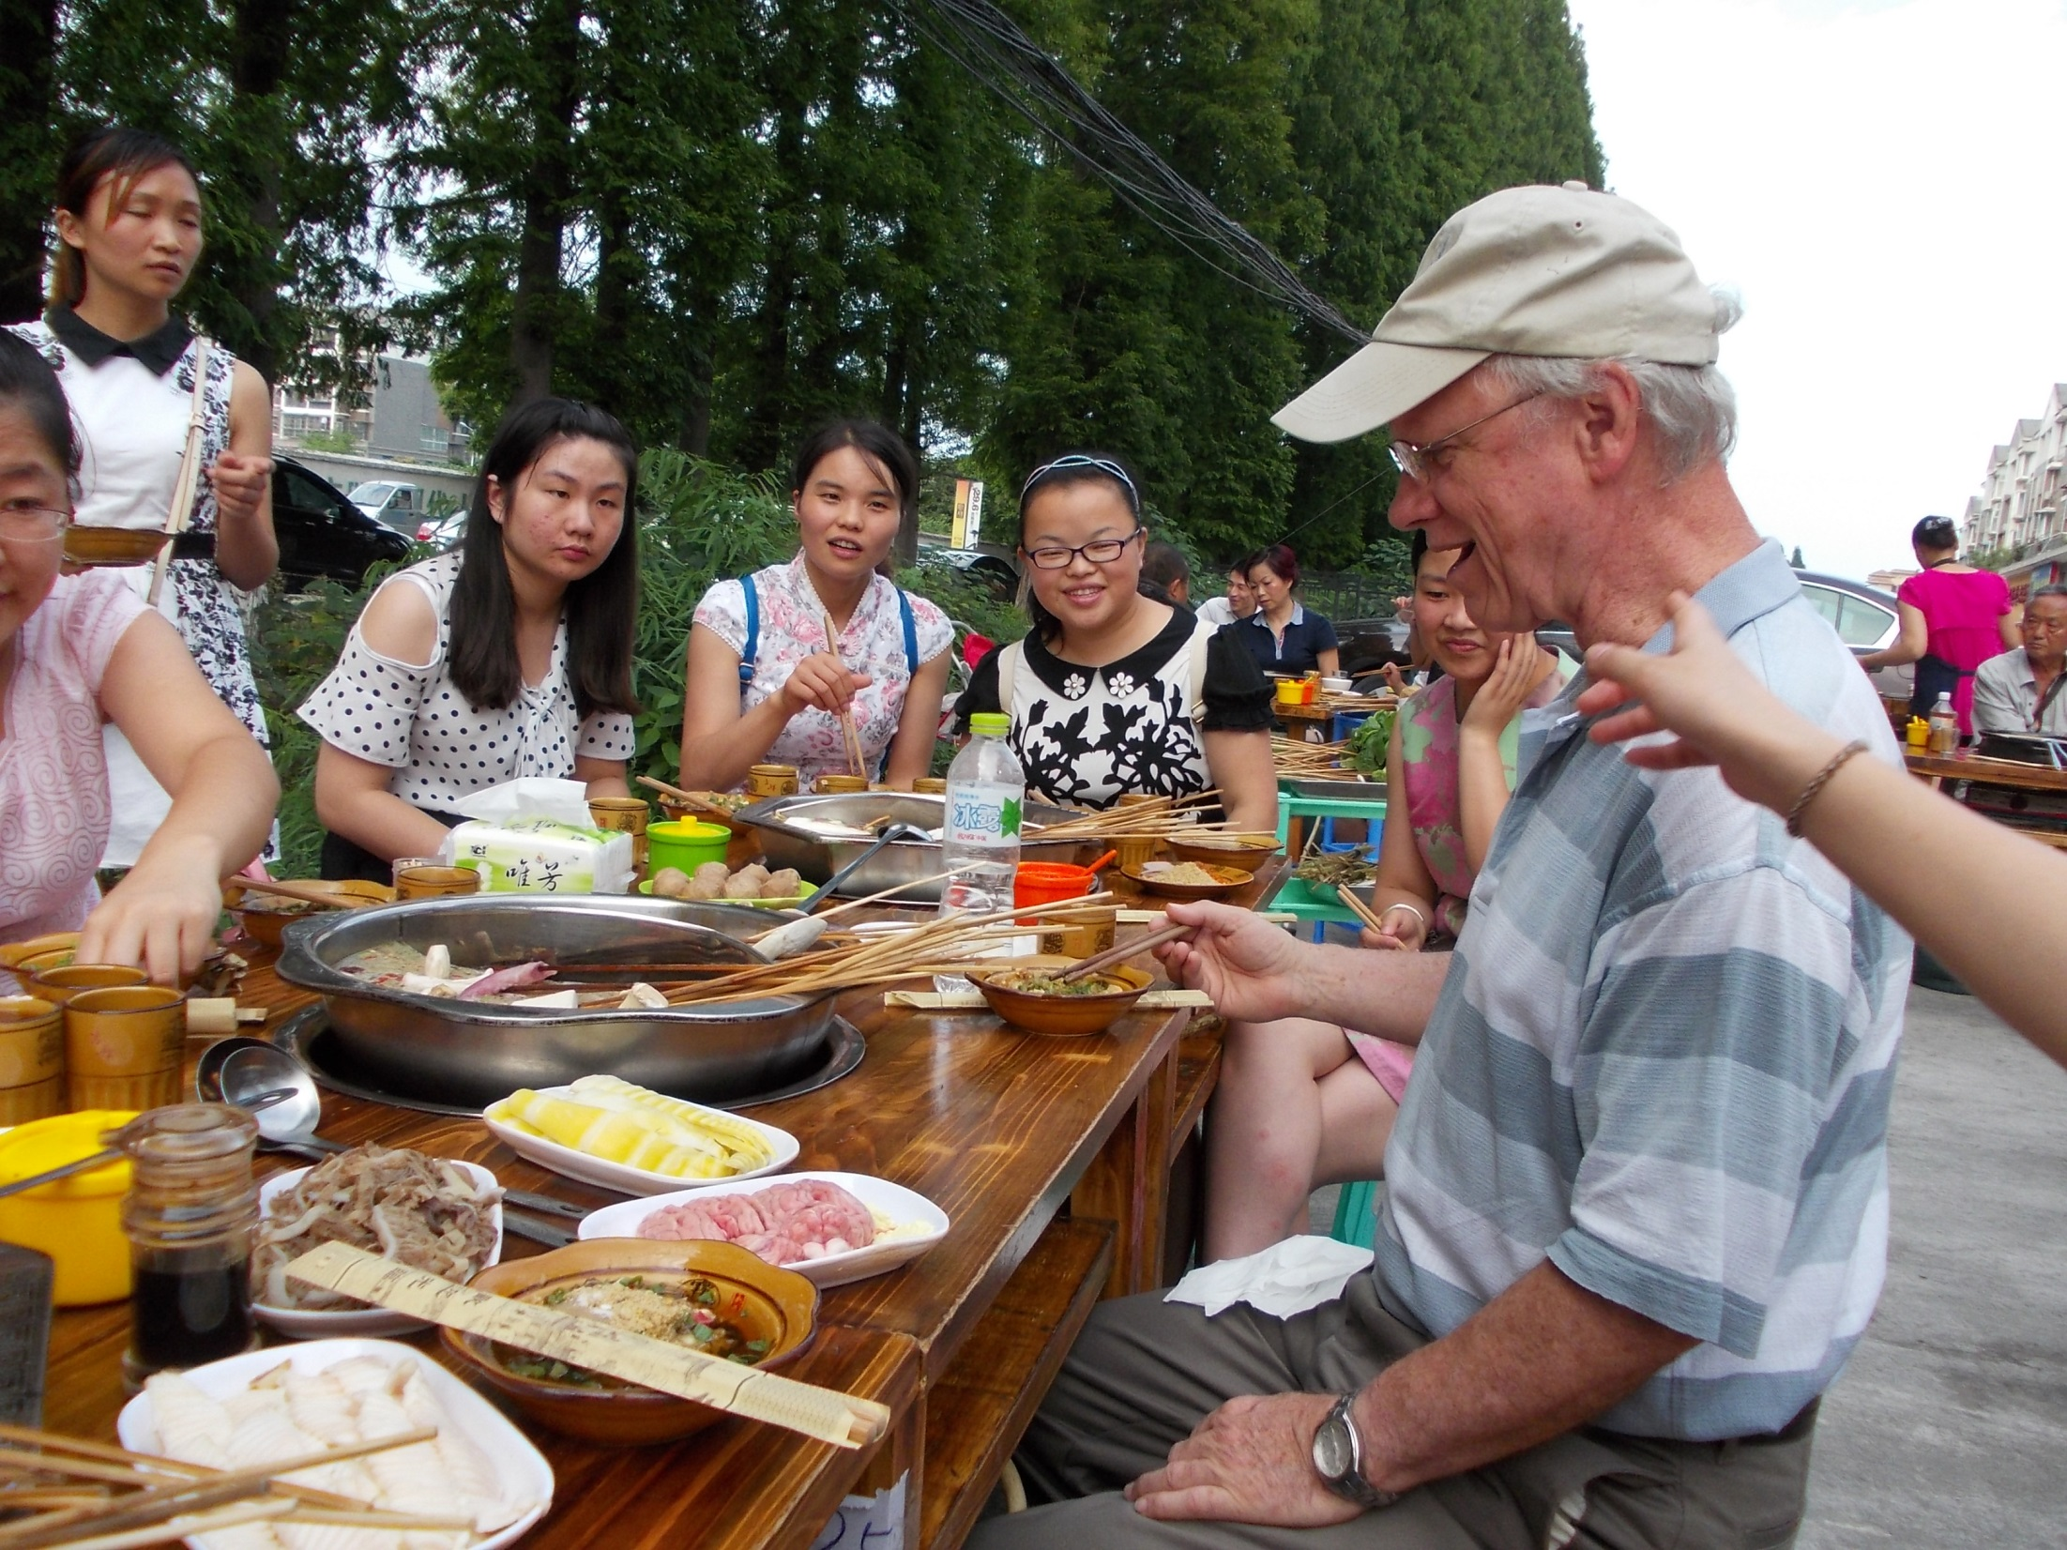

Slide 18
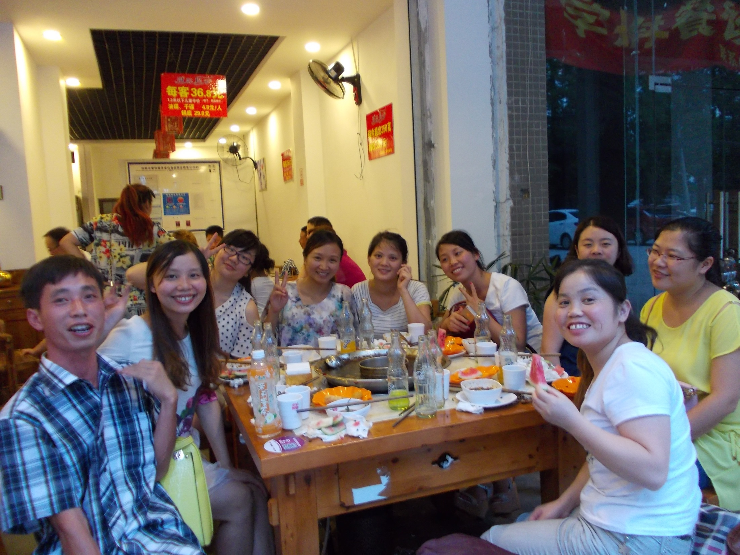

Slide 19
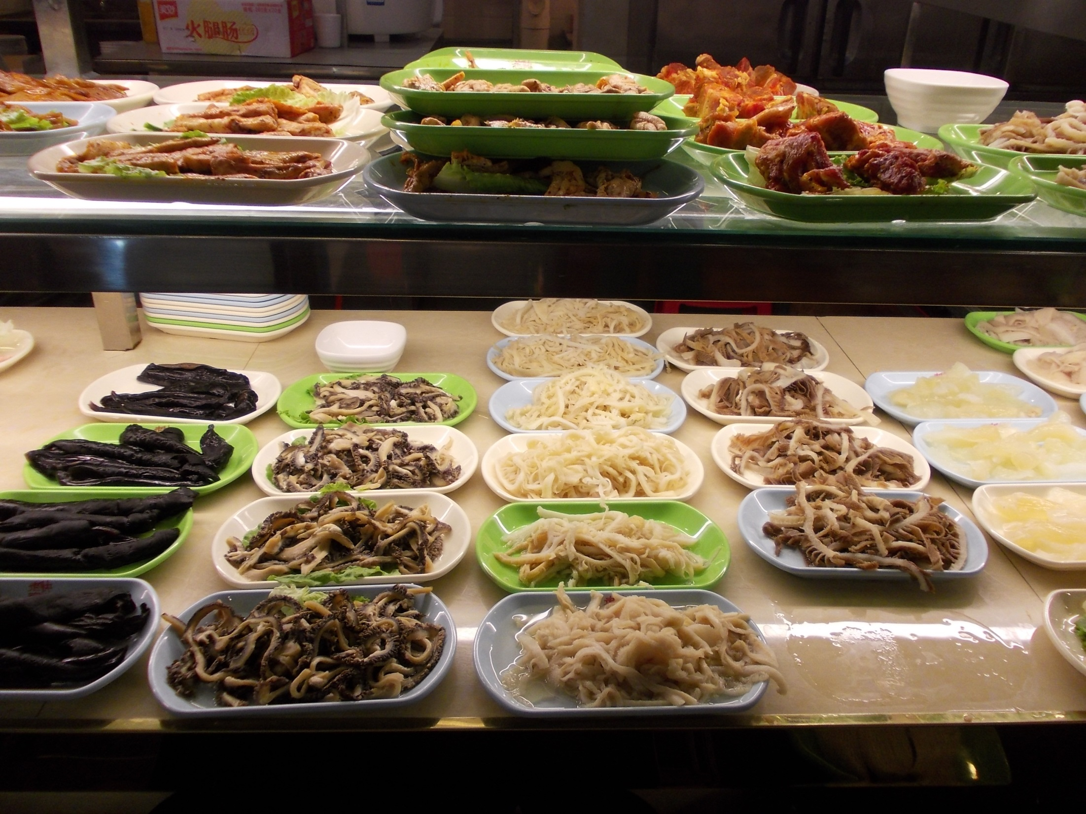

Slide 20
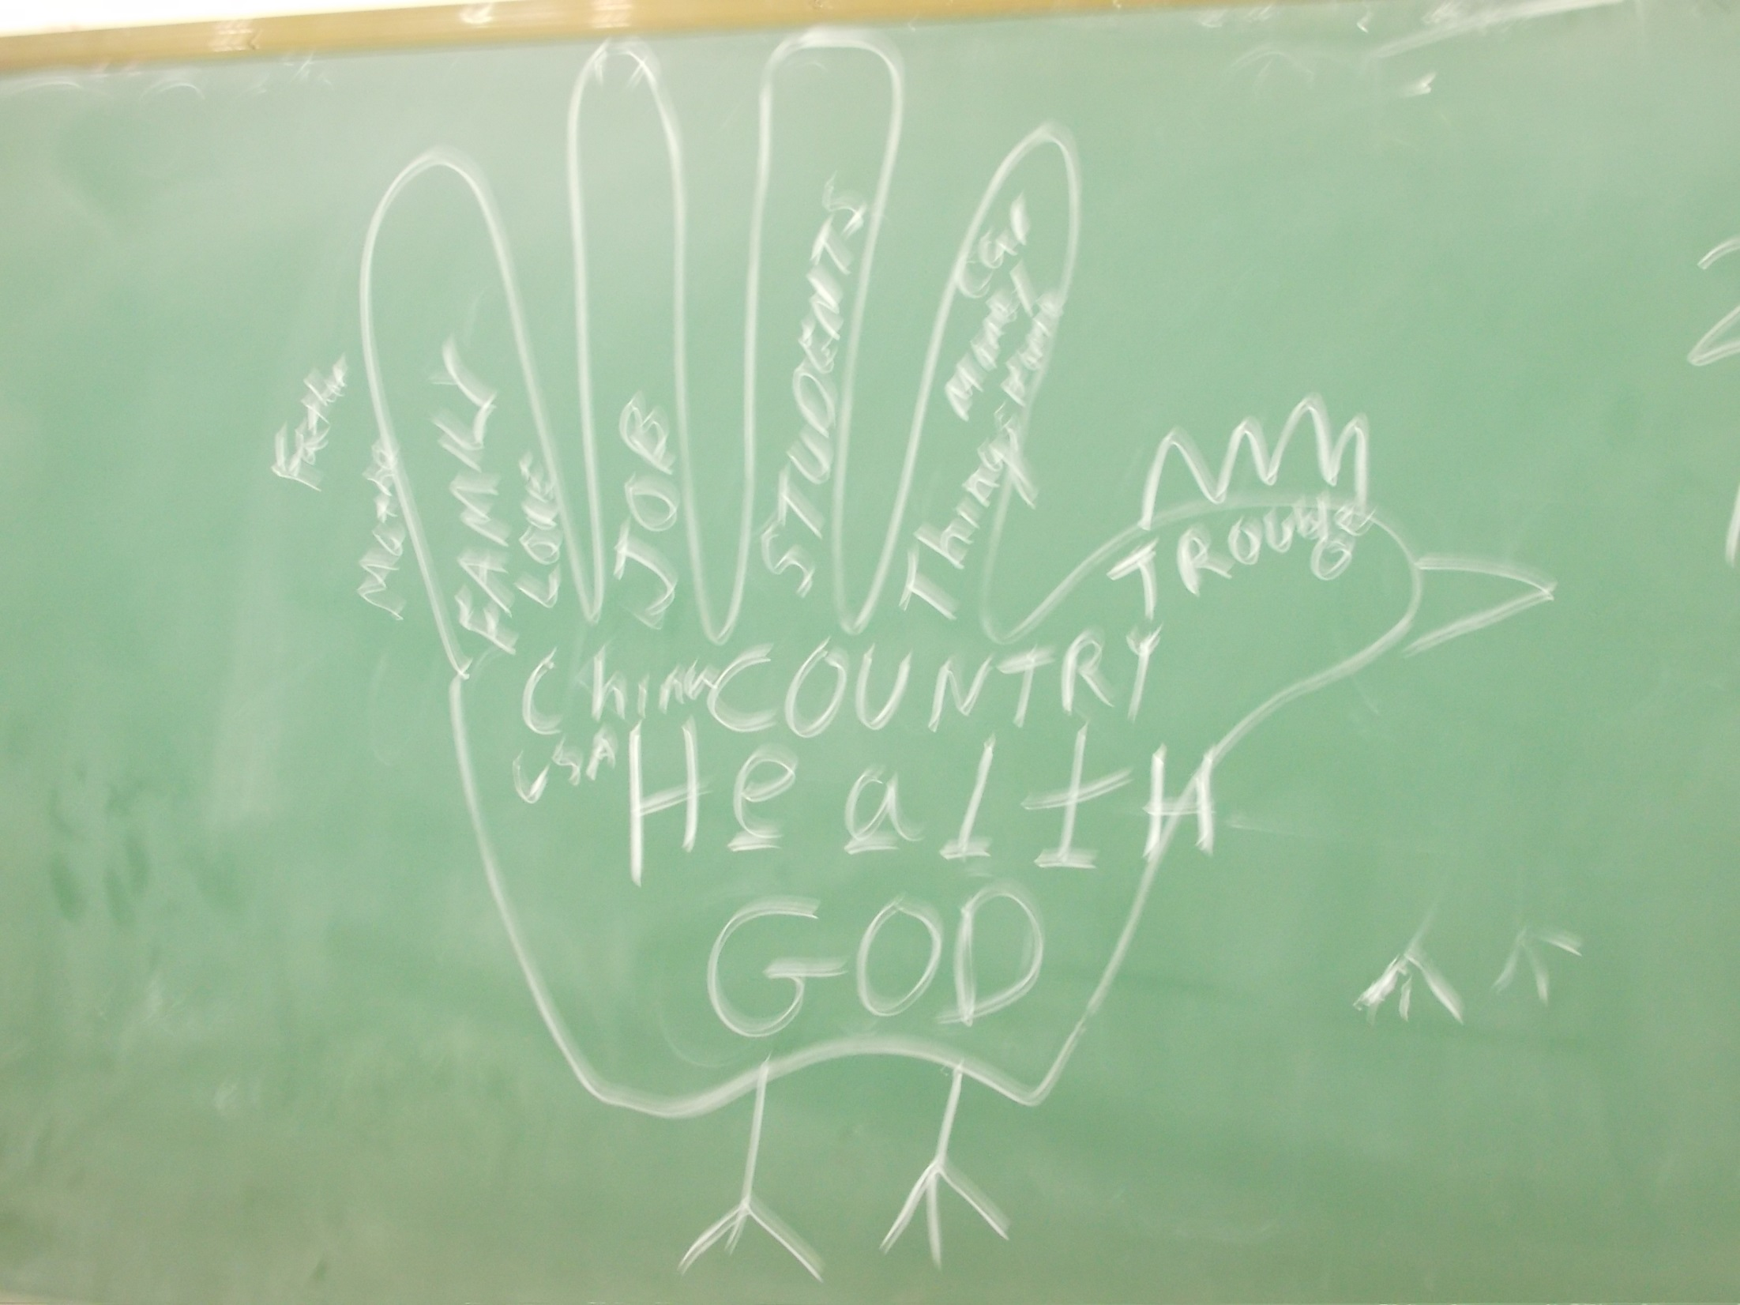
Teaching about
Thanksgiving!

Slide 21
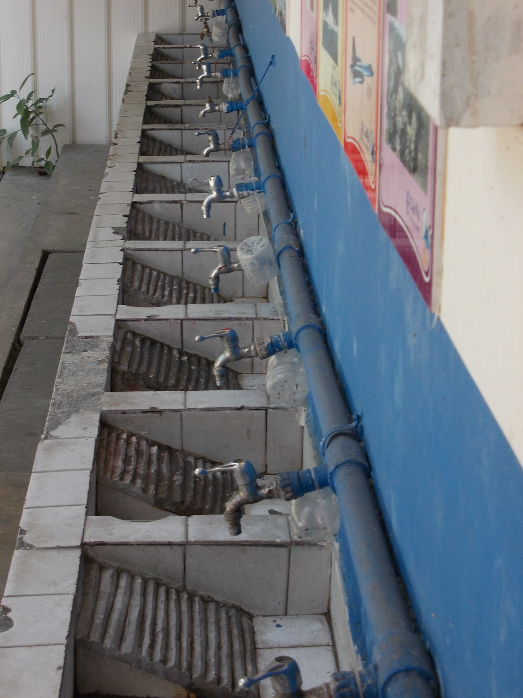
Student Laundry Facilities

Slide 22
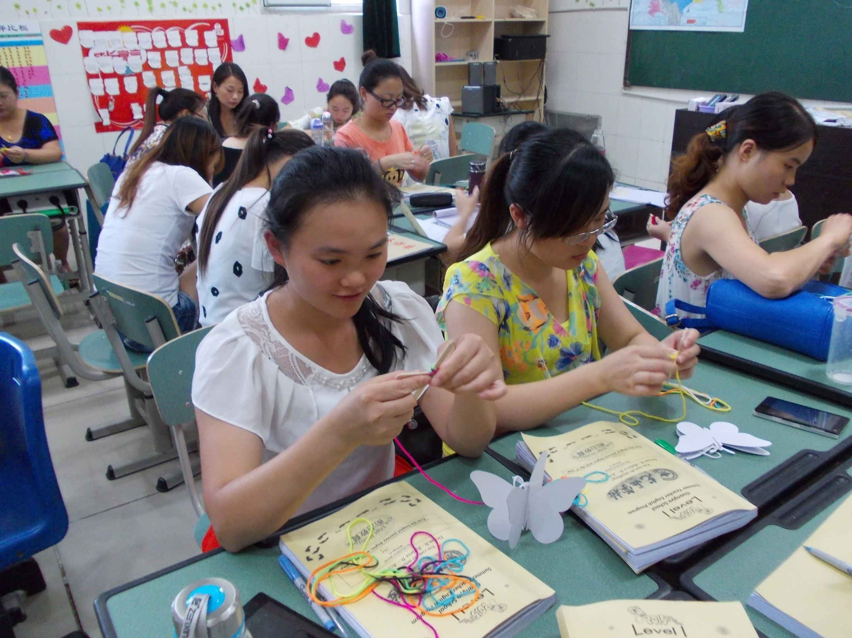
BUTTERFLIES: As part of the “CHANGE Lesson” and from the movie , “The Ultimate Gift” – What is Heaven Like? In response to a little girl who is dying.

Slide 23
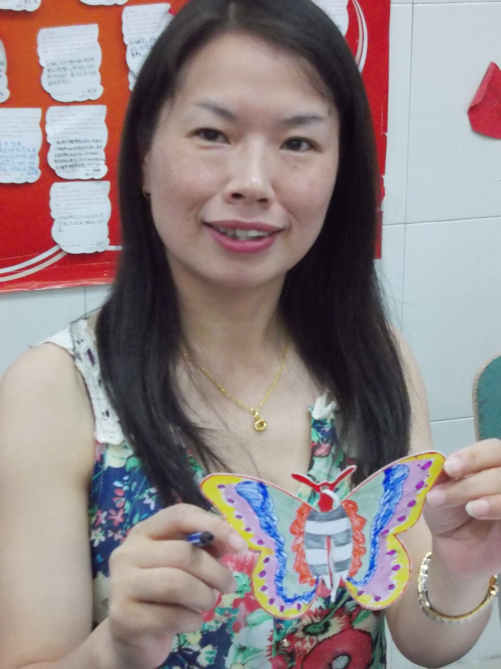

Slide 24
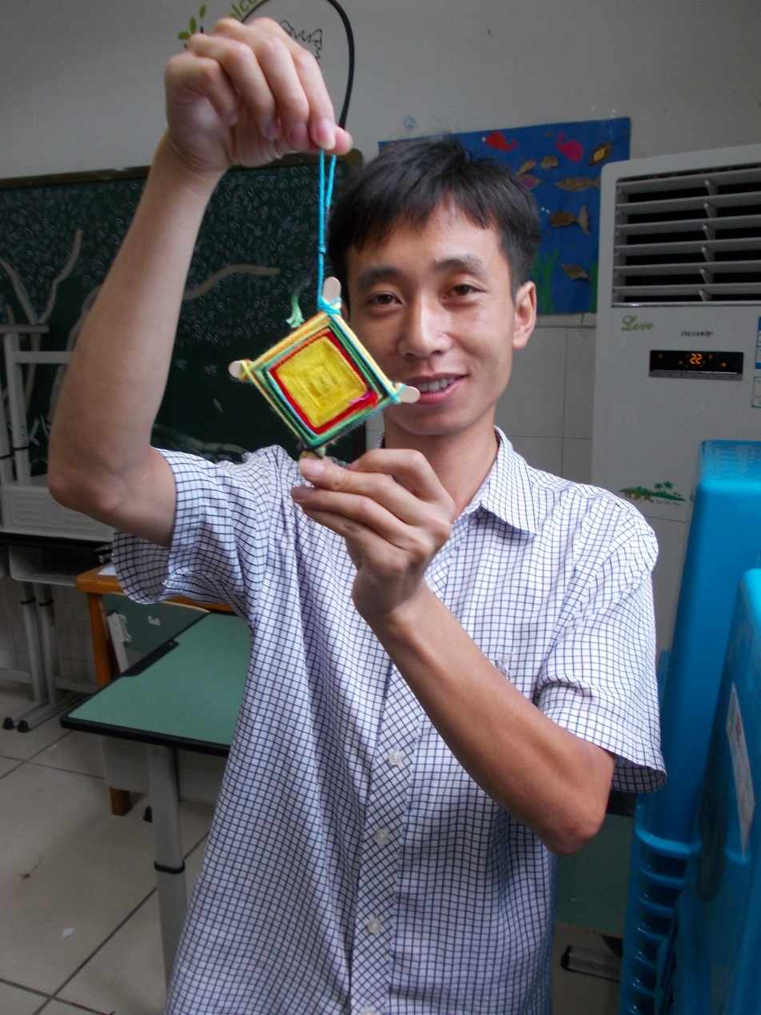
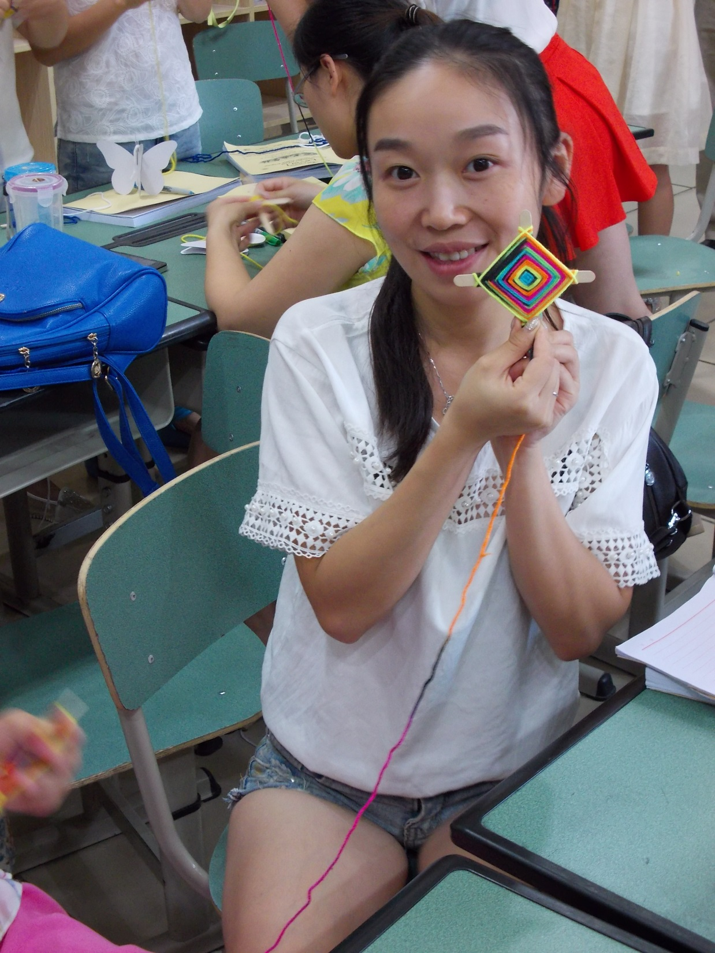
Eye-of-God
craft project

Slide 25
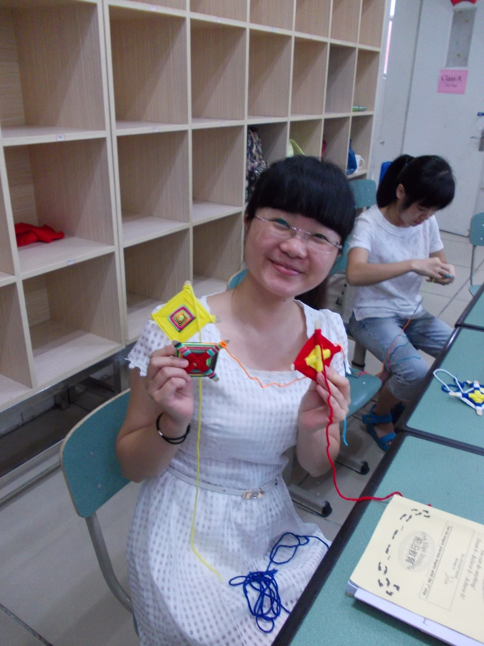

Slide 26
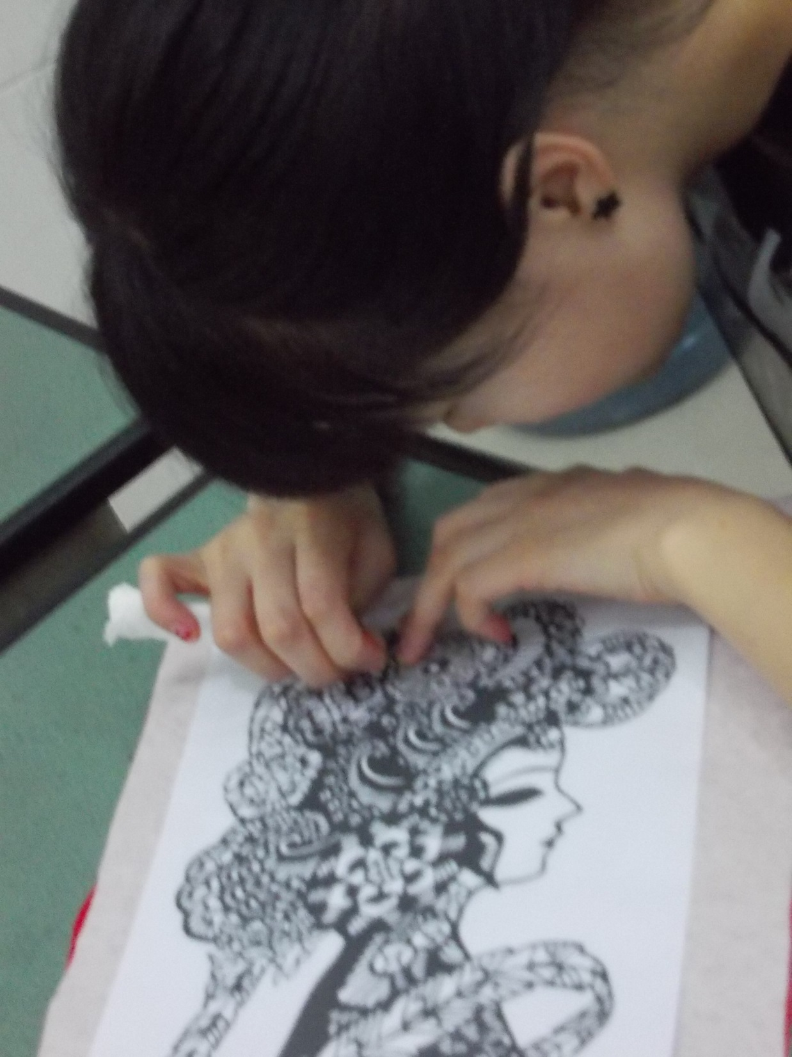
Teachers participated in Chinese Traditional Art classes in addition to the English Lessons.
They also did Dance and Guitar classes .
They were busy every day, night, and on weekends.
They worked very hard.

Slide 27
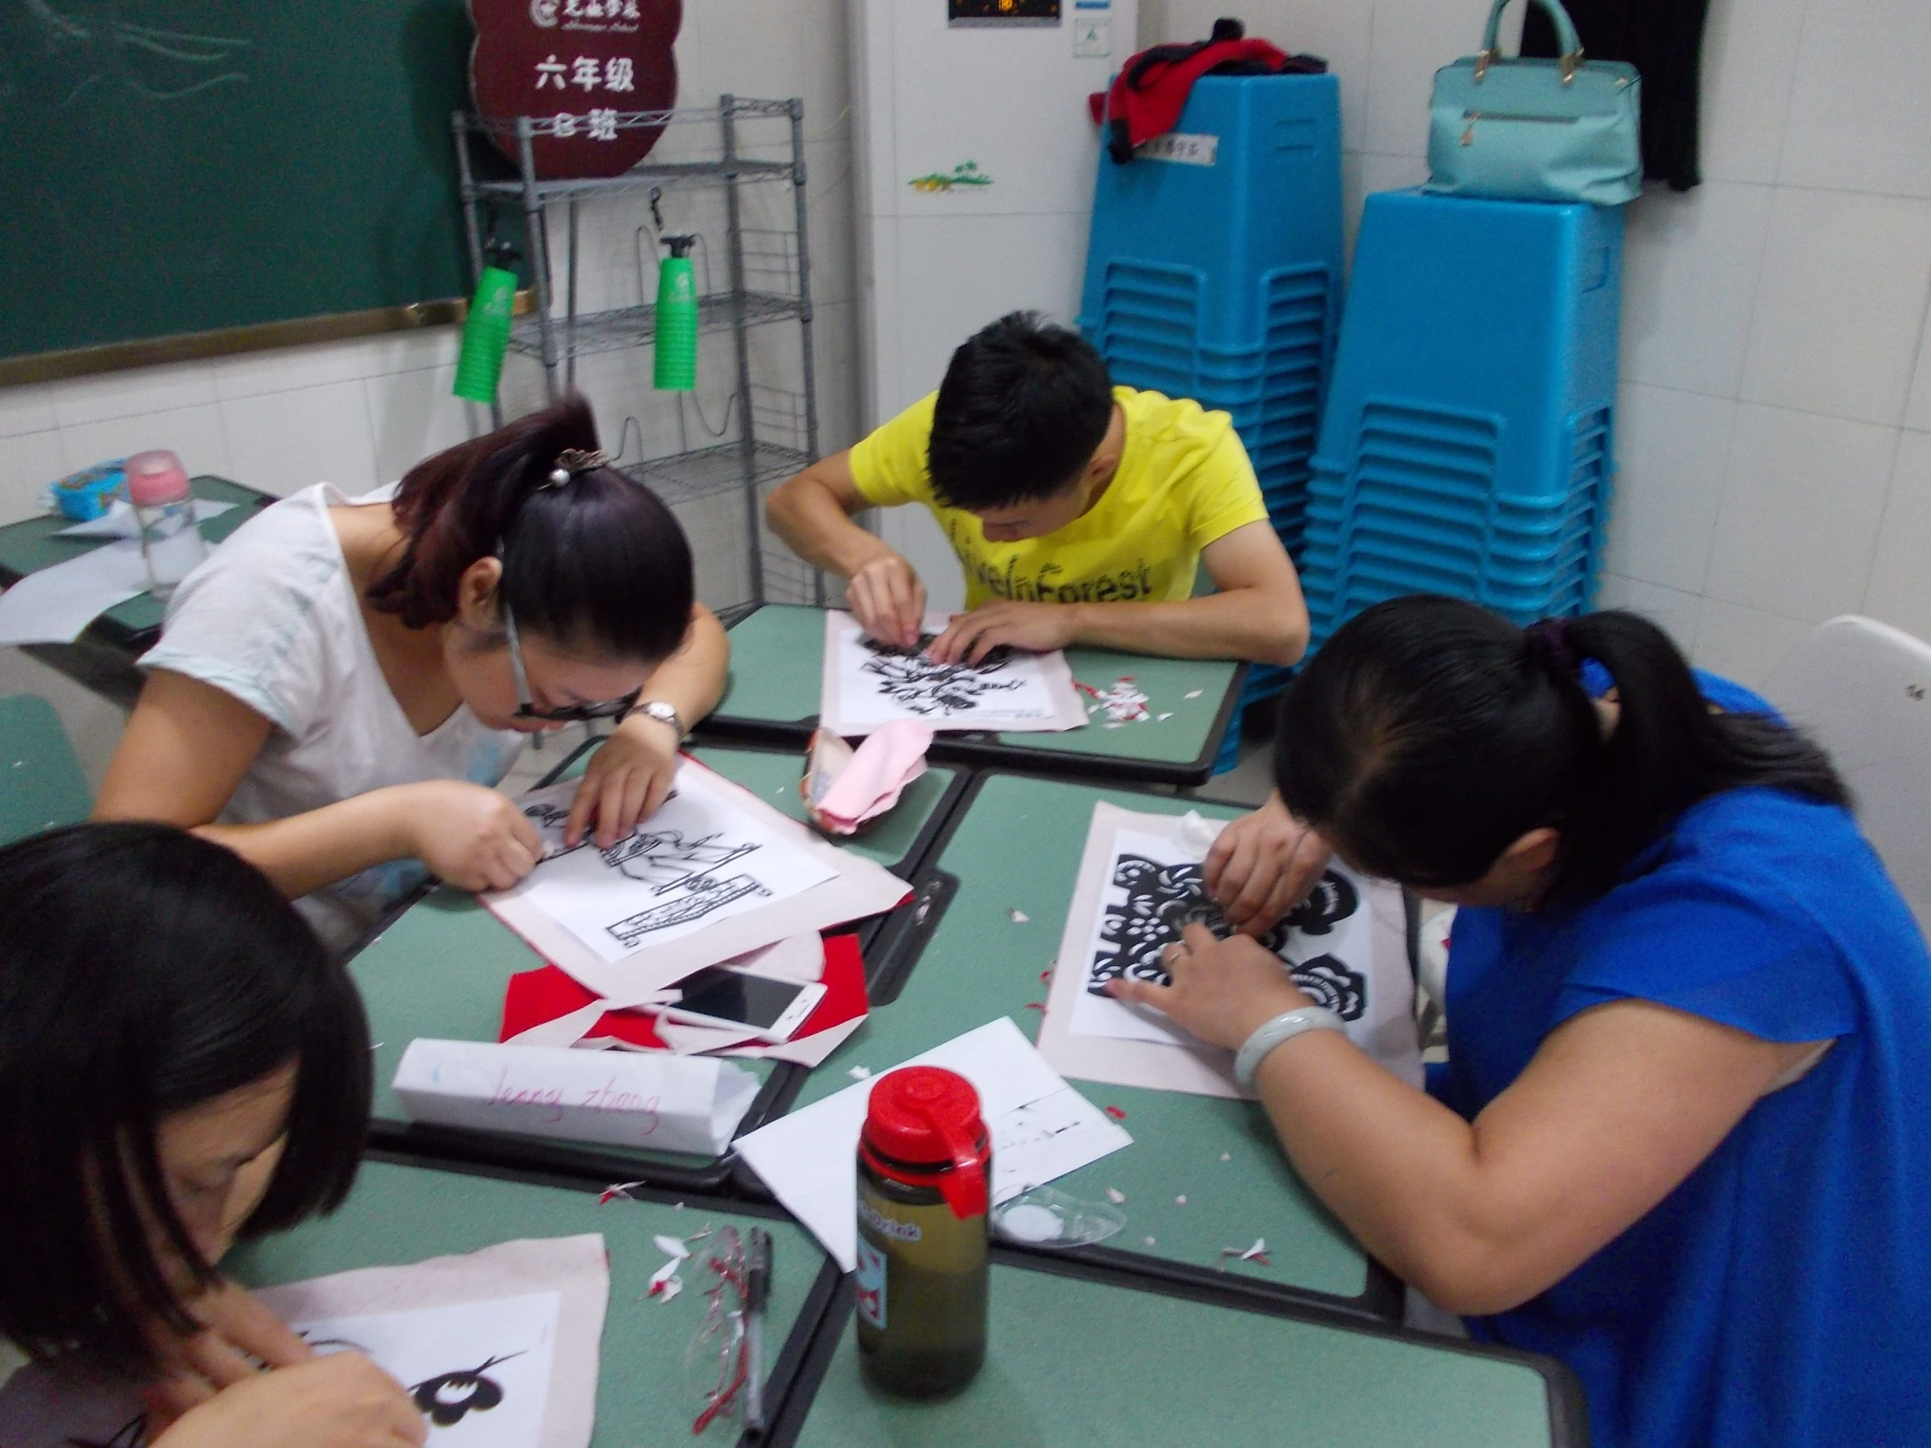

Slide 28
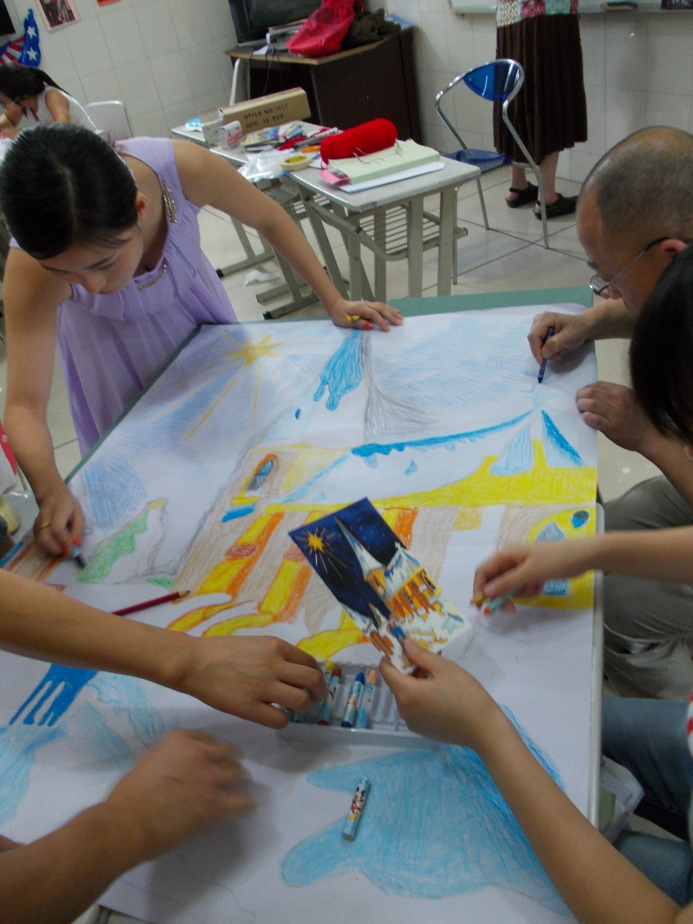
Creating ART from Christmas Cards.
A favorite song was “MARY DID YOU KNOW”?

Slide 29
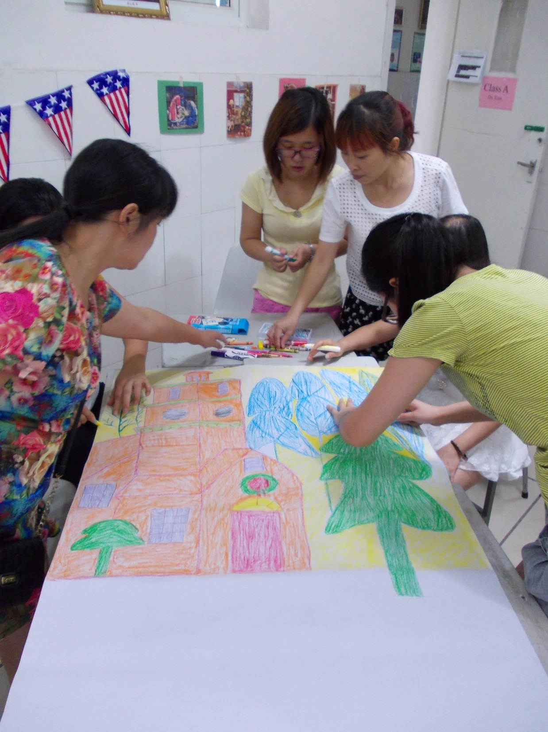

Slide 30
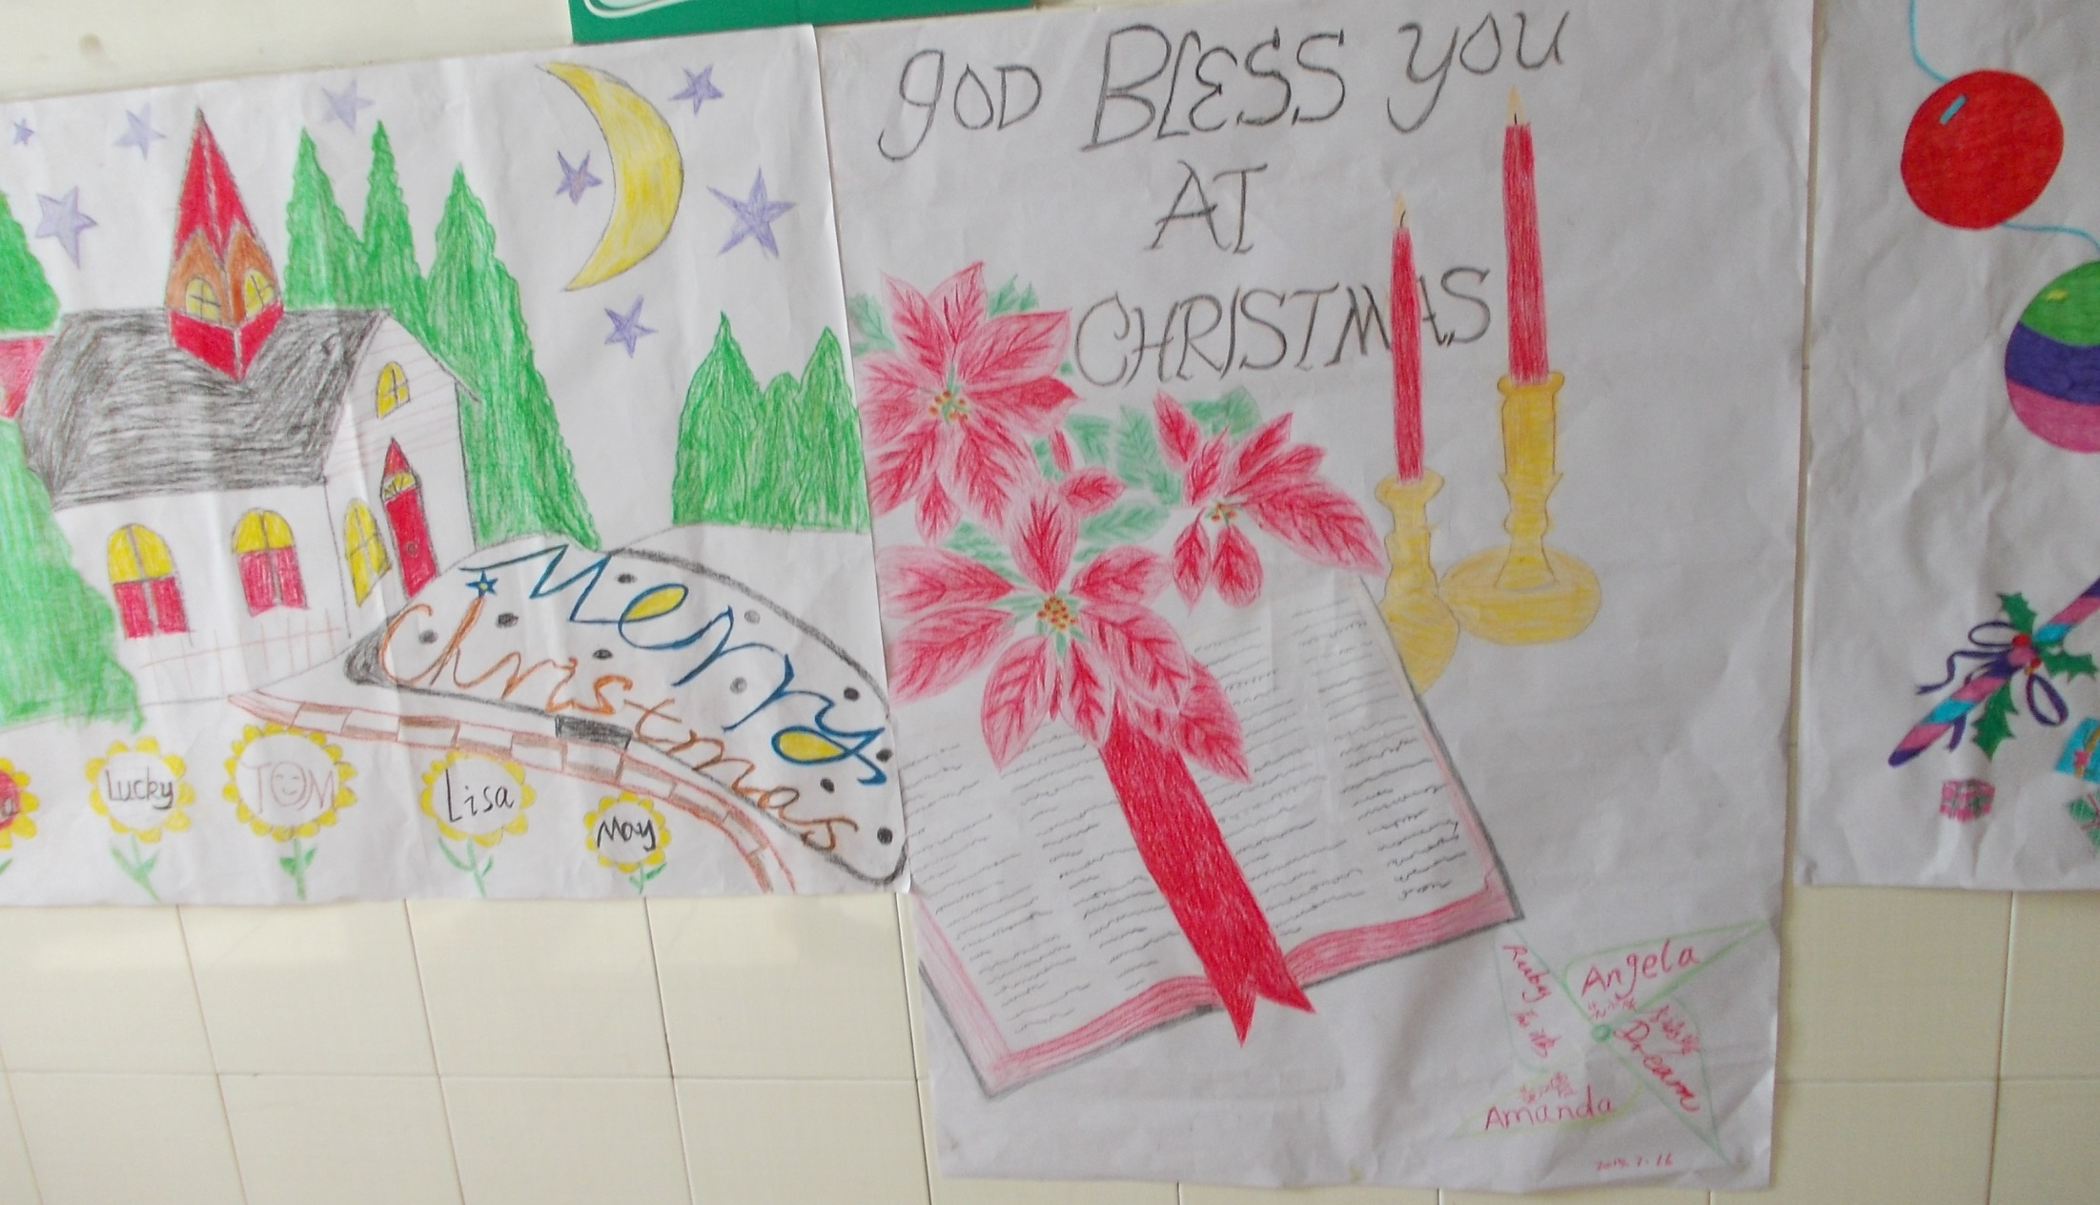

Slide 31
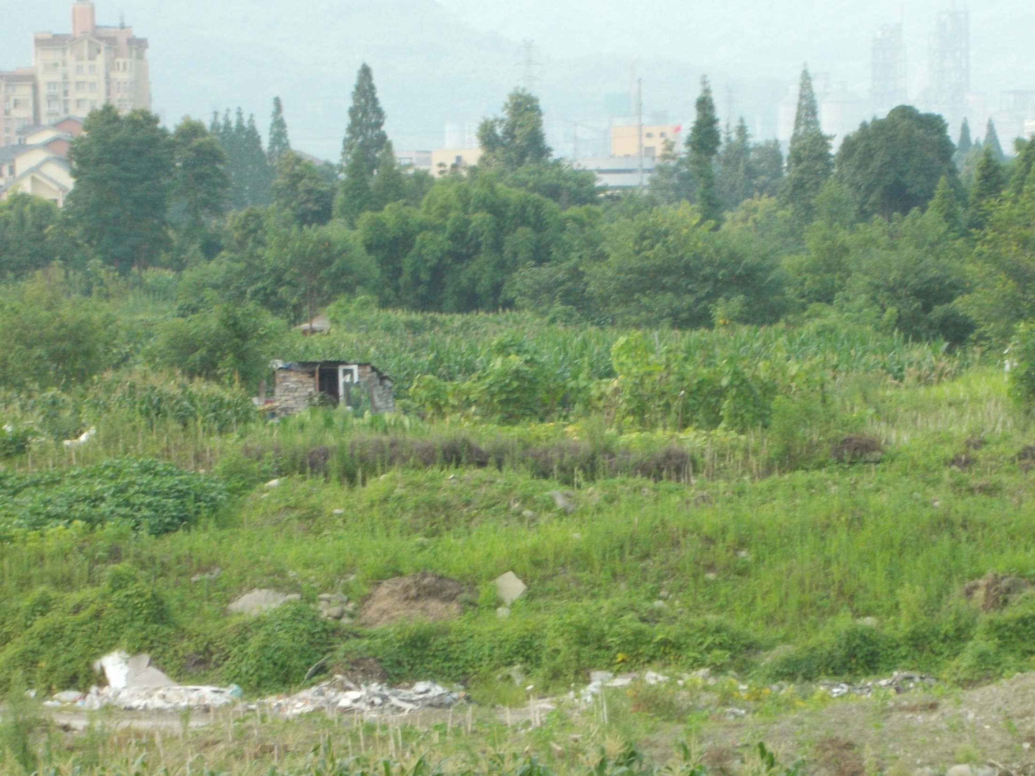
View from one of the classrooms – All available land was used for growing food!
Factory and apartment buildings in background.

Slide 32
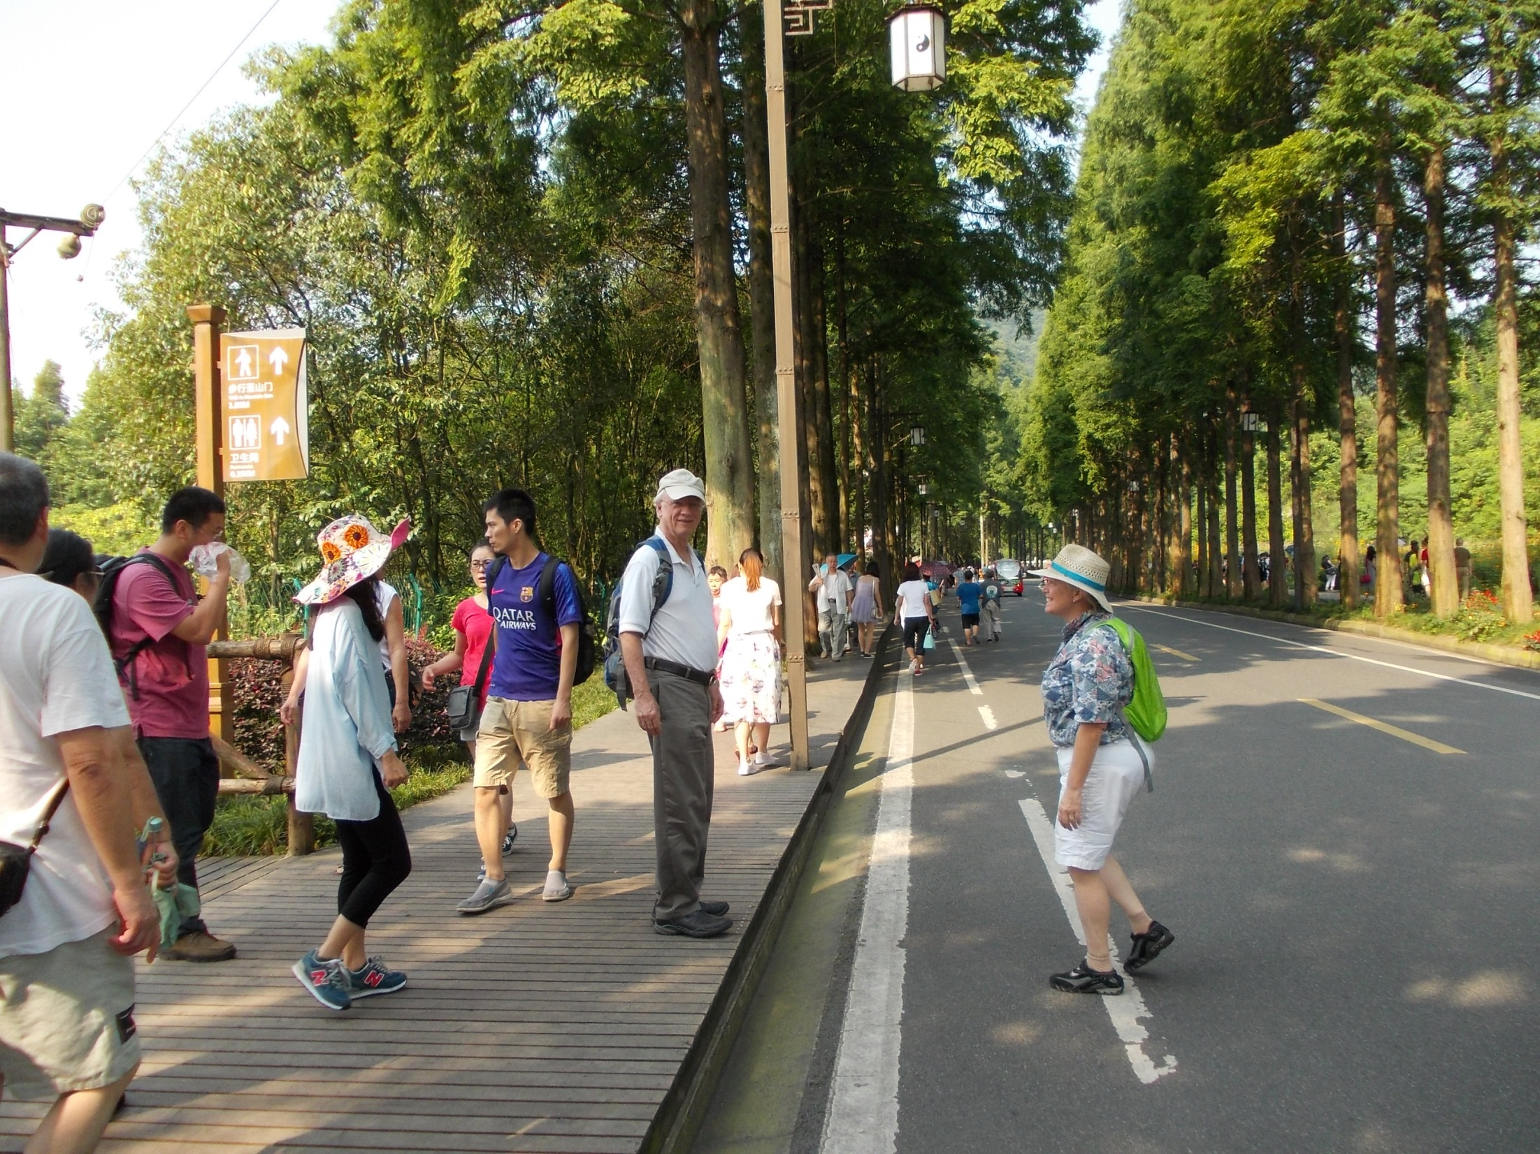
Trip to QingCheng Mountain (Home of Taoism- 150 AD) with Stewart, Rachel , and teachers.

Slide 33
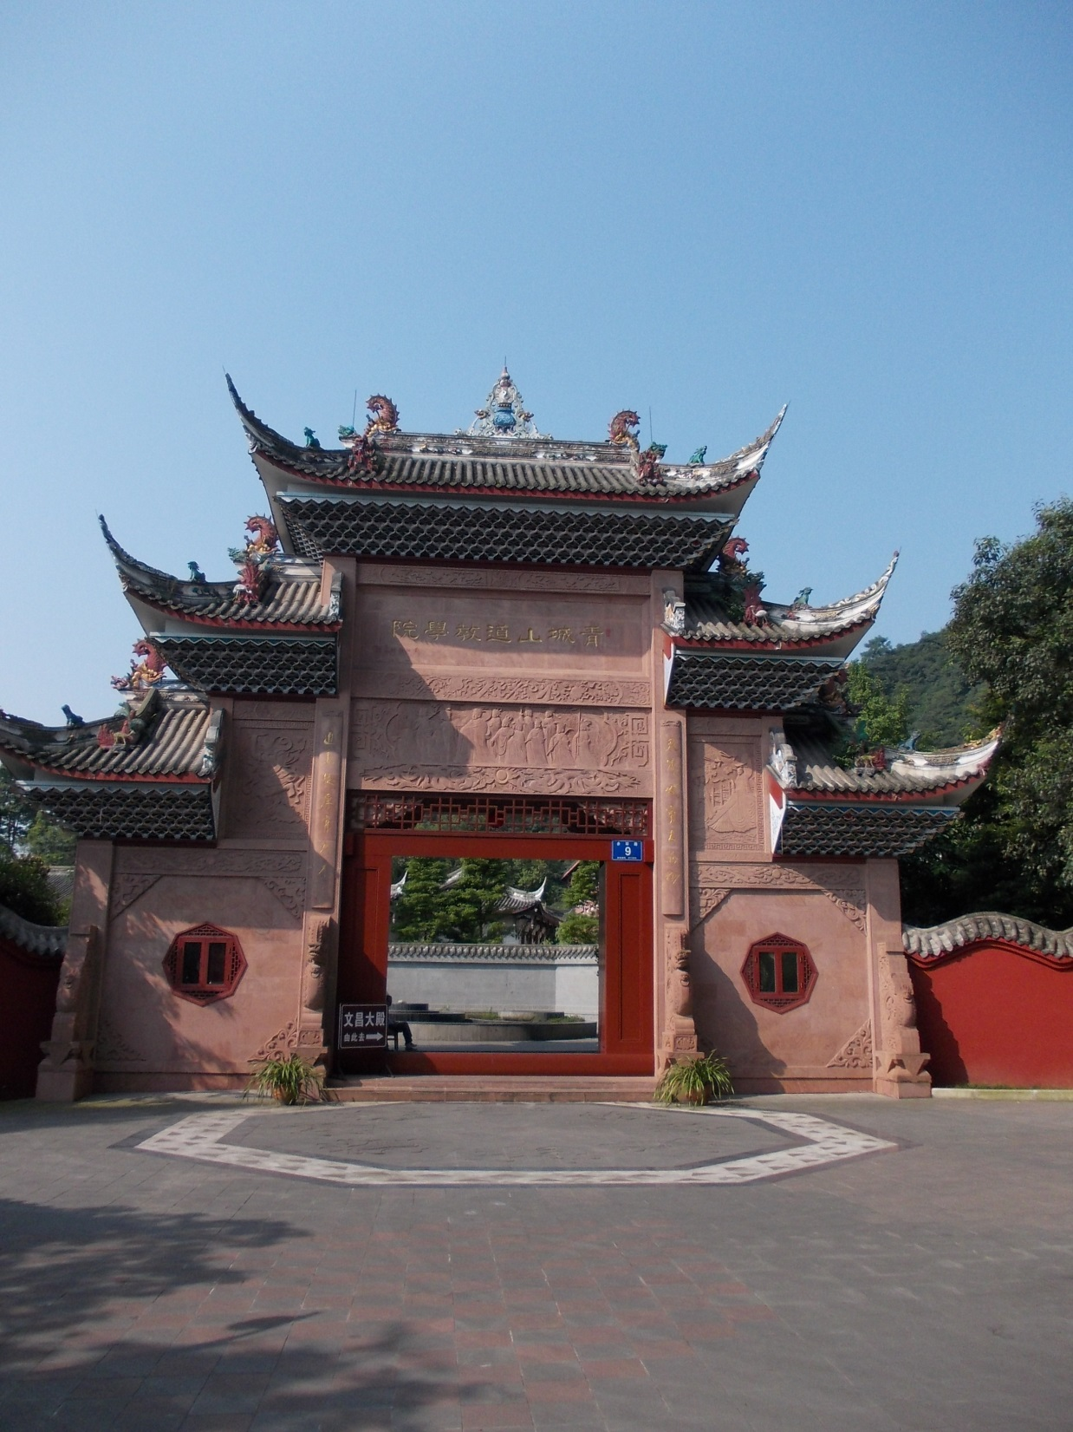

Slide 34
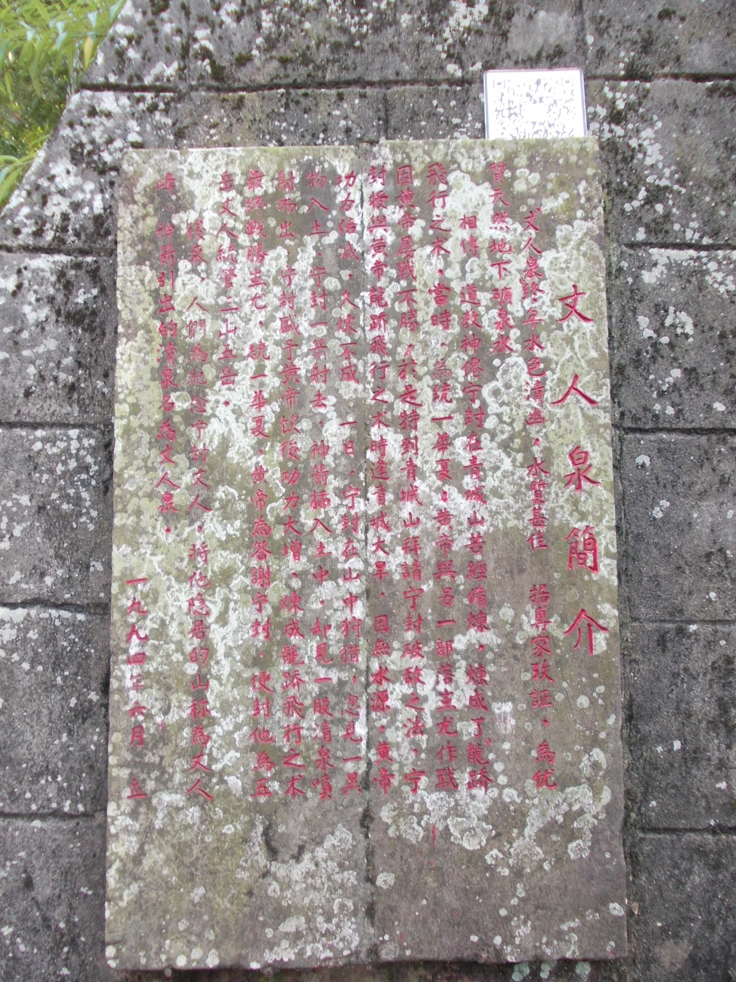
Old and New
QR code to tell you about the stone tablet!

Slide 35
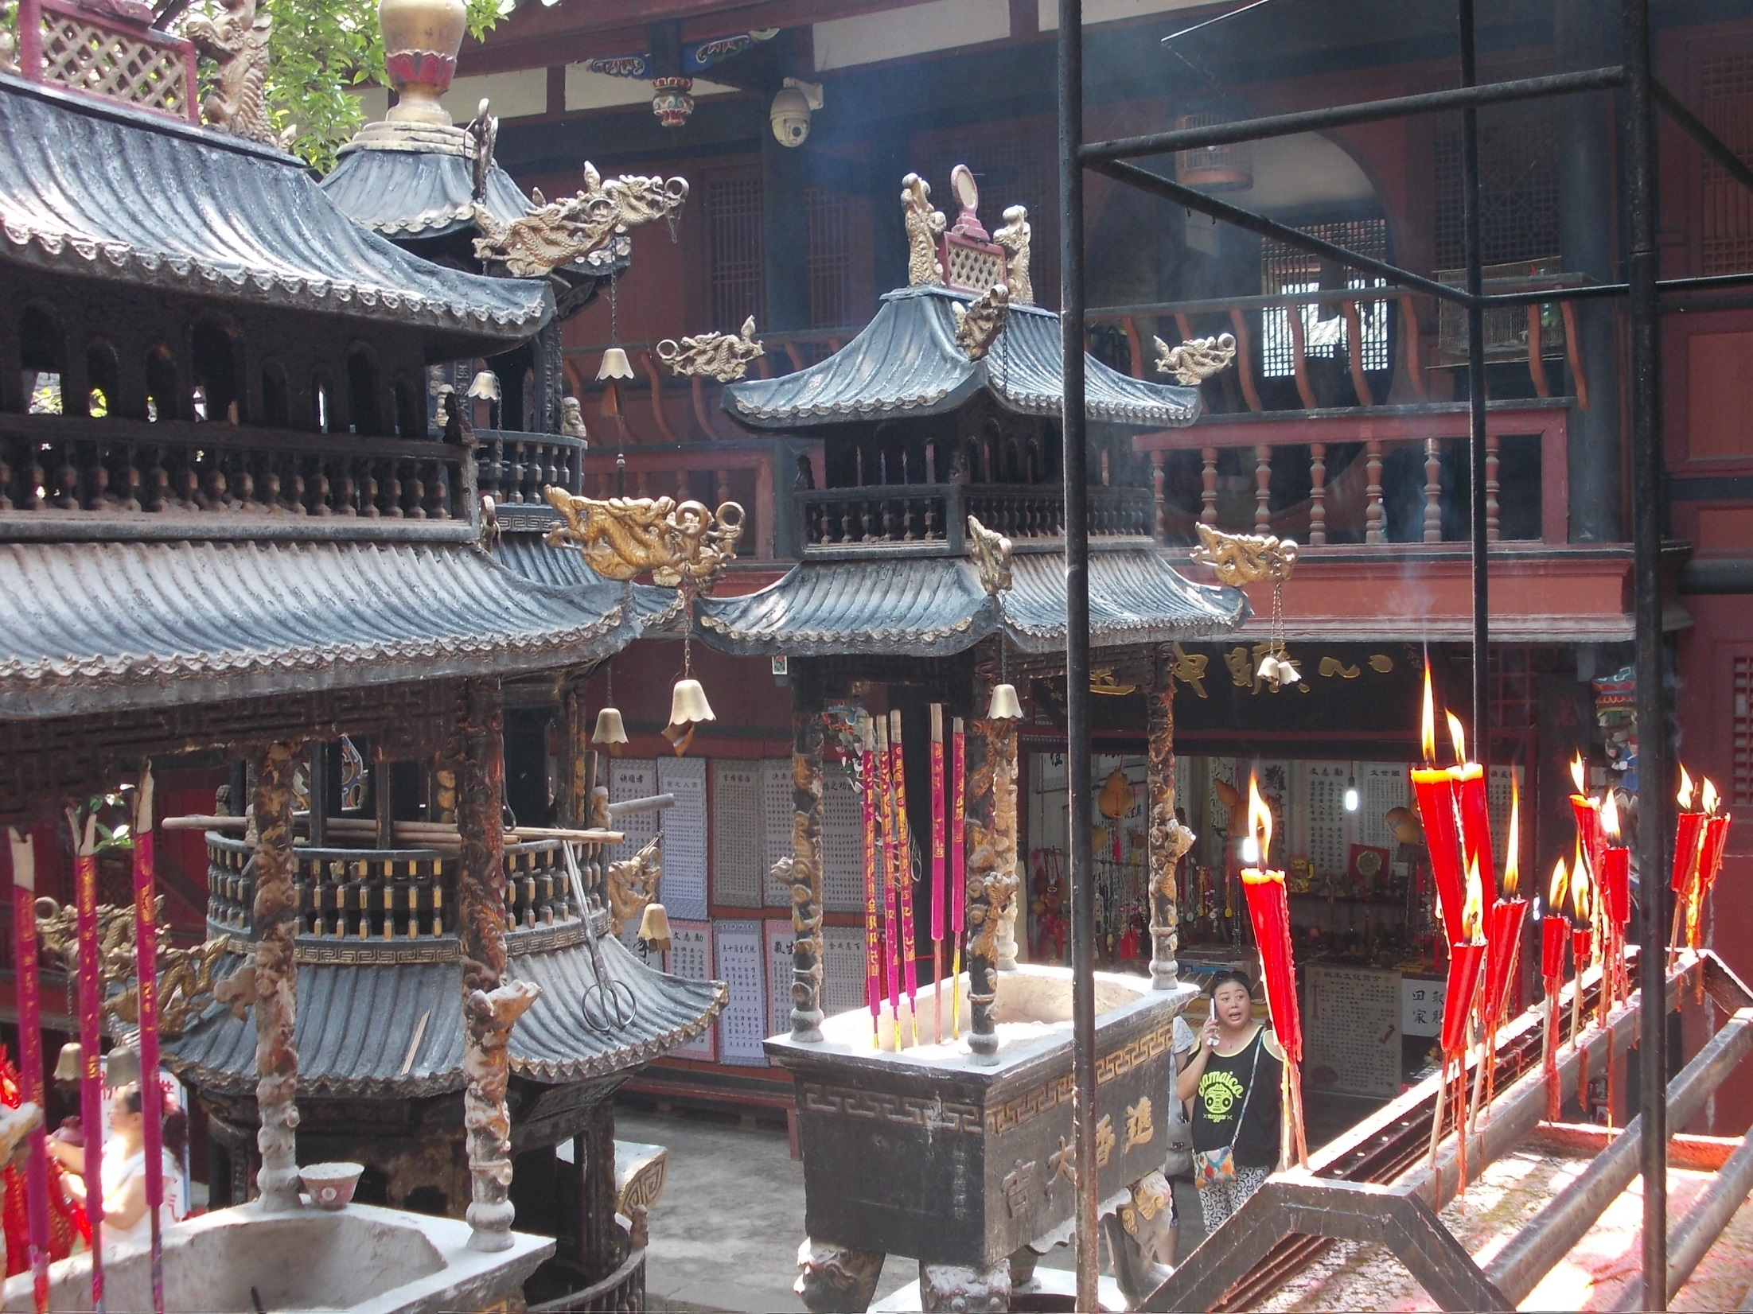

Slide 36
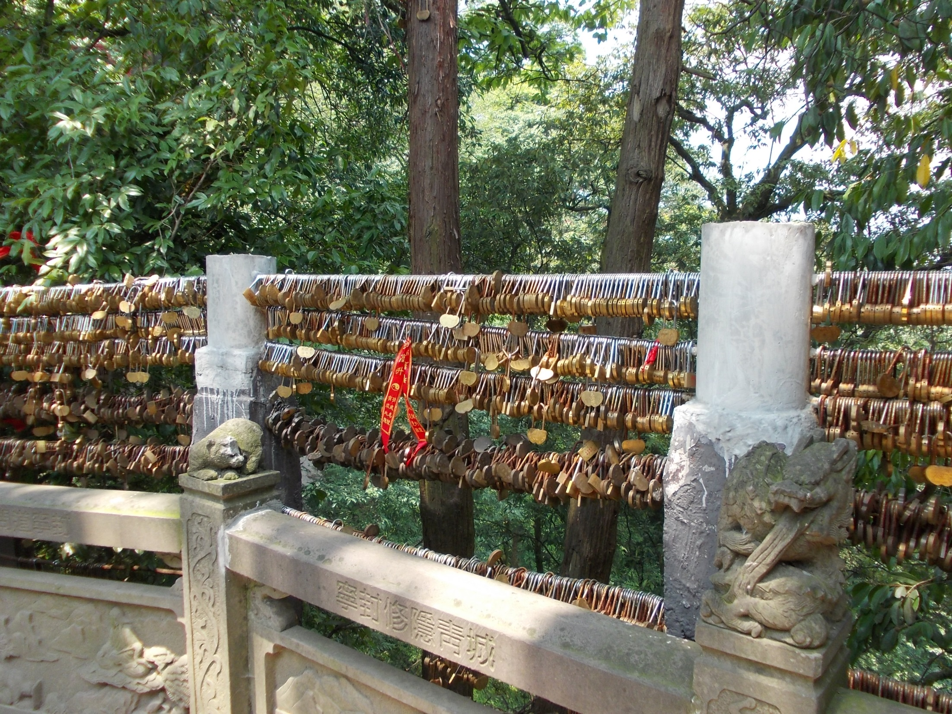
Locks of Eternal Love!

Slide 37
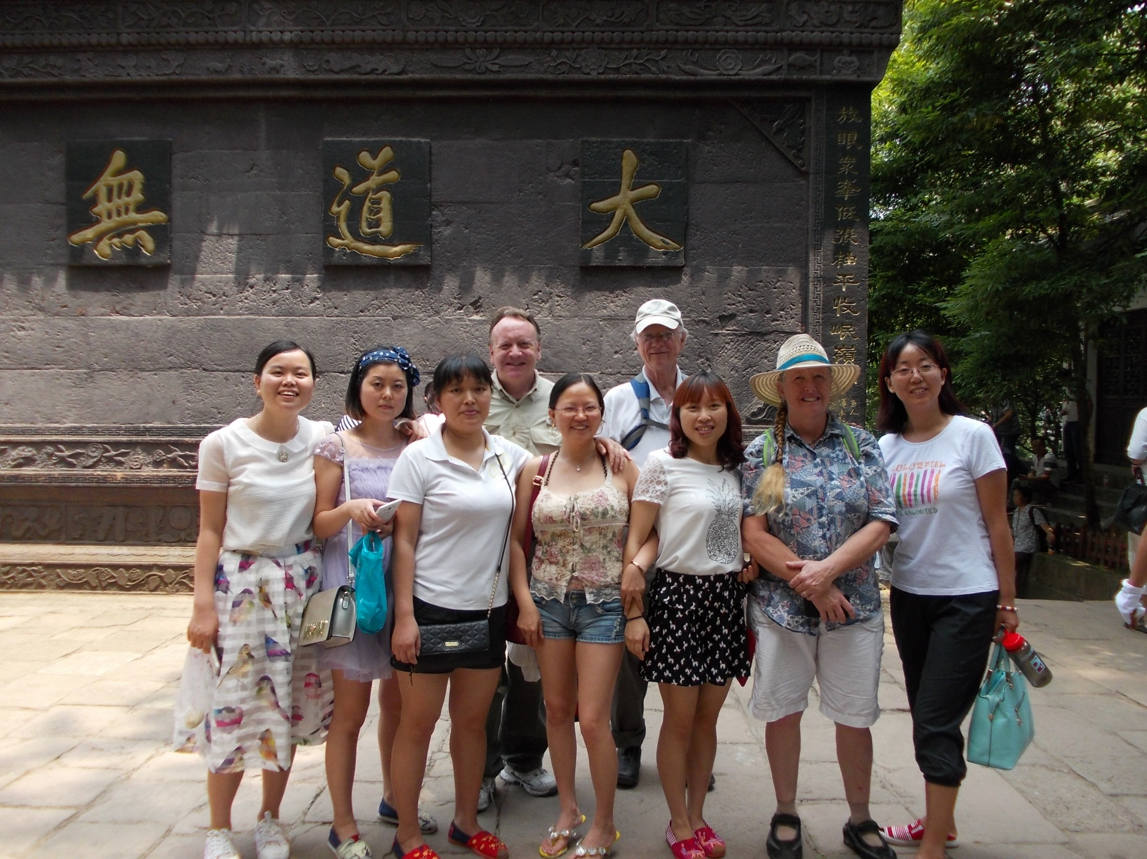

Slide 38
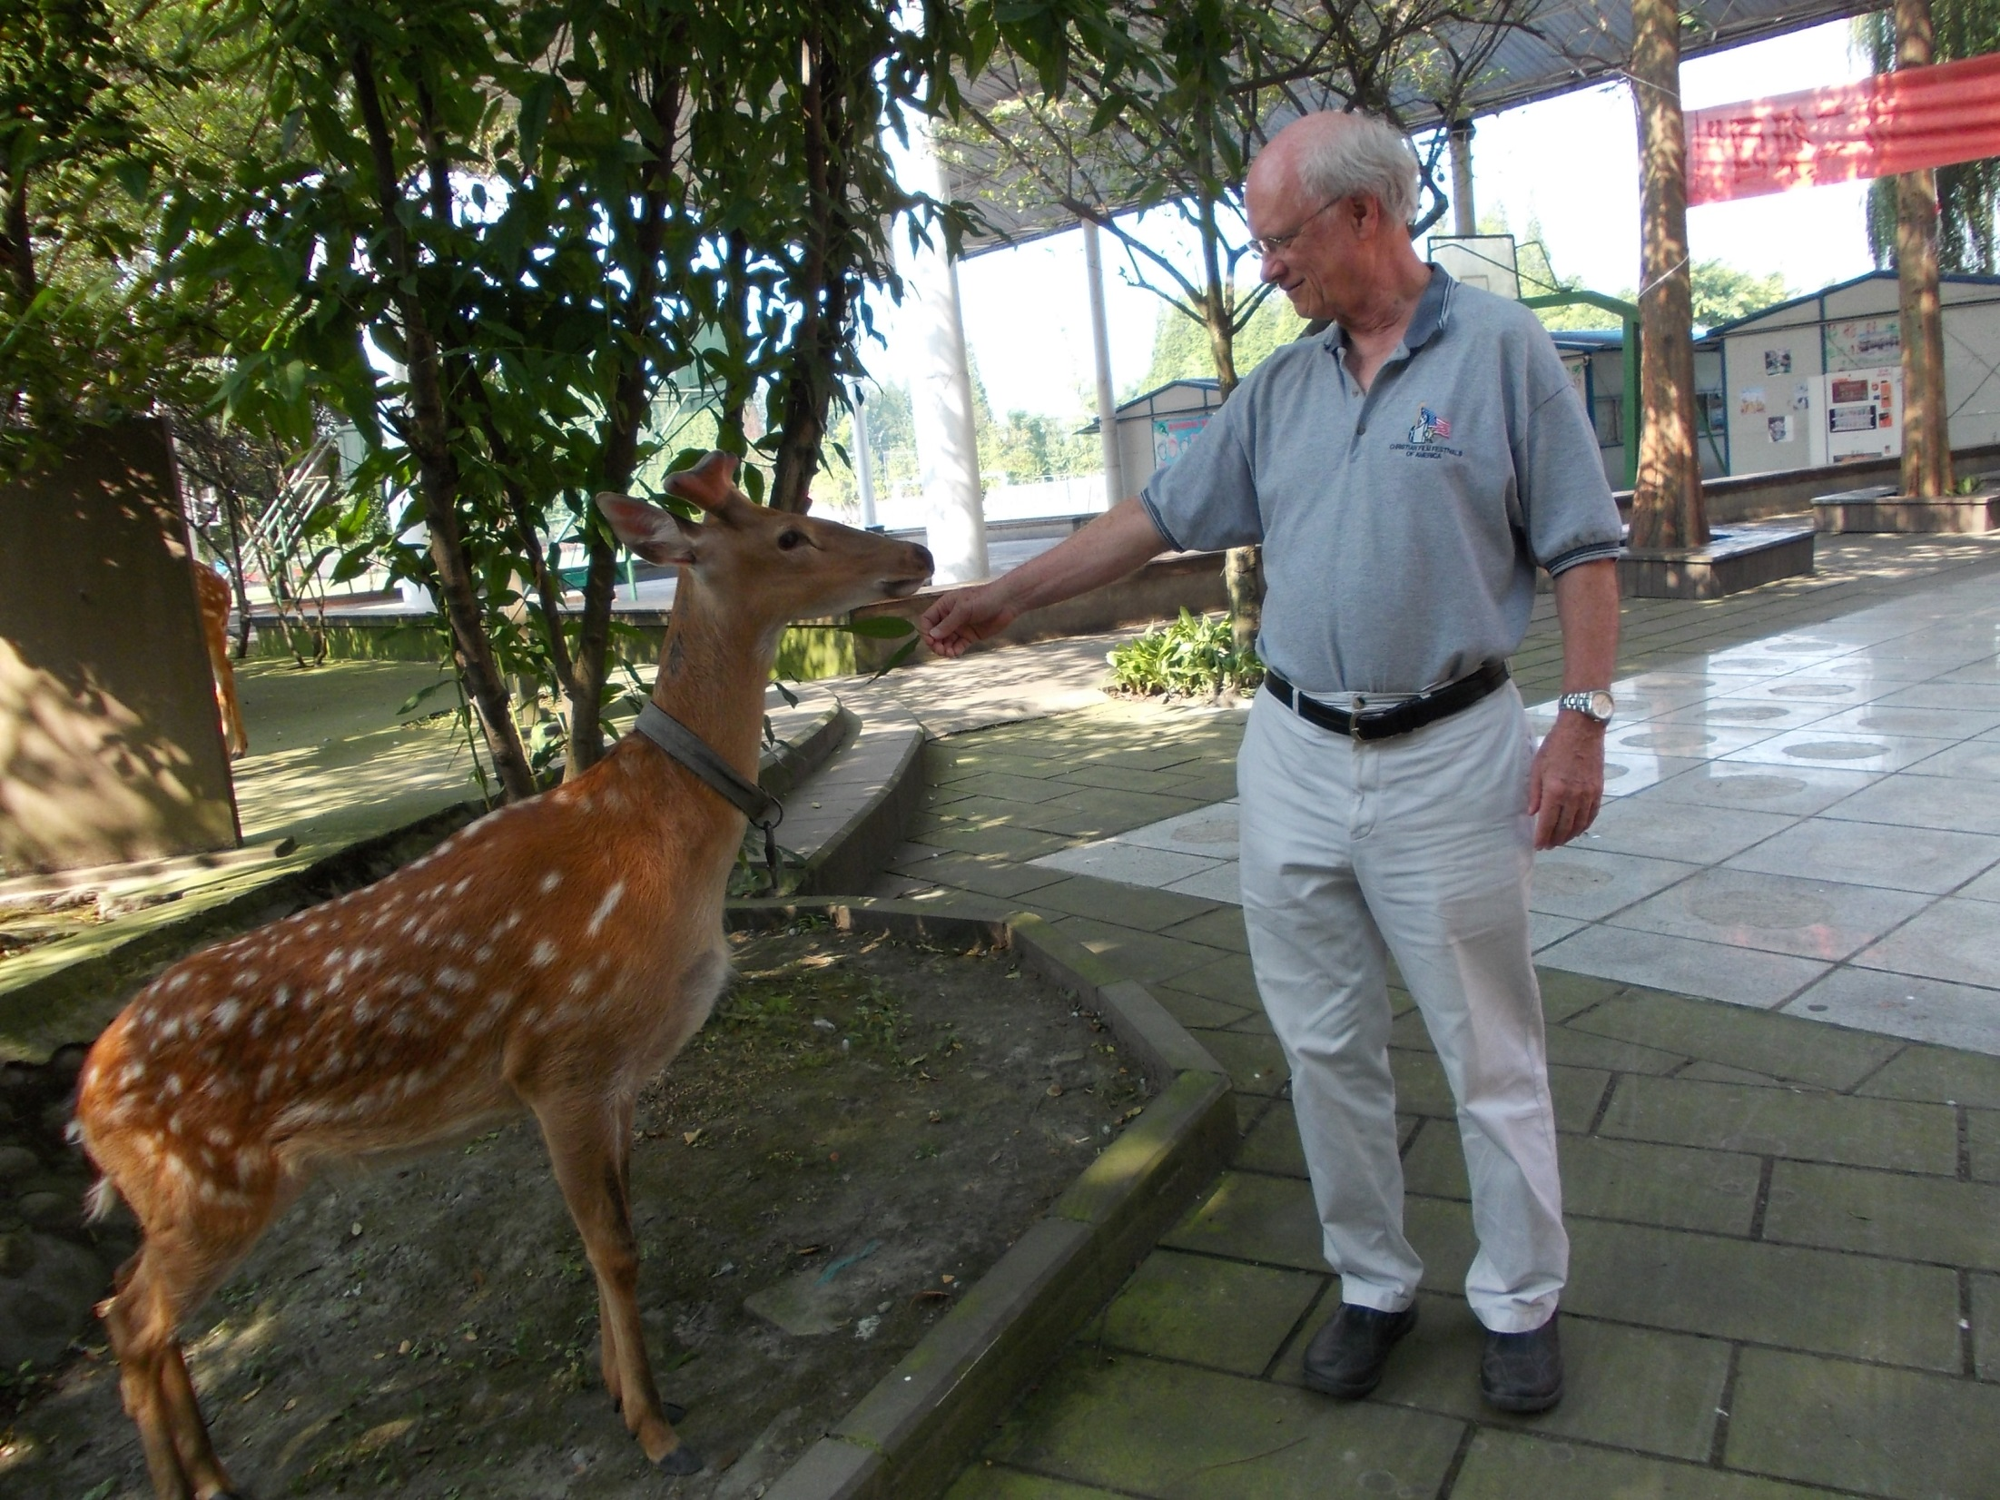
Guangya campus has deer and other animals that roam around the school.

Slide 39
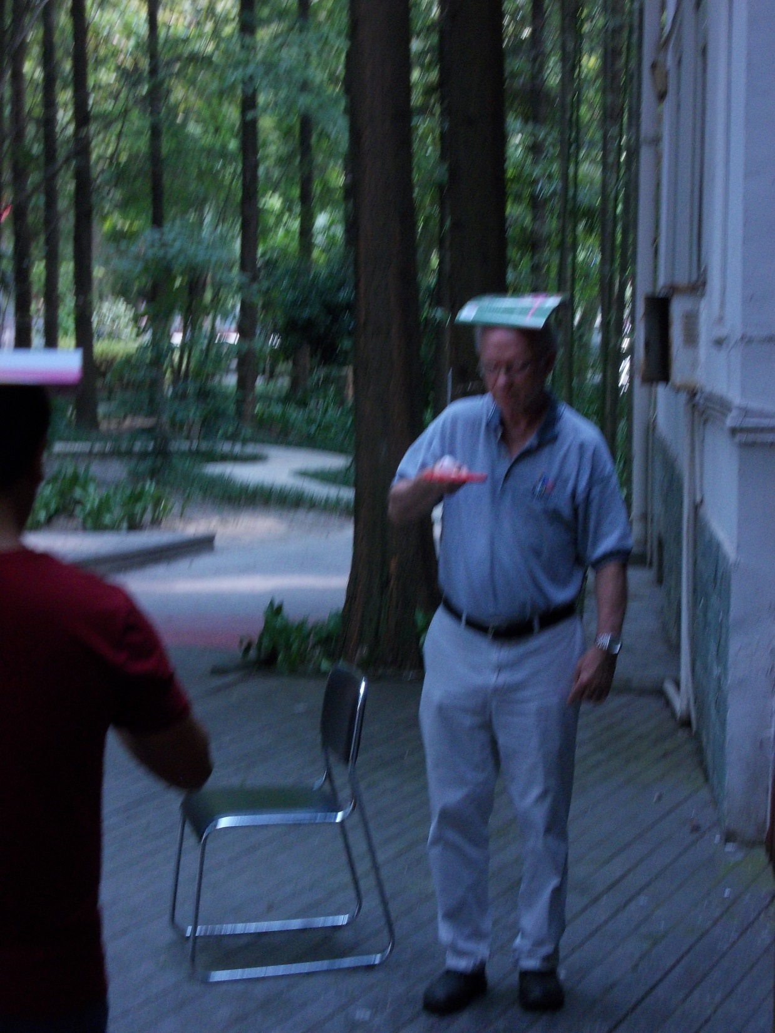
Group games to encourage teamwork and encouragement to each other.

Slide 40
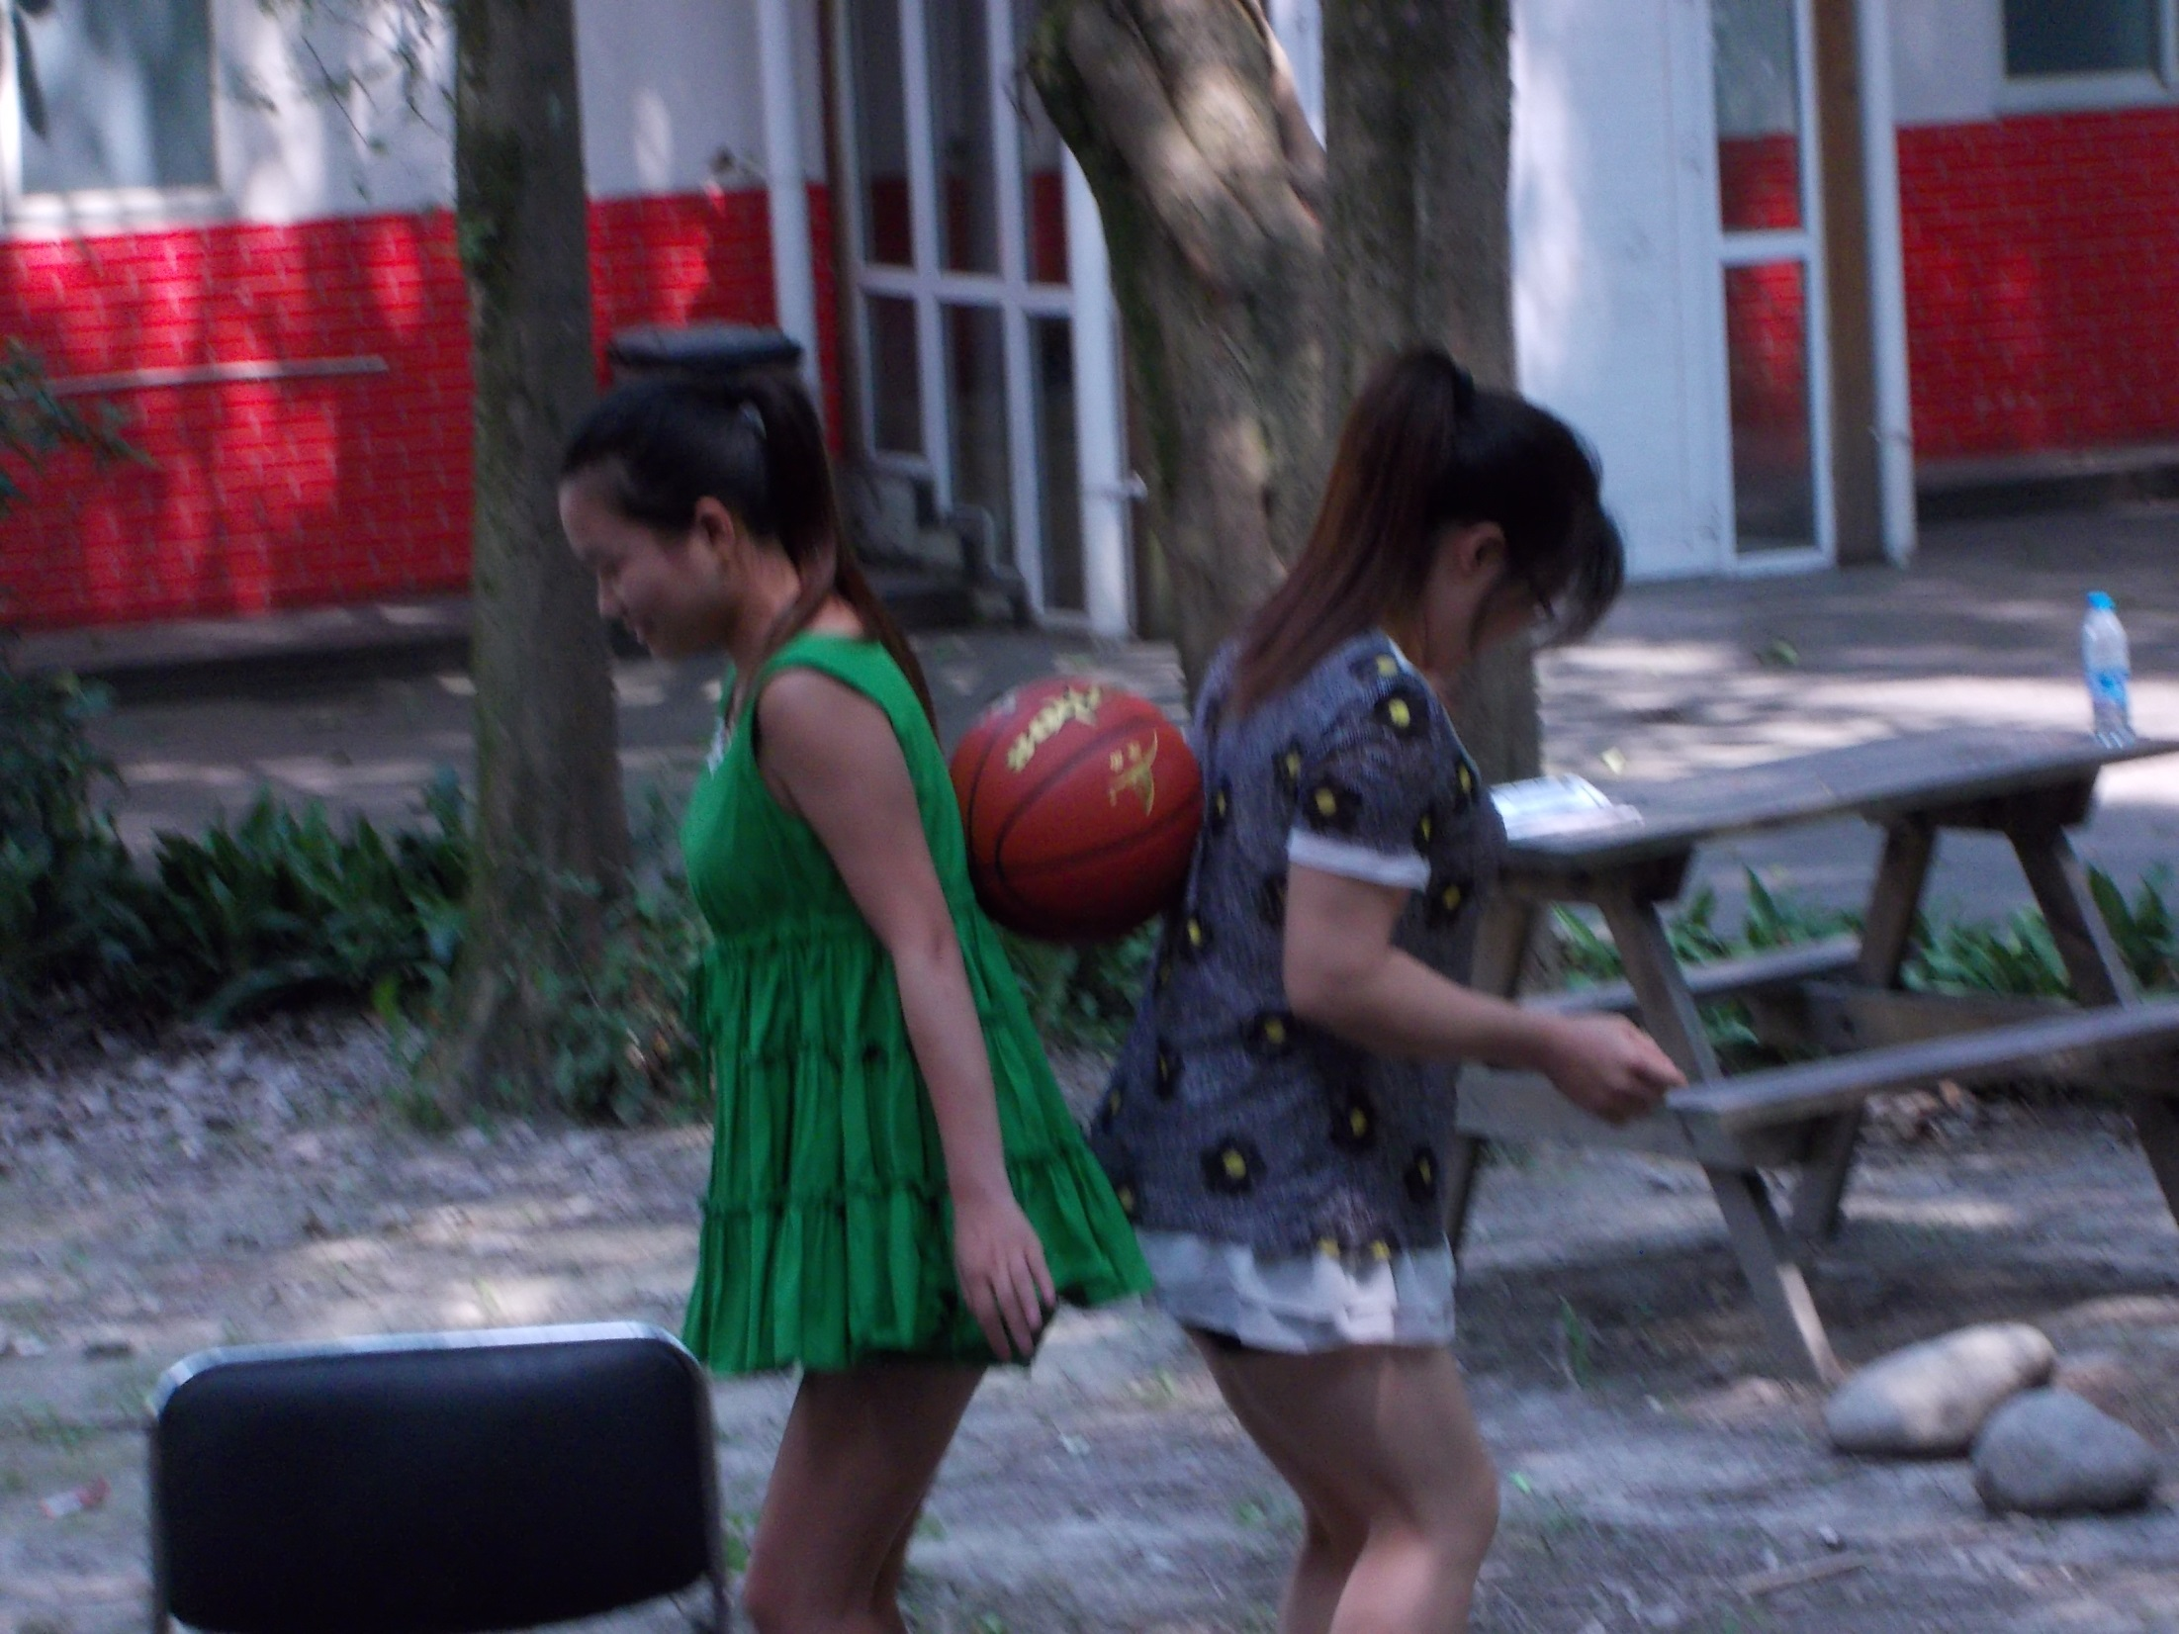

Slide 41
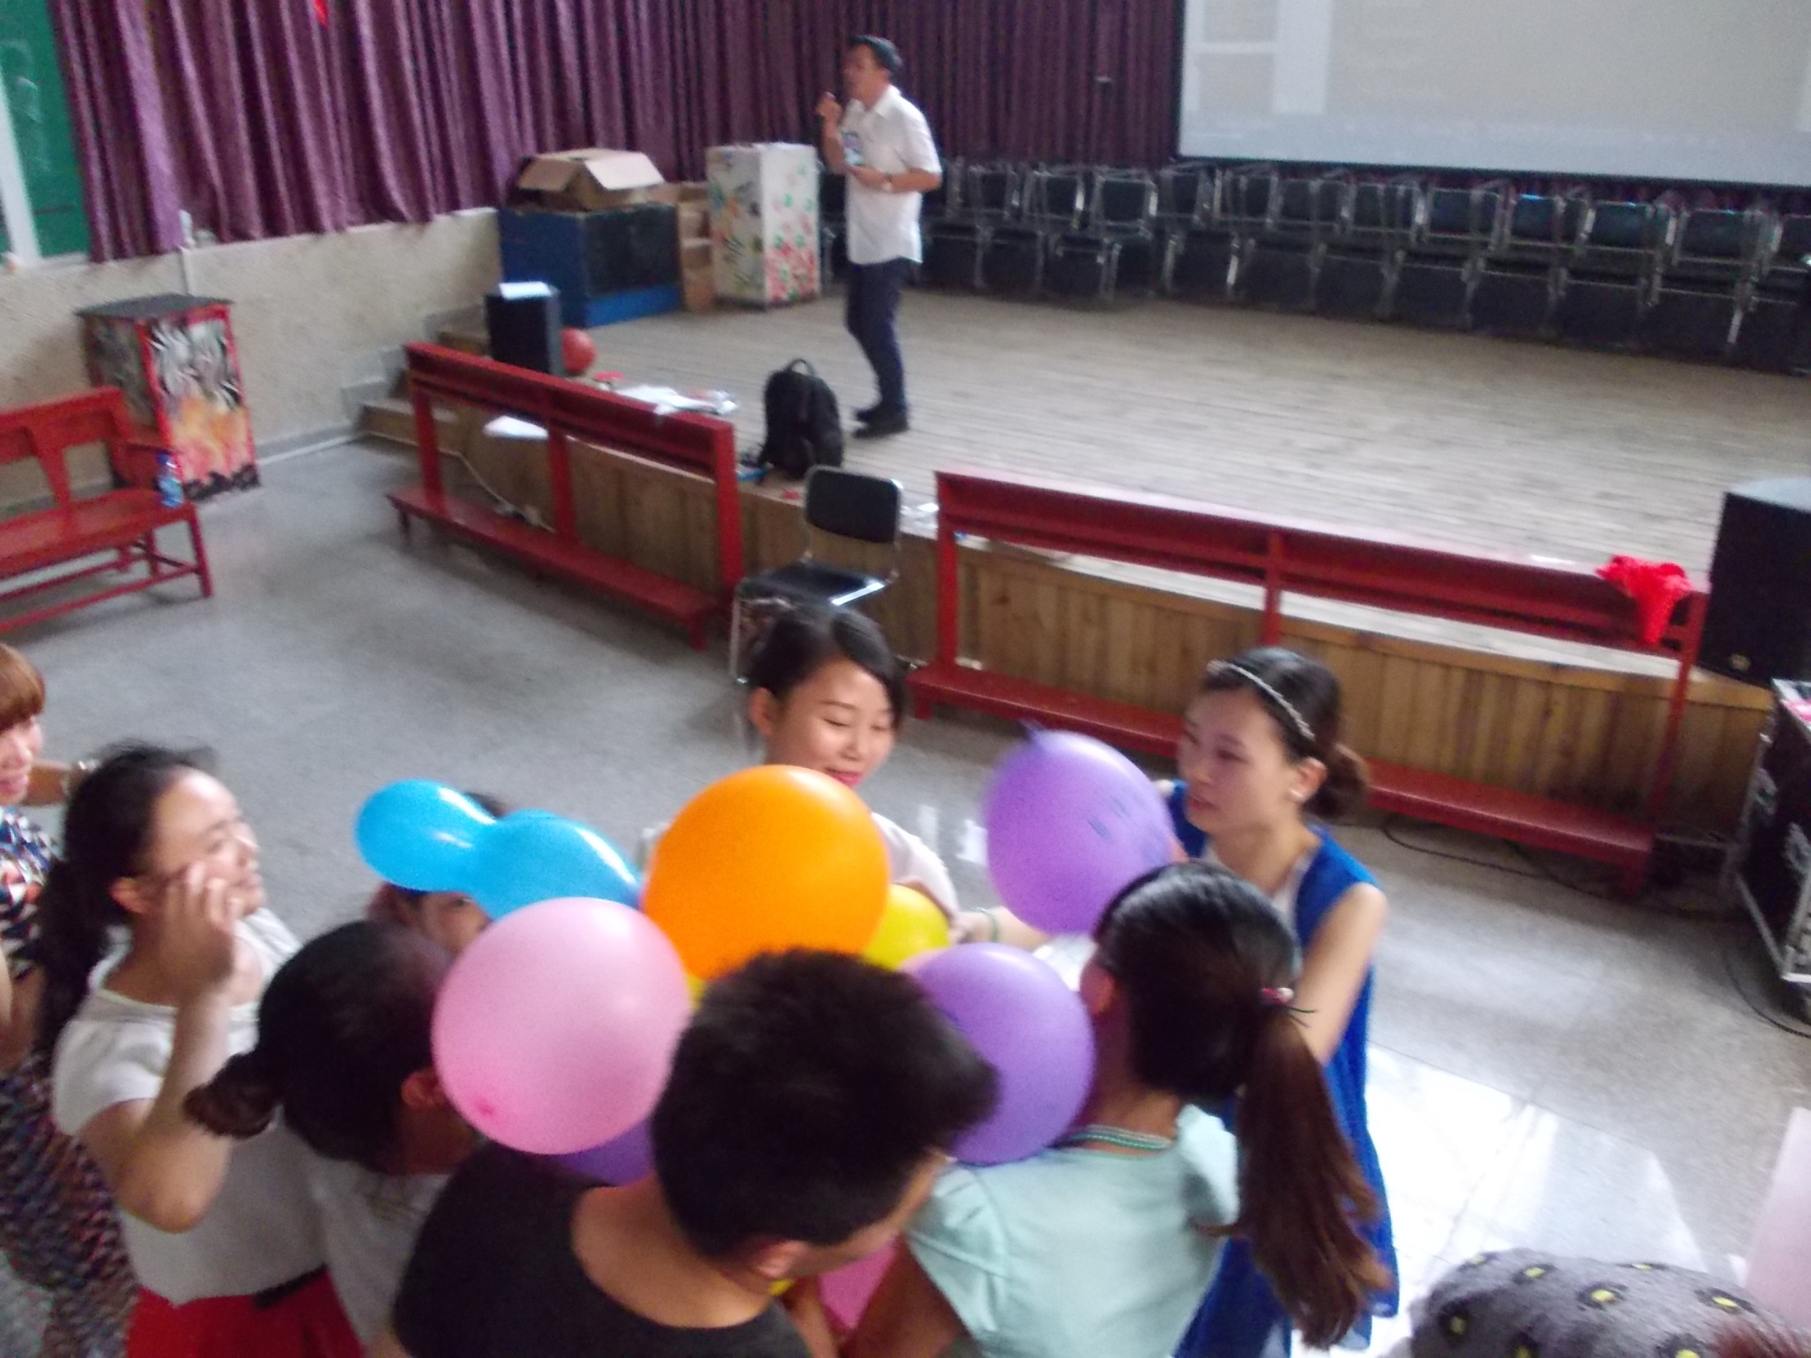

Slide 42
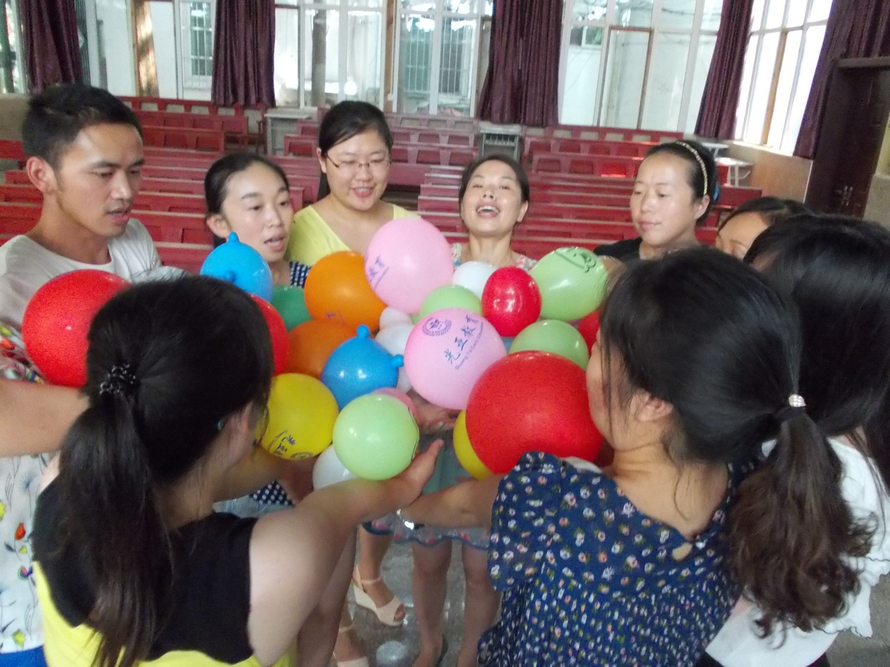

Slide 43
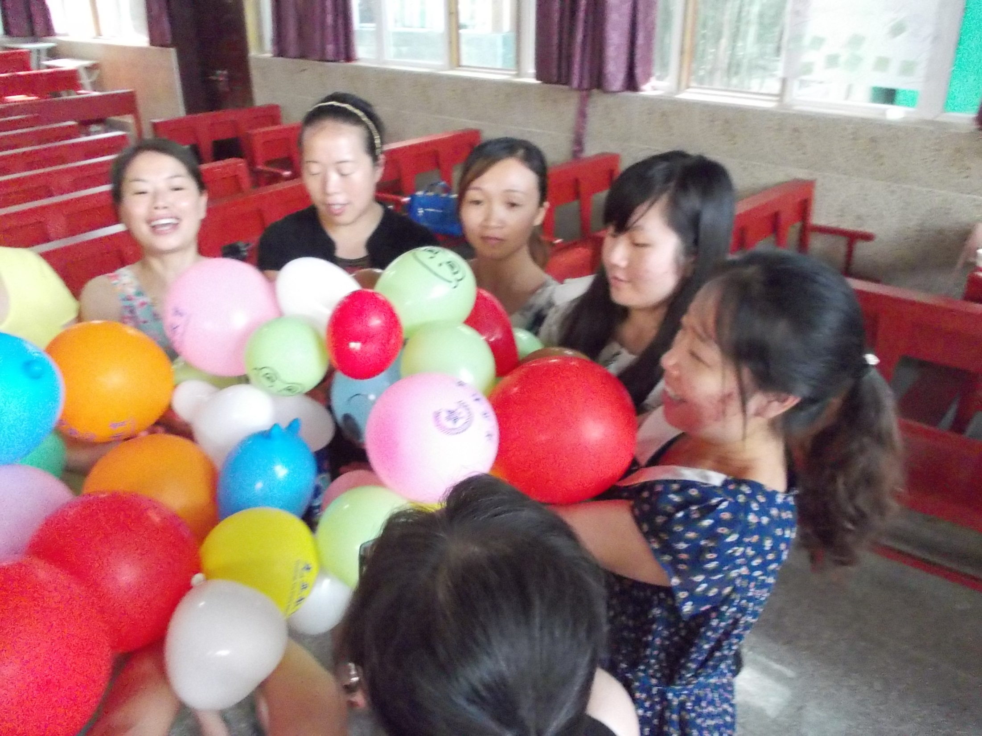
Balance and hold all the LIFE ROLES together!

Slide 44
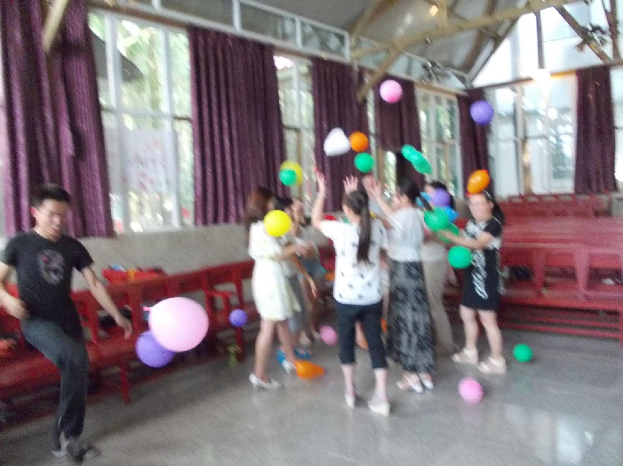

Slide 45
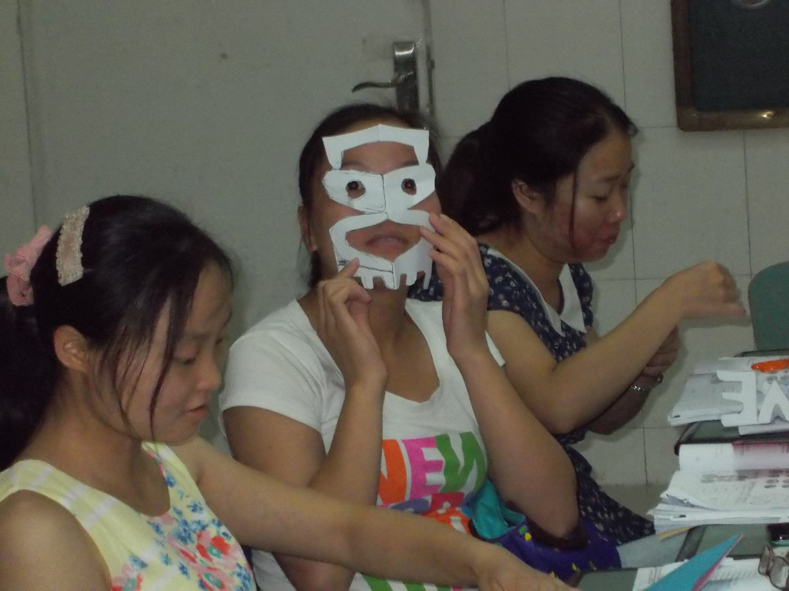
“The Many Faces Of Love” This activity is a symmetry and paper cutout to show “LOVE”.

Slide 46
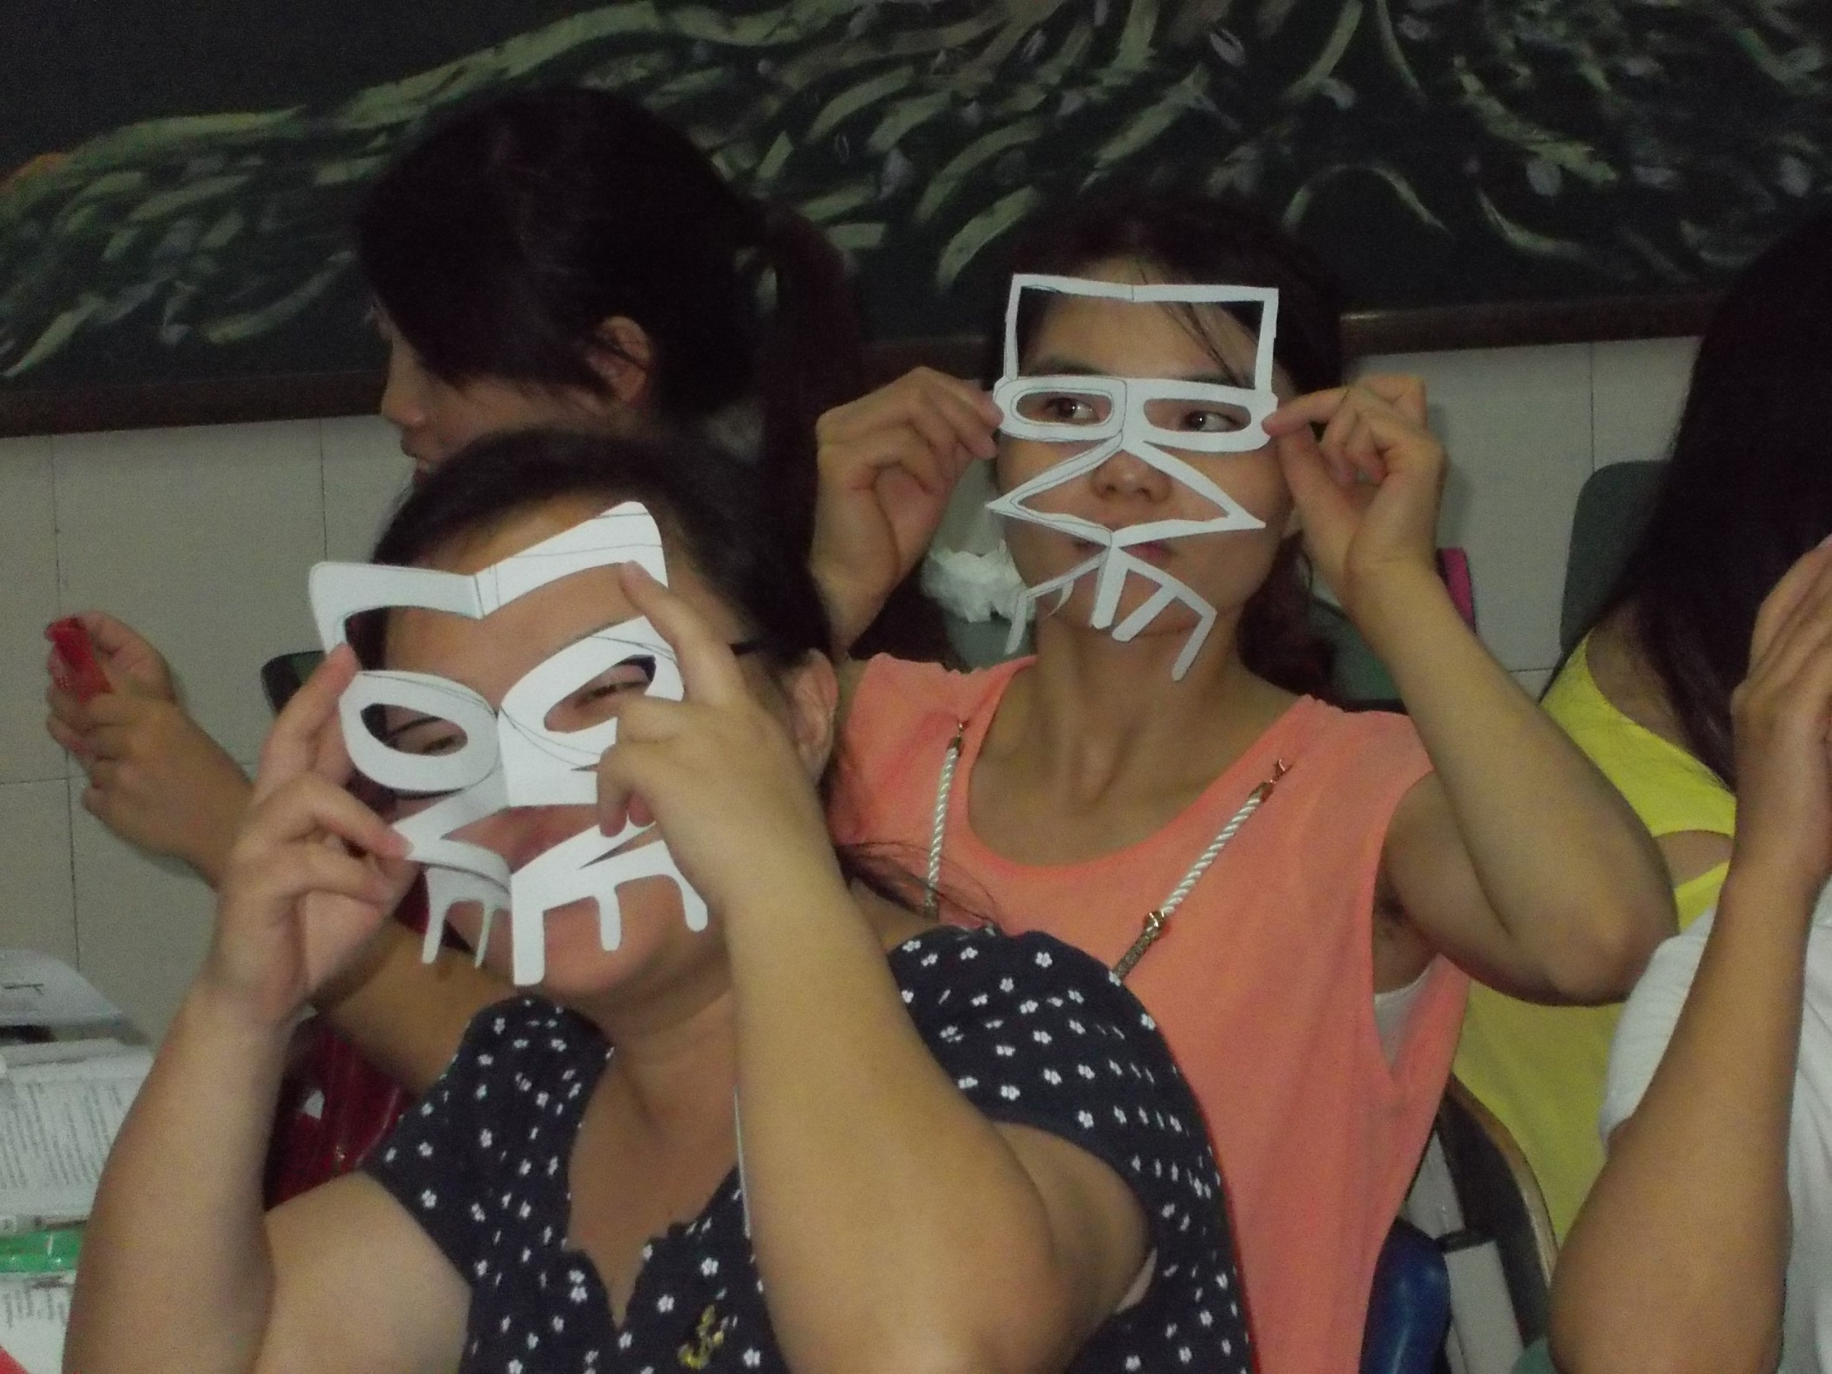

Slide 47
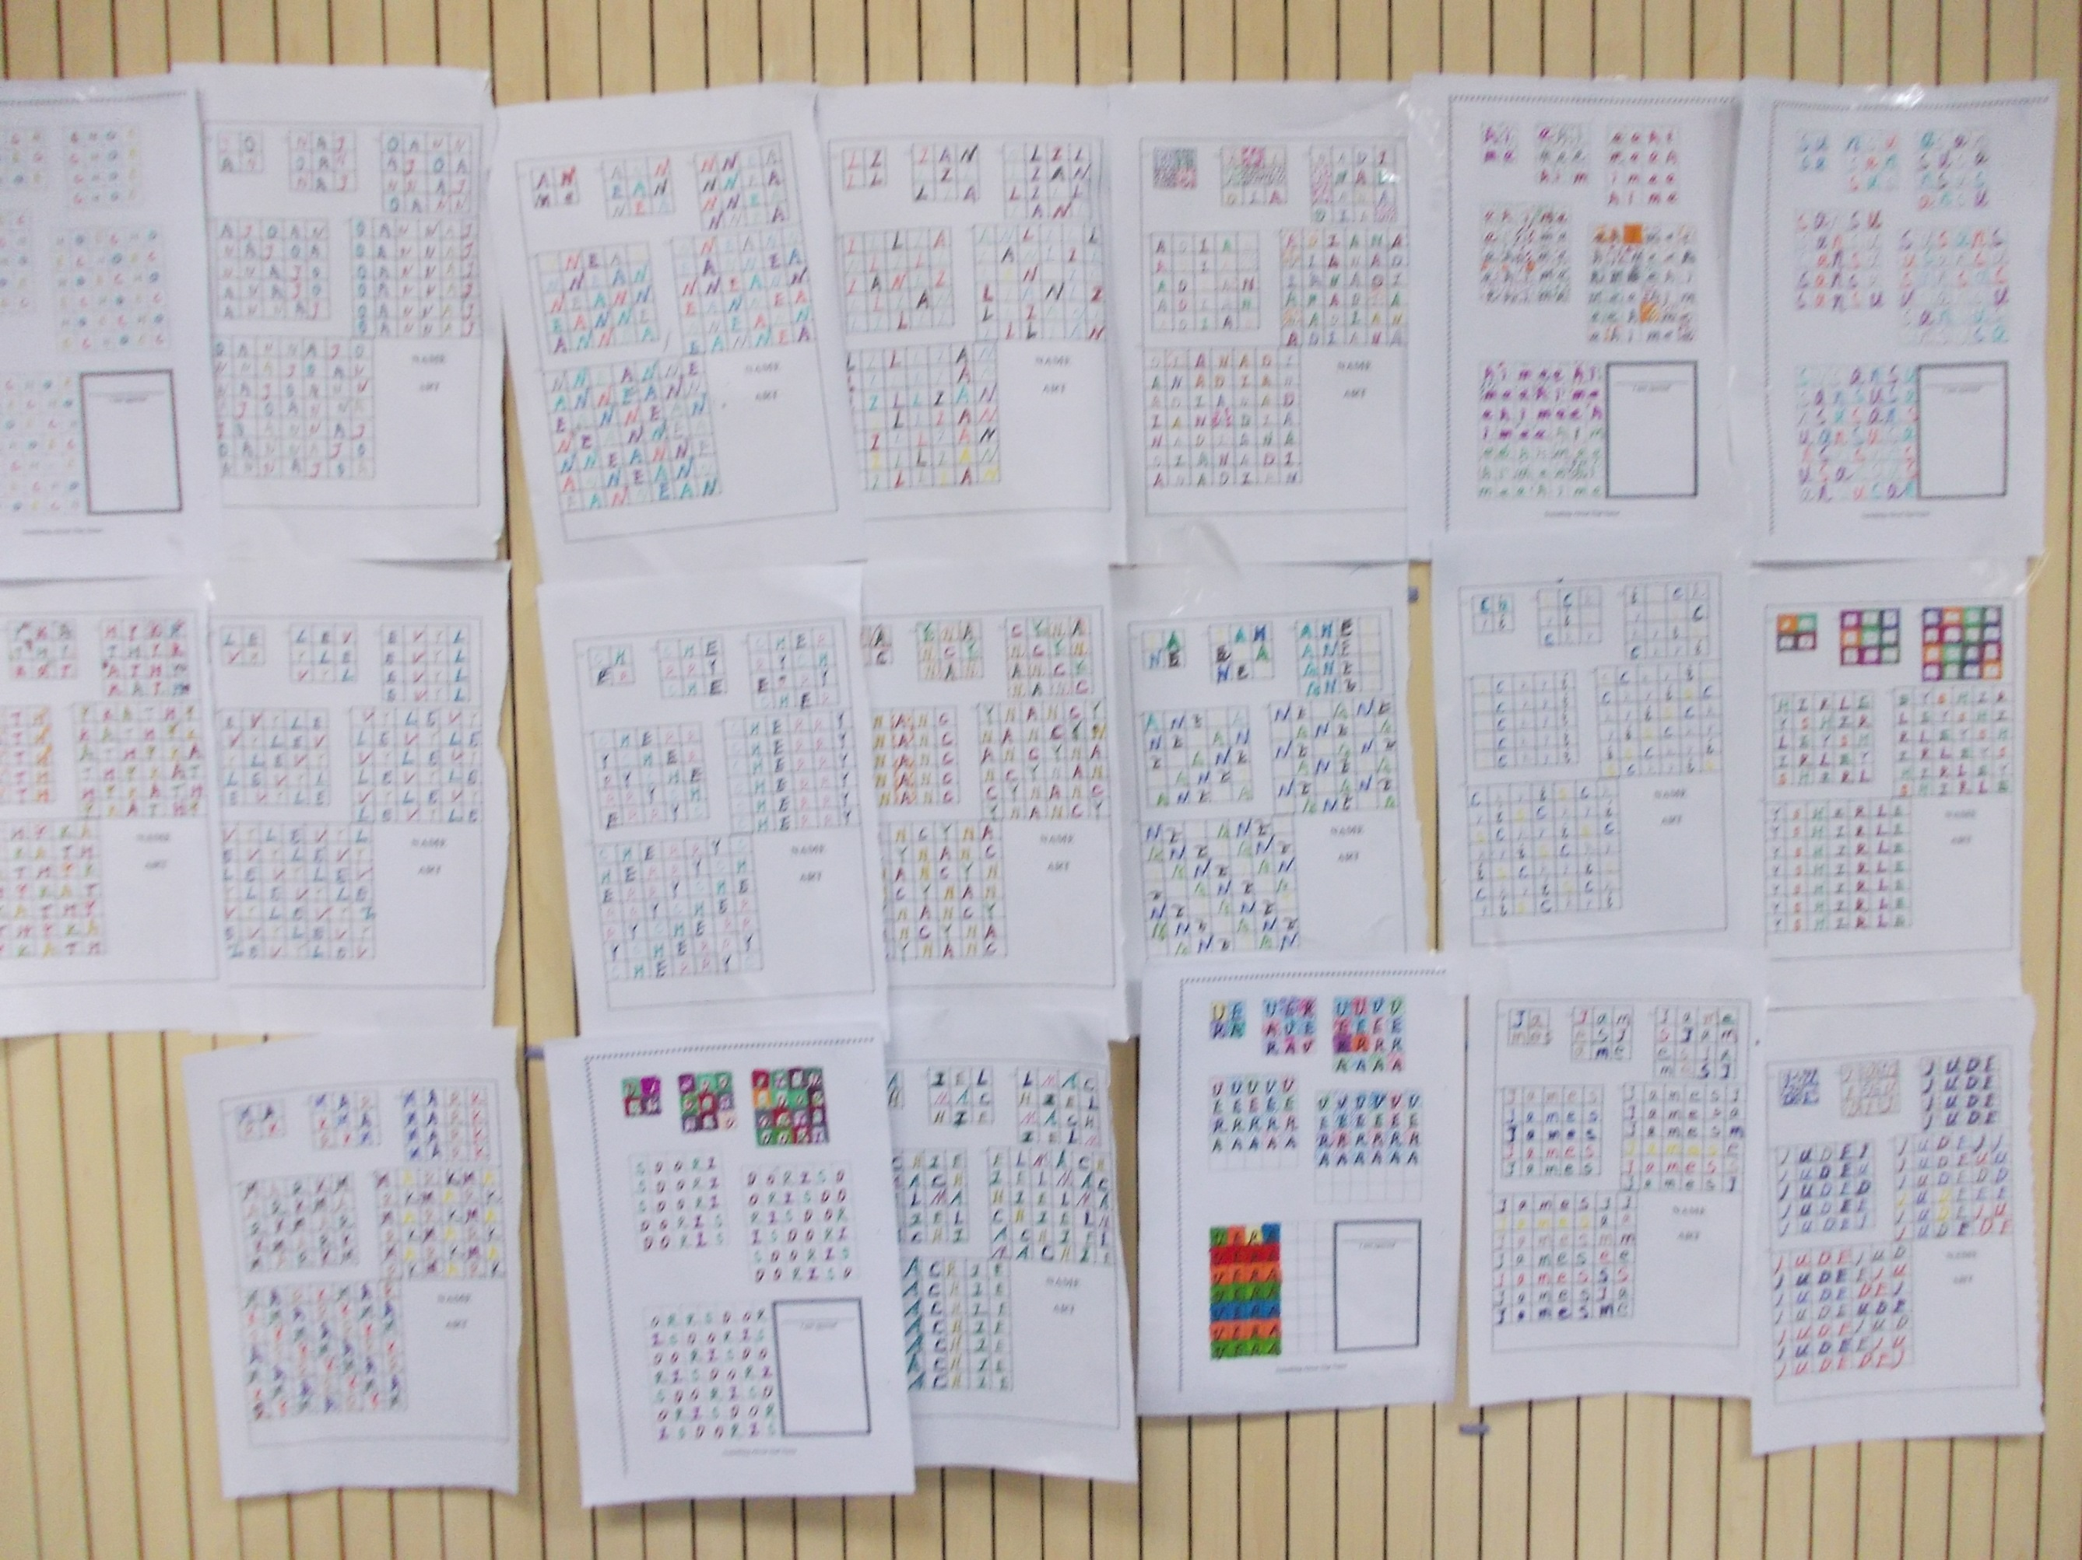
Something Special About that Name
Name Quilt Patterns. How we make a tapestry of our lives woven together!

Slide 48
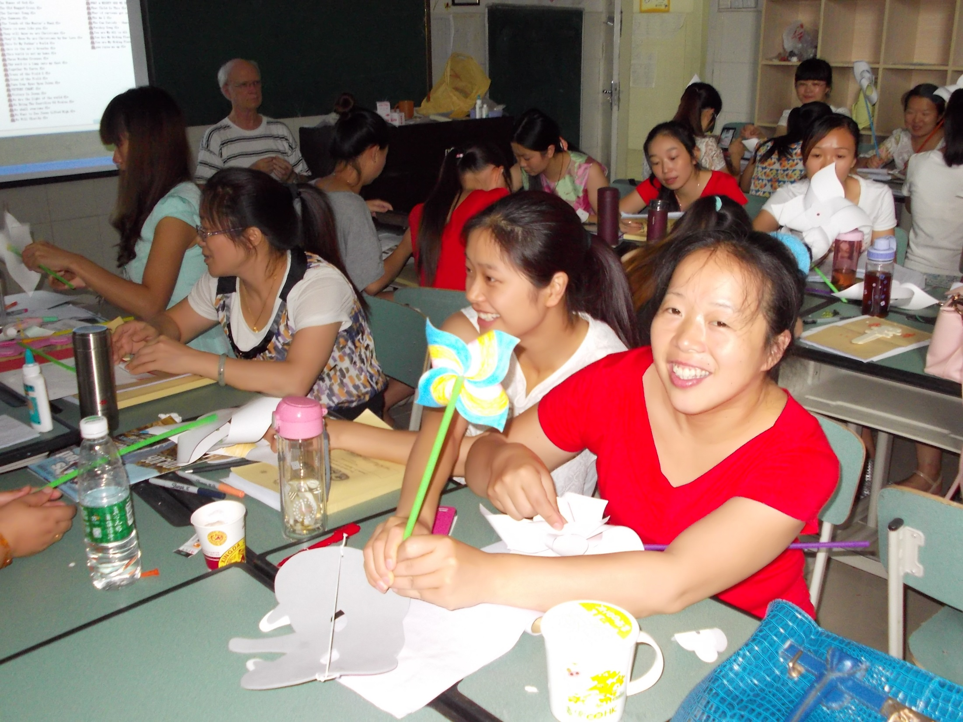
Pinwheels for Peace – International Peace Day

Slide 49
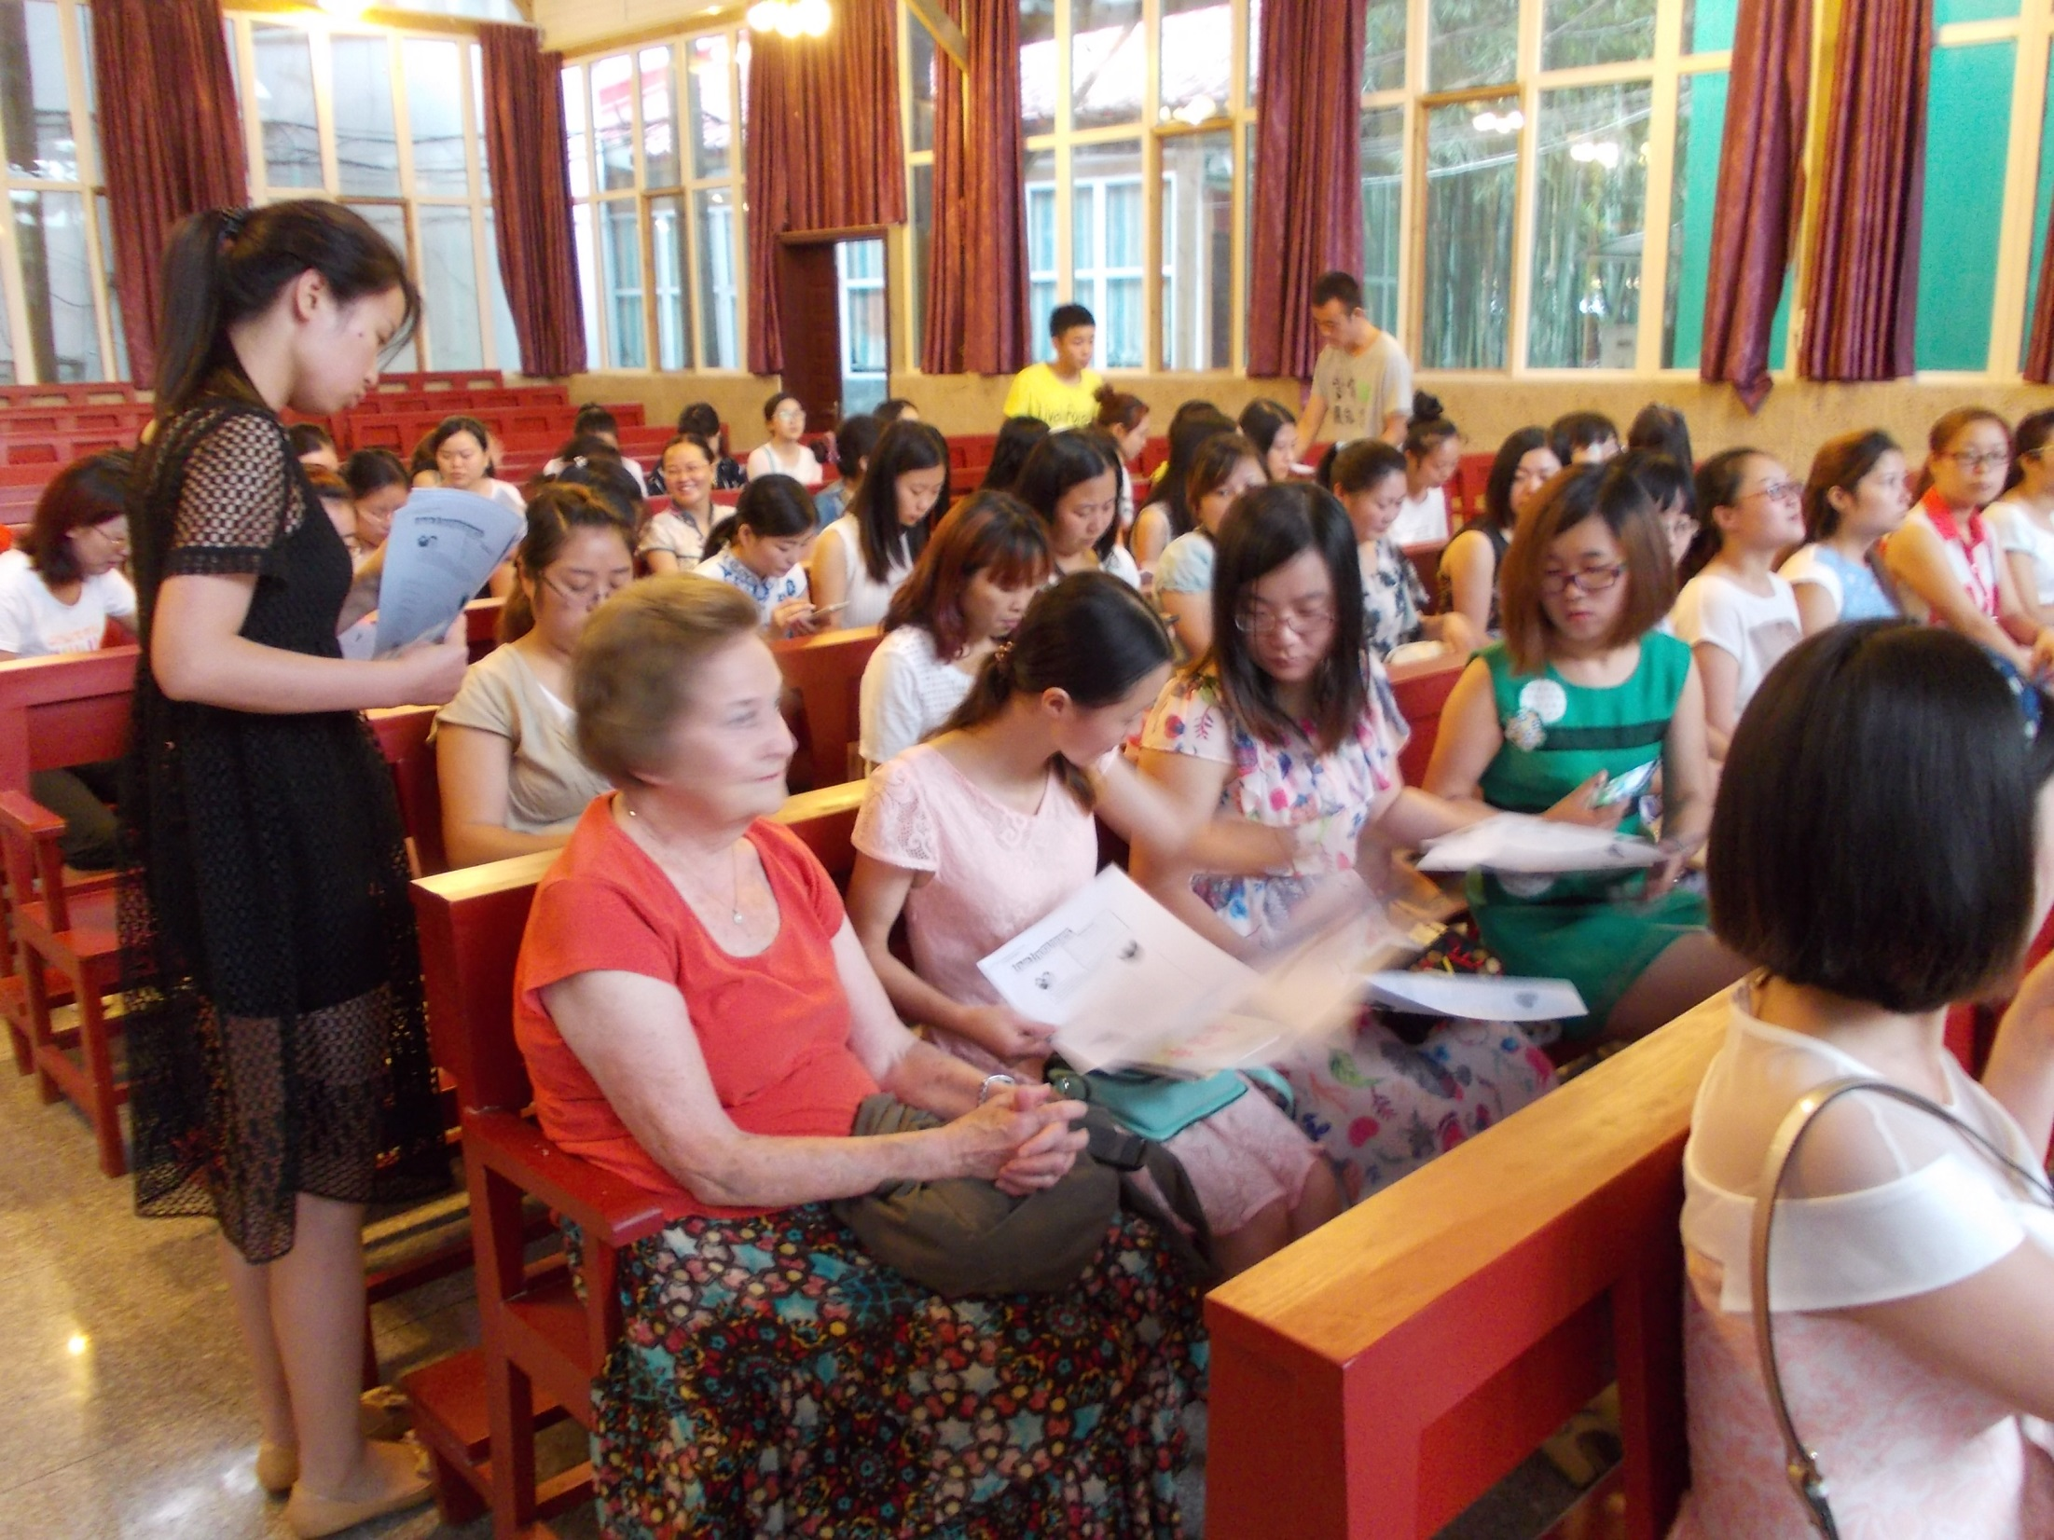

Slide 50
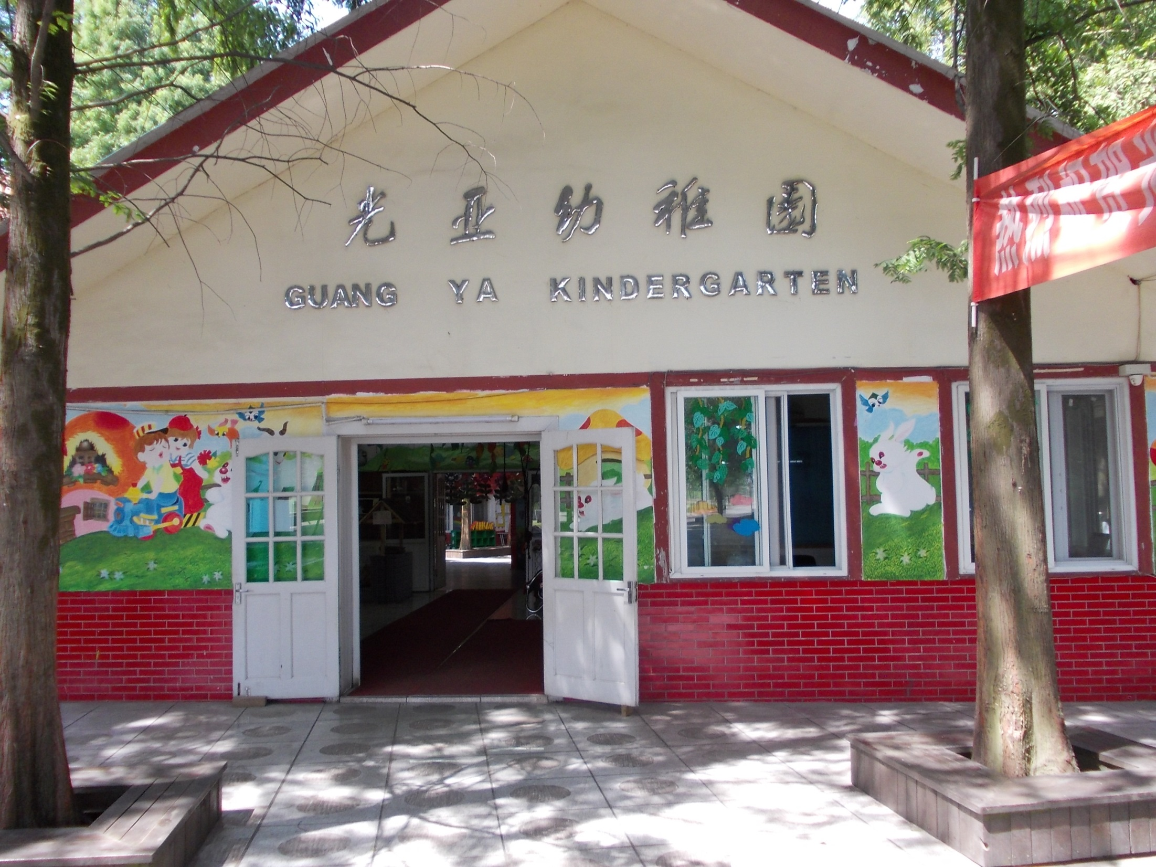

Slide 51
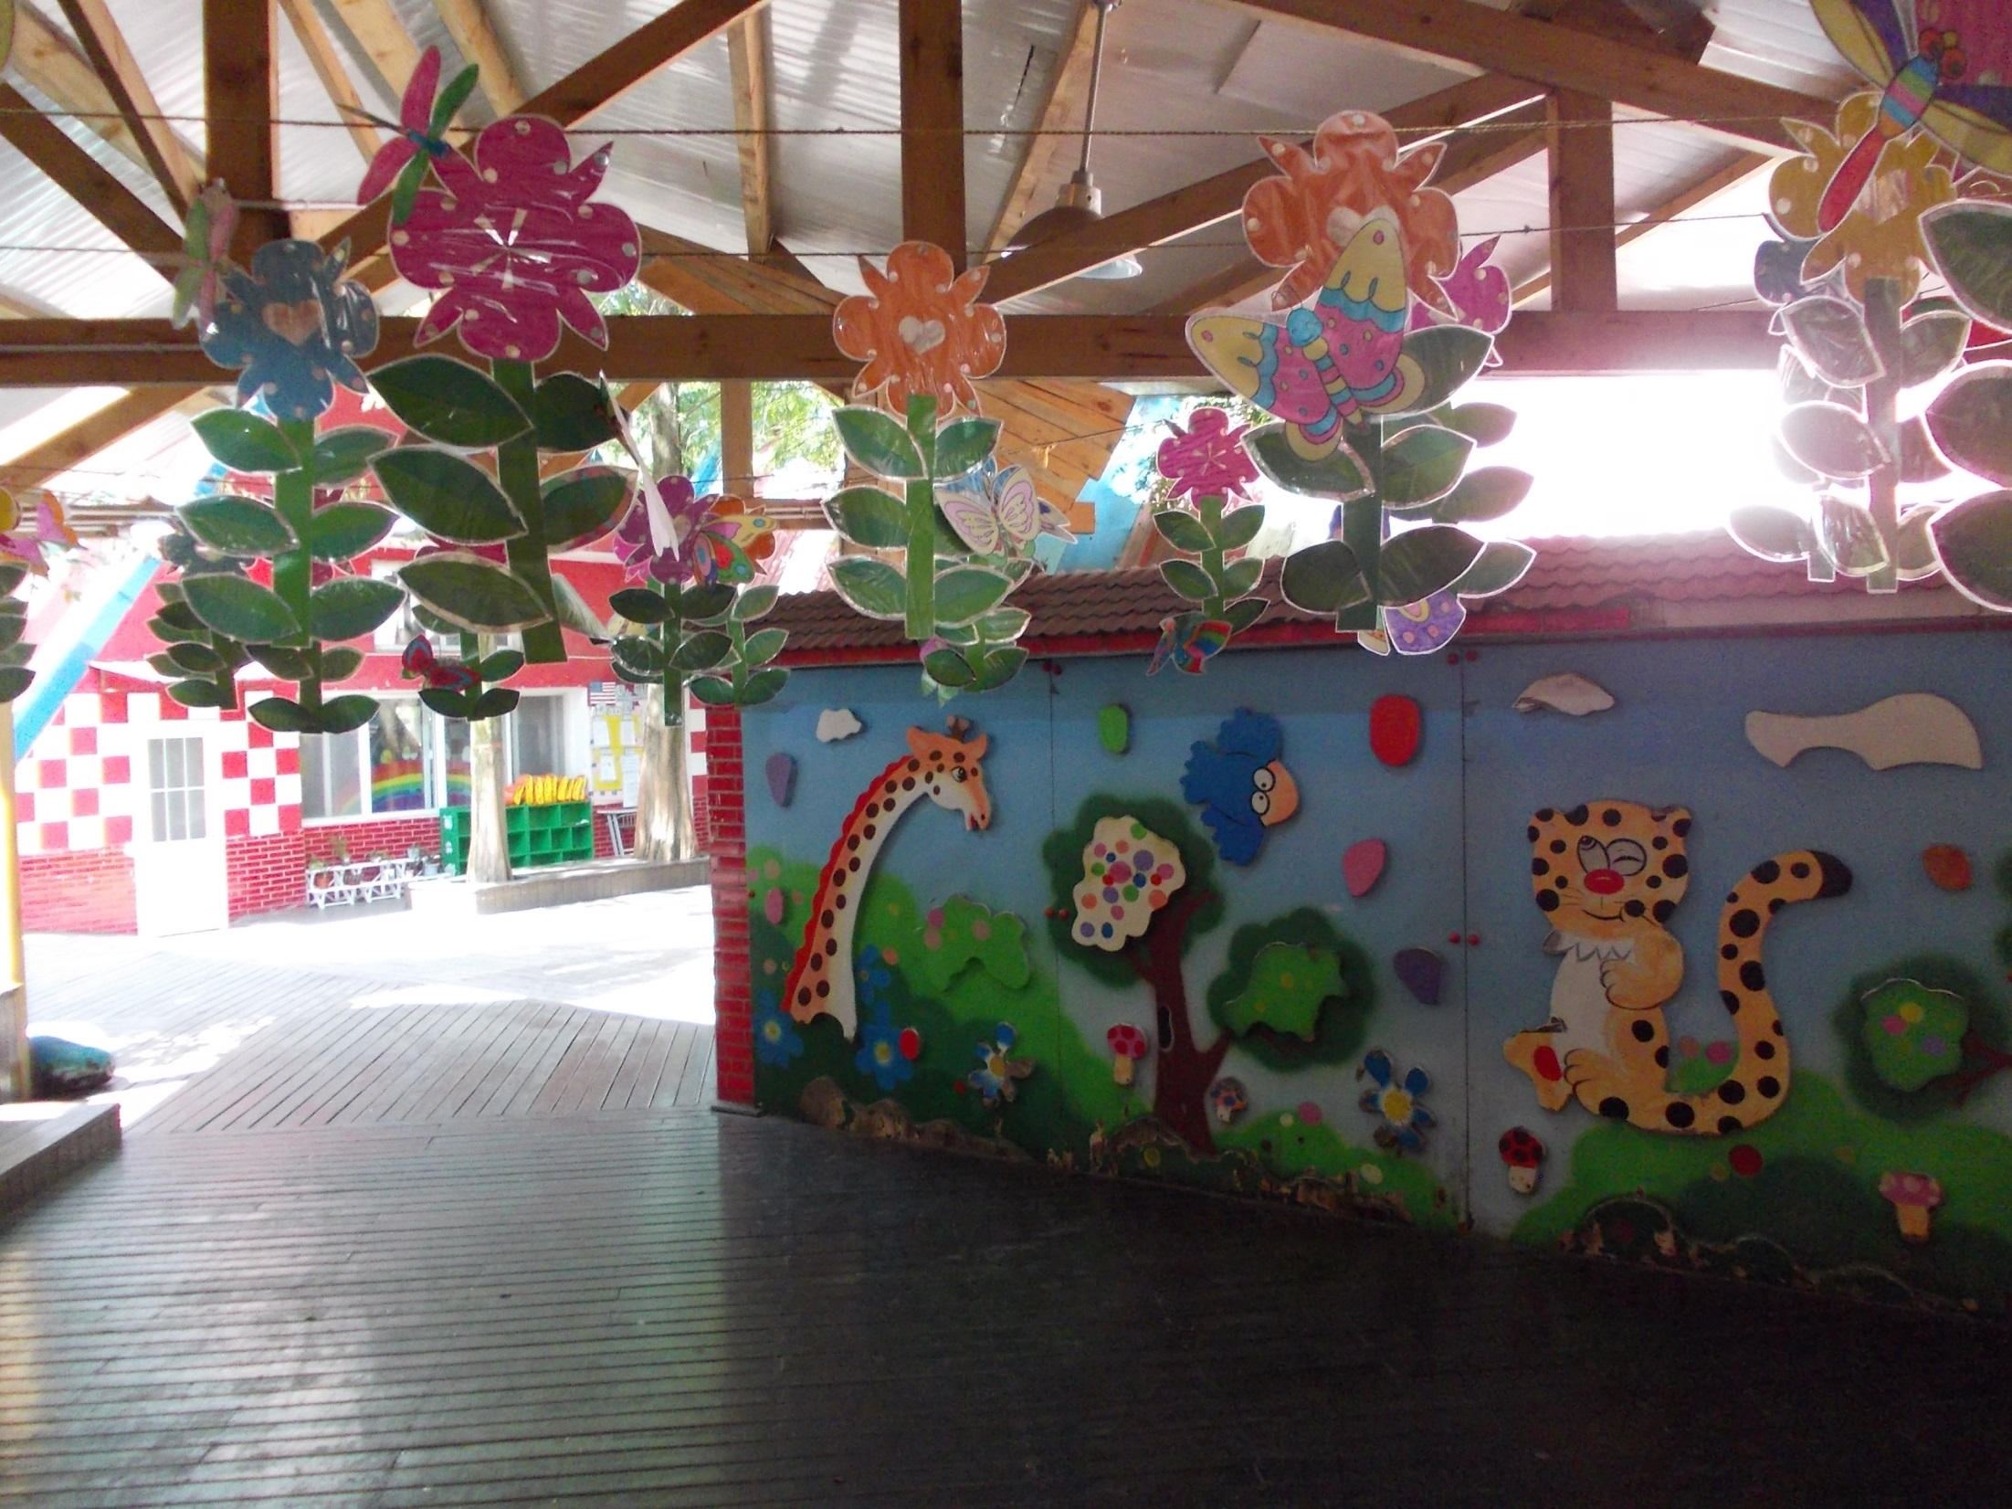
The Guangya School has a Kindergarten program with over 400 children.

Slide 52
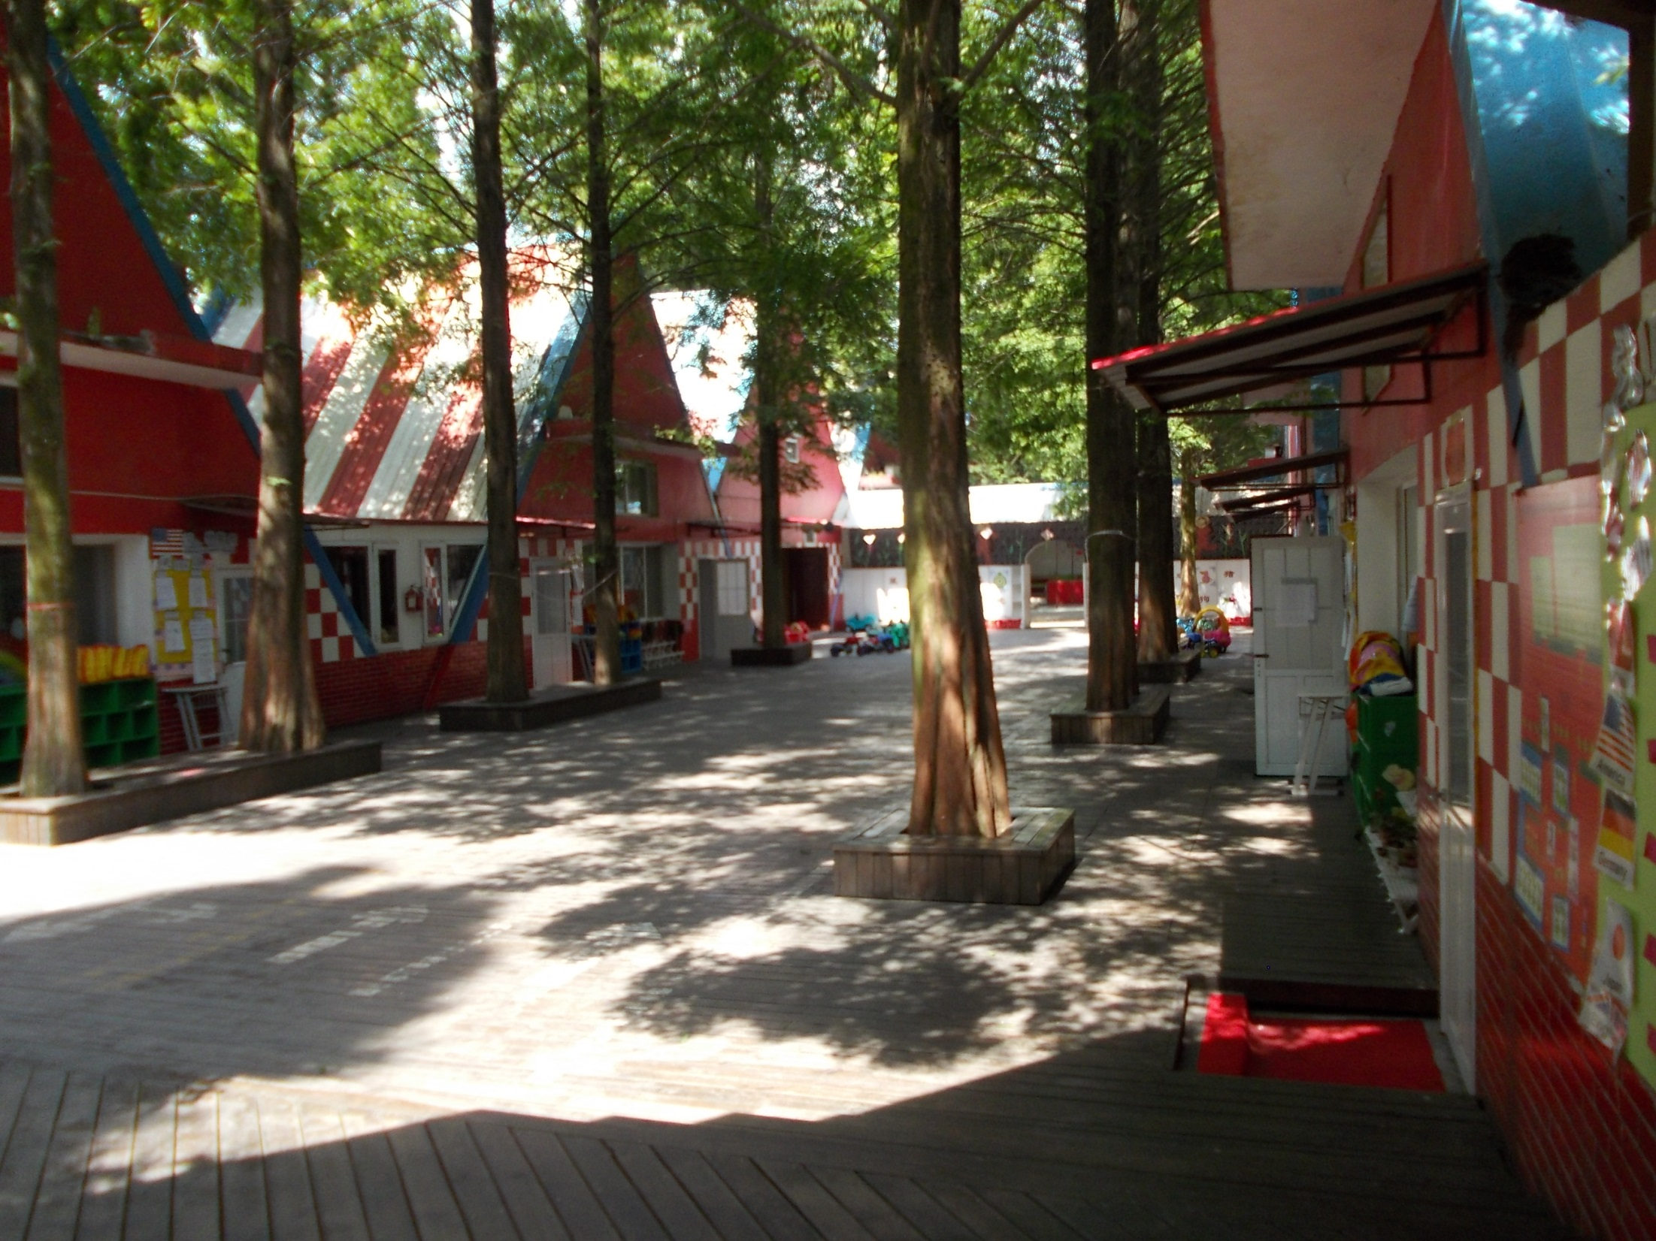

Slide 55
Louise giving a speech at the Closing Ceremony.

Slide 57
Dujiangyan - May 2008
Earthquake Memorial Museum

Slide 59
Electric Car Dealership

Slide 61
Tool used to put clothes on wire line to dry.

Slide 62
Night Market.
Spices available for sale.

Slide 63
ICE-CREAM shop with multiple vendors of products

Slide 64
Street Market with Black Walnuts being sold everywhere

Slide 65
Still using old carts for keeping street clean

Slide 66
Stewart outside of PETER’s Tex-Mex Grill..
(Sichuan University West Gate)
Peter was in one of the early programs at SIchuan University.
He started and now owns multiple restaurants.

Slide 67
Bamboo Park along river outside East Gate of Sichuan University
(Chengdu).
New building in background distracts a little from the peacefulness of the park.

Slide 68
Teachers are like farmers planting seeds of knowledge, wisdom, and creativity into the minds of our future leaders.

Slide 69
2016!
Who Will Join Us?
Will You Go?
Nolan@TEEI.org

